Slide 1
SSIP April – May 2019
MATHEMATICAL LITERACY
Topic(s) :
Maps, Plans and Other Reps of the Physical World
Measurement
Venue: Birchwood Hotel

Slide 2
SSIP AIMS/GOALS
The four interconnected outcomes that drive the professional development activities for SSIP are:
Enhancing Teachers knowledge: deep understanding of subject matter knowledge and students ideas on the content
Enhancing quality teaching and assessment for learning: effective instructional approaches that teachers may use to ensure improved understanding by most learners.
Developing ICT integration skills :Use of ICT to improve teaching and learning
Building professional learning communities: allow teachers to start collaborating and form professional networks in non-formal settings in context of their schools

Slide 3
PROGRAMME
TIME | ACTIVITY
15:30 – 16:30 | Arrival
16:00 – 17:00 | Plenary Session: Opening and Welcome, Issuing of Training Materials and Other Logistics
17:00 – 18:00 | TS 1: Pre Test
18:00 – 19:30 | Supper
TIME | ACTIVITY
06:30 – 08:00 | Breakfast
08:00 – 10:30 | TS 2: Module 1 – Unit 1
10:30 – 10:45 | Tea Break
10:45 – 13:00 | TS 3: Module 1 – Unit 2
13:00 – 14:00 | Lunch
14:00 – 15:30 | TS 4: Module 1 – Unit 3
15:30 – 16:00 | TS 5: Module 2 – Unit 1
16:00 – 17:30 | TS 6: Module 2 – Unit 2
17:30 – 19:00 | TS 7: Module 2 – Unit 2
19:00 – 20:30 | Supper
TIME | ACTIVITY
06:30 – 08:00 | Breakfast
08:00 – 09:00 | TS 8: Module 2 – Unit 2
09:00 – 10:30 | TS 9: Module 2 – Unit 3
10:30 – 11:00 | Tea Break
11:00 – 11:45 | TS 10: Module 2 – Unit 3
11:45 – 12:45 | TS 11: Post Test
12:45 – 13:00 | Closing Session: Closing Remarks
13:00 – 14:00 | Lunch

Slide 4
ATP FOR TERM 2
DATE | CONTENT | CONTEXT
14/04 – 17/04 | SCALE Scale (ratio, bar) Determine actual lengths and distances from a given scale Determine a scale for drawings and/or models Determine a scale in which to draw diagram or construct a model | Seating plan (classroom, offices, cinemas, sport stadiums, etc) Layout maps (buildings in a school or sports field, stores in a shopping centre) Street maps National/provincial maps Elevation maps Strip charts
20/04 – 24/04 | MAPS Grid reference compass directions slope on map
28/04 – 30/05 | SCALE and PLANS Diagrams (assembly instructions in manuals, etc.) Plans (symbols and notation, terminology, determine actual dimensions using a given scale, determine a suitable scale to draw
04/05 – 05/05 | MEASUREMENT (Calculating) Length, distance and time Perimeter Area | House plans Floor plans Painting Tiling(laminating, ceramic, etc)
06/05 – 15/05 | MEASUREMENT (Calculating) surface area Volume Rate (speed, costing, etc | Assembling wooden furniture or any appliance House floor plan

Slide 5
MODULE 1: MAPS, PLANS AND OTHER REPS. OF THE PHYSICAL WORLD
INTRODUCTION
In this module participants will look at the concept of
Number scale and bar scale
Map scale and calculating distance
Compass directions and giving directions
OVERVIEW
In this module, you will work with maps of possible unfamiliar contexts and complex structures.

Slide 6
OUTCOMES OF THIS MODULE
At the end of this module you will be able to:
Work with different types of scales on maps
Work with scales on maps
Calculate actual length and distance when map is known
Calculate map measurements when actual lengths and distances are known using a given scale
Determine the scale in which a map has been drawn in the form 1: … and use the scale to determine other dimensions on the map
Interpret compass directions in the context of appropriate maps

Slide 7
MODULE 1: MAPS, PLANS AND OTHER REPS. OF THE PHYSICAL WORLD
Glossary of terms
Common terms used in this unit
All learners should have a comprehensive glossary of all the relevant terms
CONTENT
Unit 1: Scale
Unit 2: Maps and Plans
Unit 3: Plans and Layout Maps

Slide 8
UNIT 1: SCALE
At the end of this Unit, you should be able to:
Work with number and bar scale
Discuss the disadvantages and advantages of bar scale and number scale
Expressing number scale as a bar scale and vice versa
Determining the scale used to resize the image
Use the given scale to do calculations
Calculating the actual length of the drawing or image of the object.

Slide 9
SCALE LESSON NOTES:
Types of scale
Number scale
Bar scale
Convert bar scale to number scale
The triangle method may be used when calculating distance or scale factor
Advantages and disadvantages of bar and Number scale

Slide 10
SCALE ACTIVITY
This activity is intended to advance skills that can be used in the classroom and possible ways in which this unit can be taught.
Activity 1.1.1

Slide 11
UNIT 2: MAPS AND SCALE
At the end of this Unit, you should be able to:
Work with different types of maps
Calculate actual length or distance on the map using bar scale or number scale
Using given map to find the way to the destination
Determine the scale in which a map has been drawn in the form 1:xxx… and use the scale to determine other dimensions on the map.

Slide 12
MAPS AND SCALE LESSON NOTES:
Types of maps
Maps of smaller areas
Maps of larger areas
Street maps
National road and rail maps
Provincial road maps
Strip route maps
Distance maps
Elevation maps
Cardinal points and inter-cardinal points
Grid reference

Slide 13
MAPS AND SCALE ACTIVITY
These activities are intended to advance skills that can be used in the classroom and possible ways in which this unit can be taught.
Activity 1.2.1
Activity 1.2.2
Activity 1.2.3

Slide 14
UNIT 3: FLOOR AND ELEVATION PLANS
At the end of this Unit, you should be able to:
Work with different types of scales on plans and in the construction of models
Determine the most appropriate scale in which to draw/construct a plan and/or model, and use this scale to complete the task
Determine the scale in which a plan has been drawn in the form 1: --- and use the scale to determine other dimensions on the plan
Analyse the layout of the structure shown on the plan and suggest alternative layout options
Determine actual lengths of objects shown on plans using measurement and a given scale viz. number or bar scale.
Determine quantities of materials needed by using the plans and perimeter, area and volume calculations
Connect the features shown on elevation plans with features and perspectives shown on a floor plan of the same structure

Slide 15
FLOOR PLANS LESSON NOTES:
Work with the following layout maps/plans
Map showing the seating plan or layout of a classroom
Map showing the layout of the buildings and/or sports fields at a school
Map showing the layout of the stores in a shopping centre
Map showing the layout of the stores in a shopping centre
Map showing layout of zoo or resort
Seating plans for cinemas and at sports stadium

Slide 16
FLOOR PLANS OR LAYOUT ACTIVITY
These activities are intended to advance skills that can be used in the classroom and possible ways in which this unit can be taught.
Activity 1.3.1
Activity 1.3.2

Slide 17
UNIT 3: FLOOR AND ELEVATION PLANS
It is a line drawing showing rooms as though seen from above without a roof
Shows a top view of a building floor (room, office, house, etc.).
The floor plan for a house usually shows the layout of different rooms, the position of windows and doors as well as the position of fittings like cupboards, stoves, toilets, etc.
Symbols are used in the floor plan or layout plan such as doors, windows, etc.
The purpose of a plan is to show the layout and design of the 3-dimensional structure
May include compass direction indicators.
Floor plans are drawn to scale just like maps
Plans will show a scale viz. a ratio or a bar scale.
Working with this scale is exactly the same as working with scales given on maps.

Slide 18
FLOOR PLAN
At the end of this Unit, you should be able to:
Work with different types of plans
Calculate actual length or distance when plan and scales are known
Calculate plan measurements when actual lengths or distances are known using a given scale
Determine the scale in which a plan has been drawn in the form 1:xxx… and use the scale to determine other dimensions on the plan.
Interpret compass directions in the context of appropriate plans

Slide 19
FLOOR PLAN LESSON NOTES:
Floor plan of a house or layout plan
It is a line drawing showing rooms as though seen from above without a roof
If we look at a building from the top, we have the top view, plan view or bird’s eye view of the building.
The floor plan for a house usually shows the layout of different rooms, the position of windows and doors as well as the position of fittings like cupboards, stoves, toilets, etc.
Symbols are used in the floor plan or layout plan
The purpose of a plan is to show the layout and design of the 3-dimensional structure

Slide 20
FLOOR PLAN LESSON NOTES:
Floor plans are drawn to scale just like maps
Plans will show a scale viz. a ratio or a bar scale.
Working with this scale is exactly the same as working with scales given on maps. However except that the scales will be much larger.

Slide 21
ELEVATION PLAN LESSON NOTES:
Elevation plans show the design of the outside of a building
Elevation is a side-view as viewed from the front, back, left or right
These plans will give details such as the height of the walls and the sizes of the windows and doors.
Elevation plans are generally named for the compass direction that the particular side of a building is facing.
For example, if the front of a house is facing North, the side that you will be looking at when you are facing the front of the house, will be called the North elevation.
However, if the direction is not obvious, elevations can be called the front, rear, left or right elevation.
Elevation plans are usually labelled
Compass directions are also used in the construction industry.

Slide 22
ELEVATION PLAN ACTIVITY
These activities are intended to advance skills that can be used in the classroom and possible ways in which this unit can be taught.
Activity 1.3.1
Activity 1.3.2
Activity 1.3.3
Activity 1.3.4

Slide 23
REFLECTION
In this module,
learners need more practice on questions involving general direction questions and questions on a given set of directions.
You should note that when a scale is given, there is every chance that some actual measurement will be done.
Therefore, learners should be afforded the opportunity to use their rulers in class to measure classroom items (books, pens, pencils, etc.) on a regular basis.

Slide 24
REFLECTION
In this module,
learners need more practice on questions involving general direction questions and questions on a given set of directions.
You should note that when a scale is given, there is every chance that some actual measurement will be done.
Therefore, learners should be afforded the opportunity to use their rulers in class to measure classroom items (books, pens, pencils, etc.) on a regular basis.

Slide 25
CLOSING REMARKS
This is the end of the e-SSIP training and hopefully, it was informative and fruitfully.
You have been equipped with the Term 2 subject content and ICT skills.
You have been provided with the teaching tips on how to approach each sub-topic or content simplification.
All of the above mentioned skills will enable you to manage and enhance teaching, learning and assessment in the classroom effectively.
Please share the knowledge gained with other colleagues within your PLCs.
Maths Lit, properly taught, is an empowering subject for young people entering the workplace and life in general in the 21st century and the 4th Industrial revolution.

Slide 26
MODULE 2: MEASUREMENT
OVERVIEW
In this module, you will work with complex projects in familiar and unfamiliar contexts
CONTENT
Unit 1: Conversions, Measuring Time, Timetables . and Speed
Unit 2: Two-Dimensional Measurement
Unit 3: Three-Dimensional Measurement

Slide 27
OUTCOMES OF THIS MODULE 2
At the end of this module you will be able to:
Read, record and perform calculations involving time values and timetables
Calculate speed, distance and time
Calculate/measure the perimeter, area, surface area and volume of objects.
Calculate/measure the Volume and surface areas of rectangular, triangular prism, cylindrical prism pyramids, cones and spheres.
Determine/calculate appropriate quantities of materials/components required to complete a task or project.

Slide 28
UNIT 1: CONVERSIONS, MEASURING TIME, TIMETABLES AND SPEED
LEARNING OUTCOME
At the end of this Unit, you should be able to:
Convert within and between the metric and imperial systems, solid to liquid measurements and temperature.
Measure time, calculate time differences, timetables, speed, distance and time

Slide 29
CONVERSIONS, TIME AND SPEED LESSON NOTES:
Metric System
South Africa use measuring system called the metric system
Imperial System
Some countries such as USA and Liberia use different system called the imperial system
Temperature
To convert temperatures from Celsius to Fahrenheit or vice versa, one of the two formulae may be provided:

Slide 30
CONVERSIONS, TIME AND SPEED LESSON NOTES:
Solids to Liquids
Volume can be measured using different units: either unit³ or in litres.
Measuring Time and working with timetables
Time can be written using a 12 hour clock or a 24 hour clock.

Slide 31
CONVERSIONS, TIME AND SPEED LESSON NOTES:
These activities are intended to advance skills that can be used in the classroom and possible ways in which this unit can be taught.
Activity 2.1.1

Slide 32
TWO DIMENSIONAL LESSON NOTES:
Glossary of terms
Common terms used in this unit
All learners should have a comprehensive glossary of all the relevant terms
Tips for calculating perimeter
Break the complex shape down into its basic shapes such as a square, rectangle, triangle or circle.
Ensure that all units are the same before calculating perimeter.
We only add the outer most lengths of the shape.

Slide 33
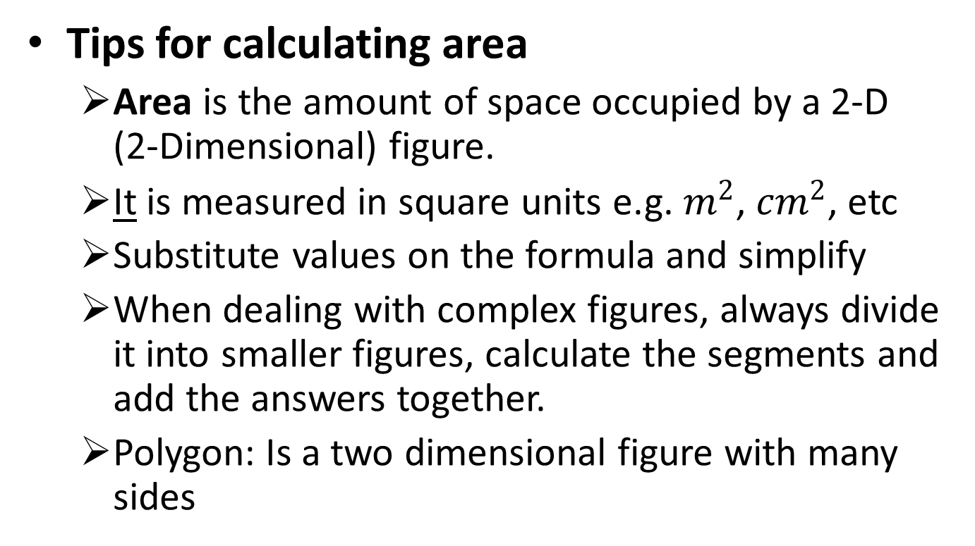
TWO DIMENSIONAL LESSON NOTES:

Slide 34
2D MEASUREMENT ACTIVITY
These activities are intended to advance skills that can be used in the classroom and possible ways in which this unit can be taught.
Activity 2.2.1
Activity 2.2.2
Activity 2.2.3

Slide 35
UNIT 3: THREE DIMENSIONAL MEASUREMENT
LEARNING OUTCOME
At the end of this Unit, you should be able to:
Calculate Volume and Surface Areas of Rectangular/Triangular/ Cylindrical Prism, Pyramids, Cones and Spheres.
Determine/calculate appropriate quantities of materials/components required to complete a task

Slide 36
THREE DIMENSIONAL MEASUREMENT LESSON NOTES:
Glossary of terms
Common terms used in this unit
All learners should have a comprehensive glossary of all the relevant terms
Volume: 3-D space occupied by a gas, a liquid or a solid. Capacity also refers to volume.
3-Dimensional is a solid that has length, breadth/width and height.
TSA is the total exterior area of all the exposed surface of a 3-D object.

Slide 37
THREE DIMENSIONAL MEASUREMENT ACTIVITY
Activity 2.3.1
Activity 2.3.2
Activity 2.3.3
Activity 2.3.4

Slide 38
REFLECTION
Teachers should provide learners with conversion tables or methods like ‘King Henry Died a Miserable Death Called Measles’ when doing conversions from one unit of measurement to another.
Glossary of terms in the module should be reinforced on a regular basis.
Teachers should encourage learners to write a glossary at the back of their books of the different terms’ meanings as they complete each topic.
Teachers should provide learners with enough exercises on how to substitute correct values into a given formula.

Slide 39
CLOSING REMARKS
This is the end of the e-SSIP training and hopefully, it was informative and fruitfully.
You have been equipped with the Term 2 subject content and ICT skills.
You have been provided with the teaching tips on how to approach each sub-topic or content simplification.
All of the above mentioned skills will enable you to manage and enhance teaching, learning and assessment in the classroom effectively.
Please share the knowledge gained with other colleagues within your PLCs.
Maths Lit, properly taught, is an empowering subject for young people entering the workplace and life in general in the 21st century and the 4th Industrial revolution.

