Slide 1
E-SSIP 2020 JANUARY/FEBRUARY TRAINING SUBJECT: MATHEMATICAL LITERACY FACILITATOR PRESENTATION (FP)
1

Slide 2
MODULE 1: FINANCE PART ONE
INTRODUCTION
In this module you will look at the concept of finance with specific focus on Financial Documents, Taxation, Tariff Systems, Income/Expenditure, Cost Price/Selling Price and Break Even Analysis.
OVERVIEW
In this topic,
You will work with complex projects in familiar and unfamiliar contexts
SPECIFIC OBJECTIVES
At the end of this module you will be able to:
Work with Financial documents relating to personal/household/work place/business
Work with tariff systems
Identify and perform calculations involving income, expenditure, profit and loss values
Determine and work with break-even analysis
CONTENT
You will study this module through the following two units:
Unit 1: Financial document, Taxation and Tariff systems
Unit 2: Income, Expenditure, Profit, Loss and Break even analysis

Slide 3
TERMINOLOGY
Account | Cost price | Debit | Fixed deposit | Luxury item or service | UIF
Balance | Cost rate | Debit balance | Fixed expenses | Net pay | Variable expenses
Bank statement | Credit | Debit order | Fund | Overdraft | VAT
Break-even point | Credit balance | Deposit | Gross income | PAYE | Wages
Consumption rate | Credit card | Disposable income | Invoice | Remittance slip | Withdrawal
Cost-effective | Credit limit | Expenditure | Loan | Salary | Zero rated VAT items

Slide 4
UNIT 1: FINANCIAL DOCUMENT, TAXATION AND TARIFF SYSTEMS
INTRODUCTION
In this unit you will:
Financial documents relating to personal/household/work place/business
Income Tax, Value Added Tax, UIF and Personal Income Tax
Tariff systems
LEARNING OUTCOME
At the end of this Unit, you should be able to:
Work with VAT in the context of purchases, slips and bills
Work with UIF in the context of payslips
Work with payslips, income tax brackets and income tax formulae, tax deductions

Slide 5
FACTS ABOUT VAT
VAT is an indirect tax on the consumption of goods and services in the economy
Revenue is raised for government by requiring certain businesses to register and to charge VAT on the supply of goods and services.
VAT is presently levied at the standard rate of 15% on the supply of most goods and services and on the importation of goods.
There is a limited range of goods and services which are subject to VAT at the zero rate
See example on page 13 PG

Slide 6
FACTS ABOUT INCOME TAX
Income tax is the money paid to government from wages to pay for schools, hospitals, infrastructure etc.
The amount of tax depends on:
how much you earns
your age
whether you are a member of retirement annuity
Example of tax table on page 13 PG
See Example on page 13 PG

Slide 7
TAX DEDUCTIONS
UIF:
Unemployment Insurance Fund: A government-run insurance fund which employers and employees contribute, so that when employees are retrenched they can collect some earnings (a portion) .The employee contributes 1% and the employer contributes 1% of basic salary.
Pension fund:
It is a fund established by an employer to facilitate and organize the investment of employees' retirement funds contributed by the employer and employees.
Other deductions like medical aid contribution, insurance policies, maintenance, house payment, car payment, etc.
PAYE: abbr.)
Pay as you earn: tax taken off your earnings by your employer and sent to the South African Revenue Service before you are paid (the balance).
Net salary:
The amount an employee “takes home” after income tax has been deducted.
See Example on page 14 PG

Slide 8
STEPS FOR CALCULATING INCOME TAX
Step 1: Calculate taxable income
Step 2: Calculate non-taxable income
Step 3: Difference between taxable income and
income tax
Step 4: Tax threshold
Step 5: BODMAS
Step 6: Subtract the rebates and medical credits
from the value calculated in step 5.

Slide 9
MEDICAL TAX CREDIT
Is the fixed monthly medical rebate aimed at relieving personal tax; irrespective of the income
The more the number of dependents the higher the medical tax credit; the person’s tax bracket is not considered.
The medical credit depends on the number of dependents.
Identify the number of members in the medical aid
The medical credit allocated to the first dependent equals to that of the main member; there after the medical credits of the remaining dependent is the same for every additional member. First means being before all others with respect to time or order. i.e. anyone can be the 1st dependent, including wife/husband, depending on the order in which the dependents are captured.
Calculate the annual medical credits as they are given as monthly values on the tax table. This will depend on the number of months the tax payer had contributed to the medical aid.
See Activity 1.1.1 – 1.1.2 in the PG

Slide 10
TYPES OF TARIFFS
Telephone tariffs differ from one network to another one. The rates are charged either per minute or per second. Promotional tariffs are different, this includes various packages which promotes calling the same network. The rates are different during peak hours and off-peak hours
Electricity tariffs are charged per unit used. It also depends on the peak and off peak hours. The rates of metered electricity and prepaid are different. Free units are given
Water tariffs are charged per kilolitre used, there are free kilolitres given and there after different rates are charged. The more water you use, the higher the cost.
Transport tariffs depend on the rates charged by service provider. Distance is used to charge the tariffs. Regular users are discounted. Distance chart may be used to determine the cost if the rates are charged per kilometre.
See Activity 1.1.2 - 3 in the PG

Slide 11
UNIT 2: INCOME, EXPENDITURE, PROFIT, LOSS AND BREAK EVEN ANALYSIS
INTRODUCTION
In this unit you will focus on Selling price, Cost price, Income, Expenditure and Break even analysis
LEARNING OUTCOME
At the end of this Unit, you should be able to:
Identify and perform calculations involving income, expenditure, profit and loss values.
Determine break-even values

Slide 12
FACTS ABOUT COST PRICE AND SELLING PRICE
For a business to make money it needs to sell goods or services for more than it cost.
The cost price is how much the item cost the business.
The selling price is how much the business gets for the item.
A business may offer the customer a discount on items. This means that the customer will pay less than the selling price for the item.
The profit a company makes is determined by the difference between the selling and cost price. If the selling price is less than the cost price, the company will make a loss.
For example: A clothing shop paid R123 for a trouser and sold them at R177 each. Calculate the percentage profit that the clothing shop made on the sale of the shirts.

Slide 13
FACTS ABOUT INCOME AND EXPENDITURE
The costs may be divided into variable and fixed expenses
Fixed expenses:
Costs that remain constant over time
For example: rent, salaries, security, insurance, rates and taxes, etc.
Variable expenses:
Depend on the production level, as the production volume goes up, so will the costs
For example: commissions, material costs, water and electricity, petrol etc.
Income may also be divided into fixed and variable
Fixed Income
Fixed income is money that is definite on a monthly basis.
For example: salary received monthly
Variable income
Variable income changes from month to month and is irregular/ unexpected . For example: royalties, dividends
Profit Margin
Profit margin is the percentage of the final selling price that is profit.
See example in the PG page 23.

Slide 14
BREAK EVEN ANALYSIS
A financial tool which helps you to determine at what stage a company or product, will be profitable.
The graphs showing the toy making business income and expenses is given below: A toy making business may below: (See also Activity 1.2.1 – 3 in the PG Page 25)

Slide 15
REFLECTION AND REMARKS
Learners should be afforded opportunities to define terms in their own words, as part of assessment to ensure conceptual understanding.
Teachers must provide learners with opportunities to extract information from tables as often as possible.
Teachers should give learners sufficient exercises on how to substitute correct values from tables (correct columns) into a given formula.
Teachers should encourage candidates to use the LOLT always during the lessons. Scenarios should be discussed and critically analysed during lessons to give learners the opportunity to think critically and develop analytical and problem-solving skills.

Slide 16
MODULE 2: DATA HANDLING
INTRODUCTION
In this module you will look at the concept of Data Handling with specific focus on:
Developing questions; Collecting data; Classifying data; Organising Data; Summarising Data; Representing data; Interpreting data and Analysing data.
OVERVIEW
In this topic, you will work with complex projects in familiar and unfamiliar contexts
SPECIFIC OBJECTIVES
At the end of this module you will be able to:
Develop investigative questions
Collect data using appropriate instruments and methods
Summarise data collected
Organise and represent data
Interpret and discuss data
CONTENT
You will study this module through the following three units:
Unit 1: Developing questions; Collecting data and Classifying data
Unit 2: Summarizing data; Representing data; Interpreting data and Analysing data
Unit 3: Measuring weight

Slide 17
TERMINOLOGY
Bar graph | Discrete | Horizontal bar graph | Measures of spread | Outliers | Sample
Box-and-whisker plot | Discrete data | Interview | Median | Population | Sampling
Classify | Equivalent | Investigate | Median [of a set of data] | Quartiles | Sort
Continuous data | Frequency table | Mean | Mode | Questionnaire | Survey
Data | Group | Mean [of a set of data] | Mode of a set of data | Range [of a data set] | Survey [biased]
Data collection sheet | Histogram | Measures of central tendency | Observation | Related [data sets] | Variable

Slide 18
UNIT 1: DEVELOPING QUESTIONS; COLLECTING DATA AND CLASSIFYING DATA
INTRODUCTION
In this unit you will look at the concept of:
Developing questions
Collecting data
Classifying data
LEARNING OUTCOME
At the end of this Unit, you should be able to:
Develop questions that require the collection of data
Use appropriate instrument to collect data
Classify the collected data as categorical or numerical
Organise the collected data using tallies and frequency tables

Slide 19
FACTS ABOUT DATA HANDLING
Data is a collection of facts, such as numbers, words, measurements, observations or even just descriptions of things.
Data can be qualitative or quantitative.
Qualitative data is descriptive information (it describes something)
Quantitative data is numerical information (numbers)
Quantitative data can also be discrete or continuous:
Discrete data can only take certain values (like whole numbers)
Continuous data can take any value (within a range)
The statistical process is made up of inter-connected stages

Slide 20
DEVELOPING QUESTIONS
A statistical question is one that can be answered by collecting data where there are single, double and multiple sets of data that contains multiple categories.

Slide 21
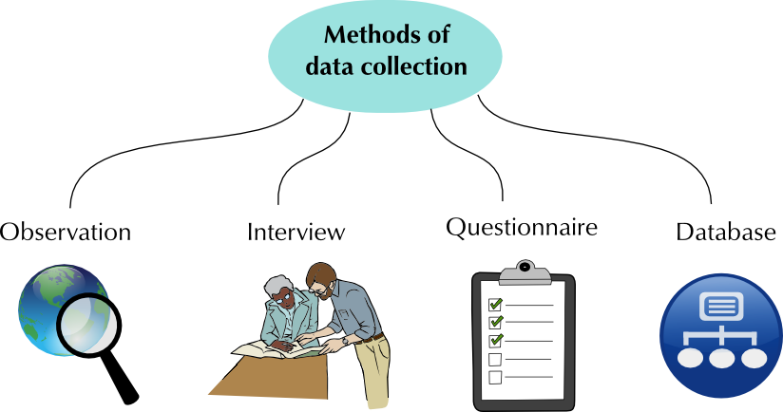
COLLECTING DATA

Slide 22
CLASSIFYING AND ORGANISING DATA
Data collected in original form is called raw data.
A frequency distribution is the organisation of raw data in table form, using classes and frequencies.
The data can be placed in categories and organized in categorical frequency distributions.
A survey can be used to gather information about a group. Often, a part of the group, called a sample, is chosen to represent the whole group or population.
A sample must represent the population fairly. In a random sample, each person in the population has an equal chance of being chosen.
A statistic is biased if it is calculated in such a way that it is systematically different from the population parameter being estimated eg when certain individuals are being more likely to be selected than others.
An estimator or decision rule with zero bias is called unbiased.

Slide 23
UNIT 2: SUMMARIZING DATA; REPRESENTING DATA; INTERPRETING DATA AND ANALYSING DATA
INTRODUCTION
In this unit you will look at the concept of Assembling diagrams and In this unit you will look at the concept of:
Summarising data
Representing data
Interpreting data
Analysing data
LEARNING OUTCOME
At the end of this Unit, you should be able to:
Summarise the collected data using measures of central tendency and measures of spread
Analyse the collected data presented in the graphs
Represent the collected data using appropriate graphs
Read the collected data from the graphs

Slide 24
FACTS ABOUT SUMMARISNG DATA
Collected data can be summarised by using the measures of central tendency and spread.
Summarise single sets (personal lives) of collected data.
Summarise and compare two sets (wider community) and multiple sets (national and global issues) of collected data using the following measures of central tendency and spread.

Slide 25
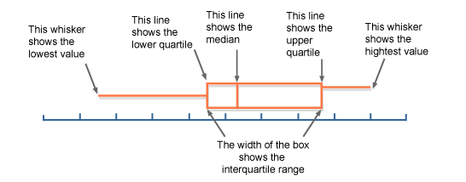
BOX AND WHISKER PLOT

Slide 26
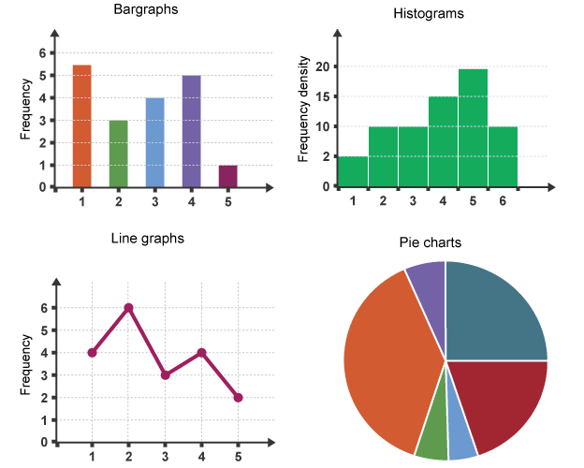
REPRESENTING AND INTERPRETING DATA
Data can be represented through the use of graphs. Different graphs displaying the same data can convey different messages, so selecting the graph that best represents the data is important.

Slide 27
UNIT 3: MEASURING WEIGHT
INTRODUCTION
In this unit you will look at the concept of:
Body Mass Index (BMI)
Growth Chat
LEARNING OUTCOME
At the end of this Unit, you should be able to:
Determine the weight/mass using appropriate measuring instrument
Use recorded weight/mass data together with recorded length/height data to calculate Body Mass Index values and determine weight status for adults
Calculate values using a formula involving mass/weight

Slide 28
GLOSSARY OF TERMS
Body mass index (BMI) | A number calculated from an adult’s weight and height, expressed in units of kg/m²
Growth charts | Graphs consisting of a series of percentile curves that show the distribution of the growth measurements of children.
Mass/ Weight | Mass/Weight is an indication of how heavy an object is.

Slide 29
BODY MASS INDEX
Obesity means being grossly overweight
One of the measures used to calculate whether a person is healthy or not is called the Body Mass Index (BMI).
The Body Mass Index (BMI), estimates the ideal weight of a person based on its size and weight.
The Body Mass Index is valid for an adults between 18 – 65 years
The World Health Organisation (WHO) defines this body mass index as the standard for measuring the risks associated with adults who are overweight.
A high BMI is associated with increased risk of death.
The risk of death increases the more overweight a person is for adults for cancer or other diseases.
BMI is, however, much more reliable.
It´s the result of a calculation between your weight and height, and gives you the possible risks to your health.
Body mass index is defined as the individual's body mass divided by the square of their height.

Slide 30
GROWTH CHARTS
Percentiles are measures of spread which divide the data into 100 equal portions. This is used to analyse the spread of large sets of data like data collected by census. The data is then divided into 100 portions and the report is given as a percentage.
The value at the 5th percentile implies that 5% of values lie below 5th percentile and 95% of the values lie above the 5th percentile.
The value at quartile 1 implies that 25% of the values lie below 25th percentile and 75% of the values lie above the 25th percentile.
The concept of the percentiles is used when the data is large. This concept will be used in growth charts. The curve on the growth chart represents the percentile values of the collected data from different age groups .E.g. height, length, weight, circumference of the head.
The growth chart is used to compare the BMI of an individual versus the one of their age group. This is also used to determine the health status of individuals.
3 types of questions should be covered:
Reading information from the chart
Understanding significance of the curve
Understanding significance of positioning on the chart
See Activity 2.3.1 – 7 in the PG

Slide 31
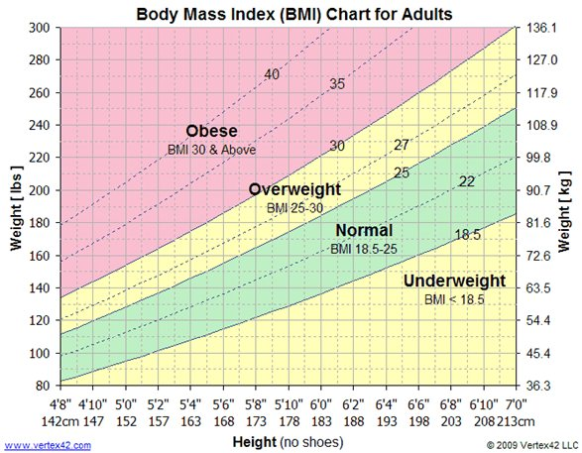
EXAMPLE OF A GROWTH CHART

