Slide 1
INTEGRATING TECHNOLOGY IN THE CLASSROOM
Module 8: Development of Materials Online
“A Guide for Subject Advisors”
“If we have a passion to keep learning, a will to innovate, and a capacity to problem-solve and collaborate, we can make great things happen for the children who we serve.” (Will Richardson, 2012)
Notes:
[2 min]
Please read the whole workbook before you go through these slides
This year the focus for full ICT schools, is to ensure ICTs are integrated into teaching and learning in the classroom
Commend these Subject Advisors for the initiative they have made to support this process
Read the quotation on the slide and discuss what it means in the context of ICT in education

Slide 2
PROGRAM OF THE DAY: MODULE 8
Time | Detail
10:30-11:00 | Demonstrations
11:00-12:00 | Principles on the Development of Online Materials
12:00-13:00 | The process of Developing Online Materials
13:00-14:00 | Lunch
14:00-15:20 | Activities
Notes:
[2 min]
Discuss the program of the day with the participants
If the same group attends each day, only discuss slide 2
Module 8 will take 2.55 hours, no tea or Lunch breaks

Slide 3
COPYRIGHT
This work is protected by the Copyright Act 98 of 1978. No part of this work may be reproduced or transmitted in any form or by any means, electronic or mechanical, including photocopying, recording or by any information storage and retrieval system, without permission in writing from Matthew Goniwe School of Leadership and Governance.
Notes:
[3 min]
Remind the participants that this applies to all Matthew Goniwe School of Leadership and Governance materials they receive. They must comply.

Slide 4
demonstration
Step 1: Need identified
Step 2: Identification of digital tool

Slide 5
demonstration
Step 3: Demonstration
Prepare an activity and decide when it can be used for teaching
Why ? Advantage of the tool in diagnosing learner ability
How to gain access? Technology
How to use for teaching? Integration
What to be enhanced in the lesson (Diagnosis and immediacy)
How lesson can be enhanced through the tool (immediate feedback)
Demonstration
Use of feedback for enhancing teaching

Slide 6
Module 8: DEVELOPMENT OF MATERIALS ONLINE
Teacher needs identified
Implementation plan
Design and develop materials that you can use to support teachers
With the dwindling of financial resources, developing resources online is the better option as printing expenses can be avoided
how do we develop these online materials
Notes:
[5 min]
Read through the slide and tell the participants what to expect in this module

Slide 7
Aim of this module
To acquire expertise in developing materials online
Notes:
[5 min]
Explain to the participants the aim of module 8

Slide 8
objectives
to learn an Instructional Design Model (ADDIE)
to be aware of online design principles
to identify a free online platform
to develop materials online to help address teacher subject needs
Notes:
[5 min]
Read through the objectives and explain to the participants

Slide 9
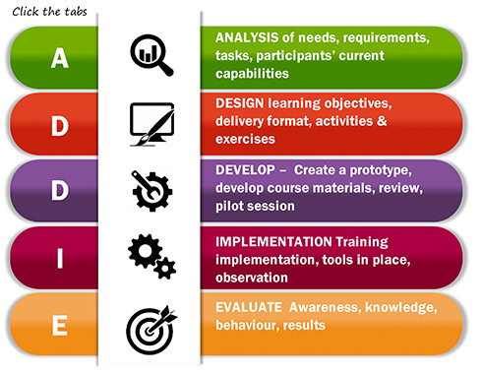
AN INSTRUCTIONAL DESIGN MODEL (ADDIE)
Notes:
[5 min]
ADDIE is one of the most common instructional design models.
The image captures and describes the components that make up this model

Slide 10
analysis
Key areas to know about the teaching and learning context
Curriculum
Subject- content coverage
Concept - understanding
Teacher/ Learner
Teacher/ Learning resources available
Teaching ability with ICTs
Strengths and weaknesses

Slide 11
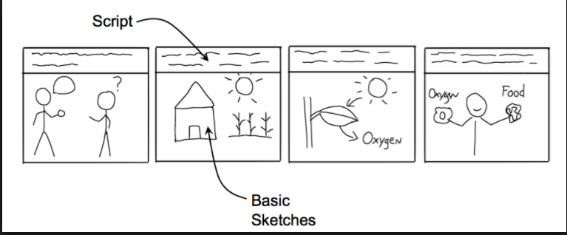
Analysis
Teaching objectives
Awareness of the nature of the challenge – CoPAF/T
Focus on the identified educational challenge
Use of online assessment to diagnose learner performance/ understanding/ progress
Use of feedback to determine level of understanding
Delivery format/ layout
Story telling – Storyboard
Activities
Experience; Discussions; Tutorials; Simulation; Voice thread;
Exercises
quiz; development of an assessment; demonstration;

Slide 12
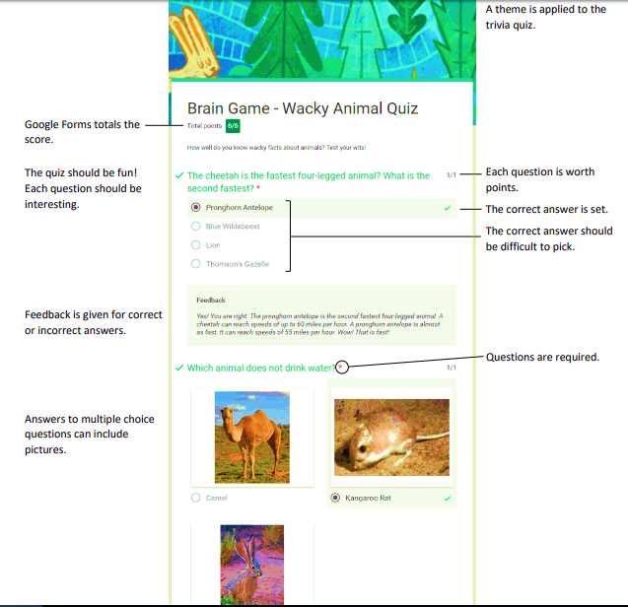

Slide 14
Analysis

Slide 15
Gagne

Slide 16
Learning Pathways

Slide 17
Activity 8.1
Attend to Activity 8.1 on page 72 of your workbooks
Notes:
[15 min]
Ask the participants to turn to page 72 of their workbooks and attend to Activity 8.1

Slide 18
Online learning environment
Online learning environment is described as courses that are:
well-organized into learning units;
have clear learning goals and objectives;
include materials and activities that directly support the learning goals and objectives;
engage the learner through interaction with content, other students and the instructor; and
offer rich and relevant resources for students.
Most of all, online courses should be fun, engaging, pedagogically sound, and relevant.
Notes:
[5 min]
In order to help understand what online learning environment is, Puzziferro and Shelton (2008:122) describe it as courses that are:

Slide 19
7 Principles of Good Practice
Good Practice Encourages Contact Between Students and the teacher
Good Practice Develops Reciprocity and Cooperation Among Students
Good Practice Uses Active Learning Techniques
Good Practice Gives Prompt Feedback
Good Practice Emphasizes Time on Task
Good Practice Communicates High Expectations
Good Practice Respects Diverse Talents and Ways of Learning
Notes:
[10 min]
With the exception of the first one, these principles form part of what we need to consider developing the online qualities described above.
Page 128 to 130 of Puzziferro and Shelton (2008) attached article presents a template that you could use to develop your own material

Slide 20
Activity 8.2
Attend to Activity 8.2 on pages 72 & 73 of your workbook
Notes:
[30 min]
Ask the participants to turn to pages 72-73 of their workbooks and attend to Activity 8.2
After completion of this Activity, explain point 8.3 on page 73 of the workbook

Slide 21
Activity 8.3
Attend to Activity 8.3 on page 73 of your workbook
Notes:
[30 min]
Ask the participants to turn to page 73 of their workbooks and attend to Activity 8.3
After completion of this Activity, explain point 8.4 on page 73 of the workbook

Slide 22
Activity 8.4
Attend to Activity 8.4 on page 74 of your workbook
Notes:
[30 min]
Ask the participants to turn to page 74 of their workbooks and attend to Activity 8.4

Slide 23
The End
Thank you for participating in this module. We trust you gained much to set the pace in integrating ICTs in learning and teaching in your school.
Notes:
[5 min]
Thank the Subject Advisors for taking part in this training

