Slide 1
Matthew Goniwe School of Leadership and Governance
cOVID-19 Response & TRANSMISSIONCONTAINMENT
How to guide
For teachers

Slide 2
Welcome & Background
We are working on an unchartered terraine as a result of COVID-19 pandemic as a country. Several public health and social measures as movement restrictions, closure of schools and travel restrictions.
Deciding to close or open schools should be guided by a risk-based approach to maximise the educational health benefit for learners , teachers, staff and wider community and prevent a new outbreak of COVID-19 in the communities.
As a result this training manual has been developed for teachers to equip them with the knowledge and skills required to rise up and meet the greatest health challenge in the world today.
We do not profess to have designed a manual that covers every single aspect associated with COVID-19 science and transmission . However, we do hope that this training manual will be seen as comprehensive teaching COVID-19 prevention pack which offers a clear introduction into COVID-19 and the important role of the teacher.
Notes:
Welcome the participants and say how important that we all learn how to prevent COVID-19 transmission ans how their responses will ensure life saving

Slide 3
OVERVIEW
Introduction
Purpose of the guide
Why is this guide issued?
Schools roles in prevention and transmission of COVID-19
Preparations and responding to COVID-19
What is COVID-19: Symptoms & Spreading
Fake News and Rumours to avoid
Teaching about COVID-19
Managing Stigma and Discrimination about COVID-19
COVID-19 Stress management
COVID-19 Support: where to get support from
Notes:
In this training we will work through six sessions which are elaborated in the next slide

Slide 4
Training agenda
SESSION 1: WHAT IS THE ROLE OF THE SCHOOL AND TEACHERS FOR RESPONSE AND PREVENTION OF TRANSMISSION OF COVID -19
SESSION 2:PREVENTION: SAFE PRACTICES AT SCHOOL AND IN THE COMMUNITY AT LARGE
SESSION 3: COMMON RUMOURS AND MISINFORMATION ABOUT COVID-19 TO WATCH FOR
SESSION 4: TEACHING AND ADRESSING ANXIETY FOR LEARNERS ON COVID -19
SESSION 5: MANAGING STIGMA AND DISCRIMINATION
SESSION 6 : HOW TO HANDLE STRESS DURING COVID-19 FOR TEACHERS AND OTHER EDUCATION STAFF
Notes:
In the next slide we will share what teachers are to know and do to prevent COVID-19 prevention.

Slide 5
Learning outcomes
UPON COMPLETION OF THIS “HOW TO GUIDE”, YOU SHOULD BE ABLE TO:
HAVE BASIC UNDERSTANDING OF WHAT IS COVID-19 AND ITS EFFECT ON THE EDUCATION SETTING (SCHOOL)
IDENTIFY YOUR ROLES AND RESPONSIBILITIES AS A TEACHER TO PREVENT TRANSMISSION OF COVID-19
ACQUIRE SKILLS TO MONITOR AND MANAGE PREVENTION AND TRANSMISSION OF COVID-19
TEACH ABOUT COVID-19 TO DIFFERENT AGE GROUPS OF LEARNERS
MANAGE STIGMA AND DISCRIMINATION ON COVID-19
IDENTIFY WHERE TO GET SUPPORT ON COVID-19 IN CONTEXT OF YOUR SCHOOL
Notes:
Say teachers have to gain knowledge and skills about covid-19 so that they can respond and contain this killer disease. At the end of the session you should be able to: see learning outcomes as on the slide.

Slide 6
Introduction & PURPOSE
This guide is for support for teachers, namely "How To" Guide, is intended to provide clear guidance on:
How to help prevent the transmission of COVID -19 within the school, classroom, and surrounding communities
How to support affected learners?
How to organise your classroom to prevent transmission of COVID-19
How to teach on COVID-19
What other alternative methods teachers can use for distance learning?
Where do I get support on COVID-19 for my learners?
Notes:
What are you going to learn?

Slide 7
SESSION 1
WHAT IS THE ROLE OF THE SCHOOL AND TEACHERS FOR RESPONSE AND PREVENTION OF TRANSMISSION OF COVID -19
Notes:
Session 1 focuses on the roles and responsibilities for teachers in preventing the transmission and spreading of COVID-19. This session will take about 20 minutes. In this first session say we will be covering six sessions. This session talks about the role the role the teacher plays and what she/he needs to understand about COVID-19
Slides 8-15

Slide 8
What is your role as a teacher in responding to covid19
It is time that we show more gratitude also for our teachers who dedicate their lives to helping the next generation realise their dreams and shape our future". Author Unknown

Slide 9
THE ROLE OF A SCHOOL IS REPONDING TO COVID-19
SCHOOL ROLES
Schools as education institutions have an essential role in preventing the COVID-19 pandemic and ensuring that learners have a safe and healthy learning environment. Schools serve communities throughout the society. All these people may have close contact in the school setting, often sharing space, equipment and supplies.
PROTOCOLS FOR SCHOOLS AS THEY RETURN TO RE-OPEN TO PREVENT COVID-19 TRANSMISSION
To prevent the spread of COVID-19 the department of Health and Public Service Administration has issued guidelines on how to manage COVID-19 cases. When schools re-open specific protocols need to be followed at different steps:
When entering the school's yard
During the day: Promoting healthy habits and prevention strategies
Reporting and support

Slide 10
What is your role as a teacher in responding to covid19
ACTIVITY: 1.1
Quickly jot down the role you have to play in responding to COVID-19 as a teacher in the context of your community where you are teaching!

Slide 11
WHAT IS YOUR ROLE AS A TEACHER IN RESPONDING TO COVID-19
Educate the communities on COVID-19 prevention and transmission
Support all staff members on the COVID-19 crises
Ensure a safe learning environment: ensure social distancing
Discourage misconceptions about CoVID-19: Address misconceptions and myths about COVID-19
Ensure that every child has access to learning
Identify and support learners who have been affected by COVID-19
Share information on where support is available for the community
Liaise with Districts and other departments (Health, Welfare) on COVID-19 issues
Train and educate learners on the effective use of PPEs
Know the protocol on the identification of a case in school
Psychosocial Care and manage discrimination

Slide 12
Preparation and responding to Covid -19 when schools re-open
Every school should be prepared for COVID-19. The Basic Department of education has developed Standard operation procedures for schools for preparing and responding to COVID-19.
The UNICEF, WHO and International RED Cross have suggested the following key messages & Actions for school stakeholders to prevent transmission of COVID-19
Basic Principles | Monitor school attendance
Know the latest facts | Plan continuity for learning
Ensure safe school Operations | Implement target health education
Establish procedures if learners or staff become unwell | Address Mental Health /Psychosocial support needs
Promote information sharing | Support vulnerable populations
Adopt school policies where appropriate

Slide 13
How should the school prepare and respond to Covid - 19
ACTIVITY 1.2
When Covid-19 case has entered the school?
When there is no community transmission?
When there is minimal to moderate community transmission?
When there is a substantial community transmission?
Follow up: From the above questions can your school formulate a protocol tree diagram on how the school must respond on the four scenarios (1-4)
Notes:
Schools have been given a template to report on school cases on COVID-19

Slide 14
Preparation and responding to Covid -19 when schools re-open
Promote and demonstrate regular handwashing and positive hygiene behaviours and monitor their uptake.
Ensure soap and safe water is available at age –appropriate hand washing stations
Encourage frequent and through washing of hands, using soap and water( for at least 20 seconds )
Place hand sanitisers in toilets, corridors, classrooms, halls, administration block and near the entrance and exists points where possible
Ensure adequate, clean and separate toilets or latrines for girls and boys
Clean and disinfect school buildings, classrooms and administration block. Sanitisation of facilities at least once a day, including surfaces that are touched by many people (railings, lunch tables, sports equipment, door and window handles, teaching and learning aids, computers, lab equipment, and other manipulatives for teaching and learning.
Use sodium hydrochloric at 0.5% (equivalent 5000ppm) for disinfecting surfaces and 70% ethyl alcohol for cleaning of small items, and ensure appropriate equipment for all cleaning staff
Increase airflow and ventilation where the climate allows (open windows, use are conditioning where available, etc.)
Post signs and posters encouraging right hand and respiratory hygiene practices hygiene practices
Ensure trash is removed daily and disposed of safely.
Notes:
The UNICEF, WHO and the RED CROSS have developed a checklist for school stakeholders which list the following five things that schools must checkout when schools re-open after lockdown:

Slide 15
Preparation and responding to Covid -19 when schools re-open
MEASURE TO CHECK | Yes | No
Put systems in place before school opens
Do you have enough number of staff to fit the ratio of learner to a teacher as per Covid -19 requirements
Have you identify the parts the school will use and not use so that you can clean the parts that will be used thoroughly
Which activities you are going to stagger to promote safety: pick up time for learners; Mealtimes
Do you have a sick room to isolate learners who present symptoms of Covid-19
Do you have contact details for parents or social welfare workers for vulnerable learners
Do you have a contact of a health worker in the local clinic
:
Notes:
Further Checklist
The GDE has produced a comprehensive Checklist to prevent the spread and transmission of COVID-19 in response to Level 4. This checklist is as found in APPENDIX A

Slide 16
SESSION 2
Prevention: safe practices at school and in the community at large
Notes:
The main outcome sof this session is to explain prevention practices and which SOPs and checklist that teachers should use to prevent transmission. Durration of the session is 20 minutes. Some little science facts are shared on what is COVID-19 and how it is transmitted and what are the common symptoms for COVID-19. Slides to use are 17-23

Slide 17
LET US UNDERSTAND ABOUT COVID-19
COVID-19 is
Coronavirus Disease-2019
Notes:
Coronavirus is a family of viruses that cause illness in both animals and humans. Several coronaviruses cause respiratory infections ranging from the common cold to more severe diseases such as Middle East Respiratory Syndrome (MERS) and Severe Acute Respiratory Syndrome (SARS). Covid -19 is the recently discovered Coronavirus. COVID-19 is a new infectious coronavirus which is pandemic, and the first outbreak began in Wuhan in China, December 2019.

Slide 18
WHAT ARE THE COMMON SYMPTOMS OF COVID -19
Common symptoms | Other symptoms
Fever : where your temperature is above 37.8C Tiredness Continuous Dry Cough Sore Throat Difficulty in breathing Loss of taste or smell | Nasal congestion Headache Conjunctivitis Loss of taste or smell Skin rash Discoloration of fingers or nails Diarrhoea Chest pains Blood clotting Brain dysfunction , bleeding clotting, strokes , dizziness delirium and hallucinations Eyes red puffy pink eye Gastrointestinal tract issues Guillain-Barre syndrome etc. Heart complications such irregular beats, heart failure and cardiac arrest Kidney complications
Notes:
If you have the above symptoms please contact your local health centre and if you have a positive test qualrantine

Slide 19
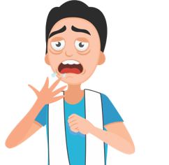
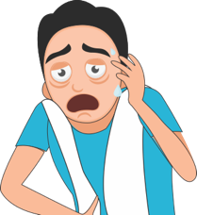
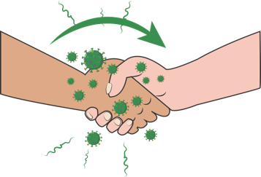
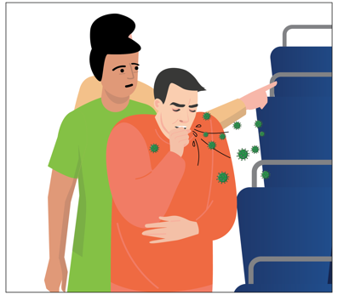
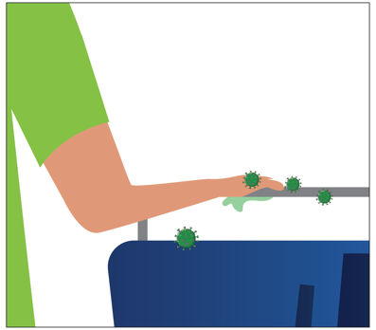
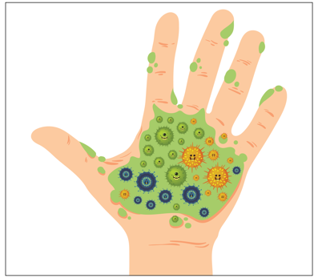
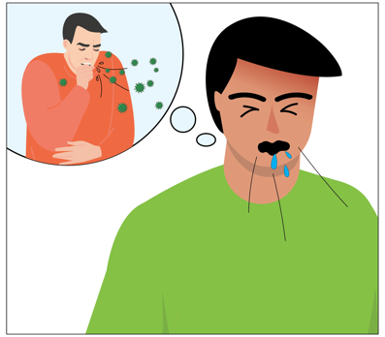
MODES OF TRANSMISSION
SNEEZE/ COUGH
BY INFECTED PERSON
INFECTED DROPLETS
INFECTED DROPLETS
GET ON YOUR HAND
AND WHEN TOUCH
ANY SURFACE OR PERSON
VIRUS
TRANSFERRED!!
SNEEZE/ COUGH
BY INFECTED PERSON
INFECTED DROPLETS
INFECTED DROPLETS
GET ON YOUR HAND
VIRUS
TRANSFERRED!!
07
Notes:
How do you get infected ? Person to person through droplets from the nose or mouth when a person who has COVID-10 coughs, sneezes or speaks
Droplets found on object and surfaces such as tables, doors knobs, and handrails
You can get infected through touching your eyes, nose or mouth.
The virus travels through the respiratory droplets of an infected person. When the person sneezes or coughs, the virus is deposited on the person’s hand if the hand covers the mouth, or droplets fall on a surface when the mouth/nose is not covered.
From the surface/hand, the virus will get transferred to an uninfected person’s hand and when that hand coms in touch with the nostril, eyes or mouth the virus gets inside the system.
We do not have the knowledge of how long this virus lives once it is out of the body. But keeping hands clean and not touching them to the face is the most important way of preventing this infection . We are going to learn about this.

Slide 20
Prevention : hand hygiene
Wash your hands often with soap and water for 40 seconds especially after you have been in a public place, or after blowing your nose, coughing, or sneezing.
Use a hand sanitizer (at least 70% alcohol based) if soap and water not available cover all surfaces of your hands and rub them together until they feel dry.
DO
touch your eyes, nose, and mouth with unwashed hands.
touch surfaces like door knobs and door bells, elevator buttons, handrails, support handles, chair backs, ATM surfaces, mobiles, jeep handles etc
DO NOT
08
Notes:
We spoke about transmission in the earlier slide. Let us now look at how we can prevent this transmission.
Washing of hands with soap and water will kill the virus. Similarly sanitizing with 70% alcohol based sanitizer. We need to wash with soap for a particular time which is 40 secs. It takes that much time for the cell wall to be rubbed off. Similarly with Alcohol. If you do not rub your hand, the virus coat does not fall off and no harm comes to the virus
As we spoke earlier the infected droplets can get transferred via shaking hands with an infected person who may have the bacteria on his hands to an uninfected person or through touching of surfaces which may have the bacteria. That is why we need to have these hand hygiene practices.

Slide 21
PREVENTION: RESPIRATORY HYGIENE
Respiratory Hygiene is a combination of measures taken to stop the spread of germs through respiratory behaviours like coughing or sneezing
DO
DO NOT
DO USE a handkerchief or a tissue to cover your face while coughing or sneezing
DO THROW the used tissue immediately into a closed dustbin
DO COVER your sneeze into your bent upper arm in case you are not carrying a tissue or a kerchief.
DO WASH hands immediately after you have covered your sneeze or cough
DO NOT use other ways of covering your face
DO NOT spit in the open, always use a spittoon or wash basin for spitting
09
Notes:
And because we do not want the infected droplets to go out into the air and infect more people, we have to maintain what is called as respiratory hygiene at all times .
Never use the saree pallu or gamcha for sneezing into as you may use these for wiping your hands and the germs will get transferred from your hand to your nose, mouth or eyes.

Slide 22
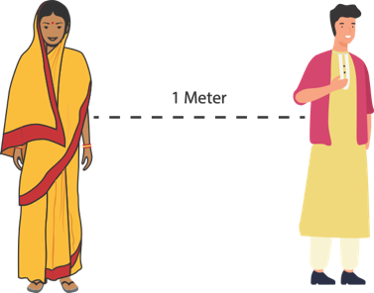
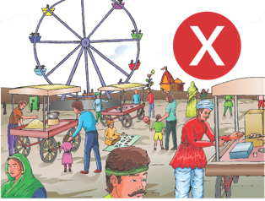
PREVENTION: SOCIAL DISTANCING
SOCIAL DISTANCING : deliberately increasing the physical space between people to avoid spreading illness. Staying at least ONE meter away from other people lessens your chances of catching COVID-19.
Stay at home unless absolutely necessary
Keep a distance of at least one meter between yourself and another person
DO
DO
NOT
DO NOT Hold events where people have to gather in large crowds
DO NOT go out without your mask
11
Notes:
Social Distancing is keeping a distance between you and other people so that you do not come in contact with their infected droplets in case they are carrying an infection. This does not mean that every person you come across is infected. But it is necessary being careful.
Social distancing also means that you avoid crowded, you do not organize events where people have to get together. All these are ways by which a virus can travel from one person to another. Be aware that the virus cannot live for long when it is out of the human body. It will require to find a human body to grow and survive. If it does not, it will die. When people have been around, used places, touched things, the virus can get transmitted from one person to another. That is why it is necessary to decrease human to human contact in this period.

Slide 23
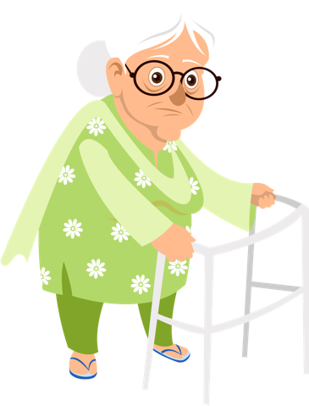
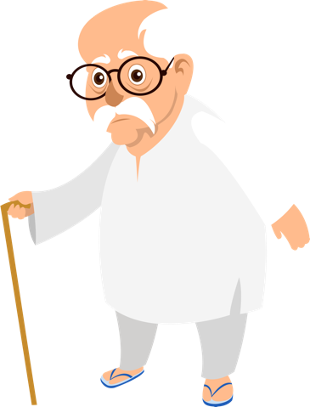
PREVENTION: HIGH RISK GROUP
High Risk Groups are people who are at A higher risk from severe illness if they get COVID-19. This includes:
older adults
PREGNANT WOMEN
(AS WE DO NOT KNOW THE IMPACT OF THE DISEASE ON PREGNANCY AS OF YET, IT IS BETTER TO TAKE CARE)
people who have underlying medical conditions like:
Heart disease
Diabetes
Lung disease
Kidney disease
On cancer
medication
12
Notes:
Though the infection can happen to anyone, the infection becomes severe when it happens in old people or people who already have an illness. This is because the immune systems of such people is weak and cannot defend the body when it is attacked by disease causing organisms. Now you will understand the importance of immunizations which prepare our bodies for attacks from viruses and bacteria.

Slide 24
SESSION 3
COMMON RUMOURS AND MISINFORMATION ABOUT COVID-19 TO WATCH FOR
Notes:
In this session 3 we will look at romours and fake news on COVID-19 and what teachers have to do to support and prevent such for learners. This is a short five minutes session but very important to prevent misleading information for children and communities at large.

Slide 25
COMMON RUMOURS AND MISINFORMATION ABOUT COVID-19 TO WATCH FOR
Rumour | Fact
There is a cure for COVID | There is NO vaccine or cure for CORVID-19
Antibiotics are effective in the prevention and treating COVID-19 | NO antibiotics only treat bacteria, NOT Viruses
COVID-19 only attacks older people | People of all ages can be infected but older people with other underlying health conditions are easily infected
Garlic prevents infection | No evidence to such although garlic has some antimicrobial properties
Regula saline rinsing of the nose prevents infection | No evidence
Hand Dryers are effective in killing COVID-19 | NOT TRUE
Cold Weather Kills COVID-19 | No reason for that
COVID-19 cannot be transmitted in areas with hot and humid climates | Can be transmitted in all climates
Being able to hold your breath for 10 minutes and above shows that you don't have COVID-19 | This breathing exercise is not a test for COVID-19
Drinking vodka, ethanol, and bleach prevents and cures COVID-19 | Not True and that is very dangerous: but you can dilute these to clean surfaces
Hot Pepper into my food prevents COVID-19 | Not true
If I do a COVID -19 Test, I will be infected | Not true
If somebody tested positive for COVID-19 and recovers can infect other people | NOT true if you have fully recovered you no longer carry the Coronavirus in your body
Hydroxychloroquine(an anti-malaria drug) can be used to prevent (prophylactic) or cure COVID-19 | No scientific proof as yet that this prevents or cures COVID-19
Notes:
As a result of the unprecedented COVID-19 pandemic, there is so much information, both rumours and other factual due to easy access to information from the media (Newspapers, TV, Radio), Social Media and the internet. This easy access to information can also be hazardous and damaging to the wellbeing of our society. As it is now complicated to know which a fact is and which is not genuine or fake. There is so much available misinformation, for example, that drinking bicarbonate of soda and lemon cures COVID-19. Unfortunately, some of this information has caused the spread of COVID-19. Teachers have an essential role to Weed Out fake news and misinformation in the school value chain (parents, teachers, learners, and communities).
IT IS A CRIMINAL OFFENCE TO WILLINGLY SPREAD MISINFORMATION OR FAKE NEWS ABOUT COVID-19

Slide 26
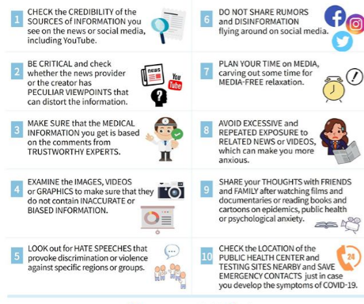
Tips for dealing with rumours
Notes:
Here are some tips on dealing with Fake COVID-19 misinformation done by the Korean Association of Teachers, where they recommend ten tips that can help you survive the COVID-19 rumourville!

Slide 27
SESSION 4
TEACHING AND ADRESSING ANXIETY FOR LEARNERS ON COVID -19
Notes:
Teachers isn this ession will be able to share some steps with learners and other staff members on teaching and addressing some of the anxieties on COVID-19. The session is planned for 20 minutes s teachers have to include COVID-19 as part of the curriculum. Slides 27-37

Slide 28
Teaching young learners
Teacher's notes Deal with the news head-on and talk about it openly and calmly, giving them the facts | Give age-appropriate information
Encourage questions | Allow them to ask to satisfy their curiosities Answer them with a friendly tone Repeat if they seem not to have any sign of understanding
Be a role model | Recognise and manage your concerns Be open and share with the young ones Encourage them not to have too much exposure to sad news
Let them know it is reasonable to be concerned | Reassure them that the young ones have an excellent immune system to beat COVID-19 hence the effects are very mild when infected
Promote awareness of the importance of the immune system | Share them ideas on how to live healthy – eating habits (vegetables and balanced diet), exercising and good sleeping hours
Be aware of children with higher levels of anxiety (e.g. those with existing phobias or obsessive-compulsive disorders) | Know which children have such behaviours and calm them by assuring them that will soon pass on.
Keep doing your bit to help children reduce the spread of germs | Use the poster on the steps of washing hands and let them count up to 20 (1-20) or sing "Happy Birthday" twice and that will ensure they have washed their hands properly to prevent any transmission of germs.
Share the Tips with young children parents wherever you can!

Slide 29
FOR PRIMARY SCHOOL LEARNERS & FOR SECONDARY SCHOOL LEARNERS & CHILDREN WITH SPECIAL EDUCATIONAL NEEDS
Show them practical steps on well being
Teach them facts about COVID-19
Show them reasonable steps on how to prevent the transmission
Suggest the importance of new blackout/lockdown
Discourage overexposure to negative stories
Let them know they will be safe as long as they practice reliable prevention measures
Let them know it is normal to be concerned
Let them know the importance of schooling and education

Slide 30
FOR PRIMARY SCHOOL LEARNERS & FOR SECONDARY SCHOOL LEARNERS & CHILDREN WITH SPECIAL EDUCATIONAL NEEDS
Tailor the conversation to suit the age of the learners
Find the RIGHT TIME to talk about COVID-19
Be candid and truthful about COVID-19
Moderate the tone of your voice: Listen to your voice does it express hopelessness or courage that we shall beat Coronavirus.
Forget the habit of whining! But show confidence and not mumble about this pandemic!
Impute the virtue to learners that you trust them to prevent the spread and transmission of COVID-19
Avoid any stigmatisation about COVID-19
Do not name and shame or threaten learners as this won't succeed on what they ought to do!
There are educational, psychological, physical, social, and cultural differences amongst learners: Plan your responses accordingly!

Slide 31
ACTIVITY 1.3
Is COVID-19 a sensitive or controversial issue to teach in the context of your school?
Why should you include COVID-19 in the curriculum?
What are the benefits of teaching COVID-19 in the curriculum?
How should COVID-19 be approached in the classroom?
Is COVID-19 subject-based or all subjects can teach on COVID-19?
Which pedagogies are suitable to teach COVID-19?
What are the practical examples that you can share with other teachers to teach COVID-19
Where is health education located in the CAPS curriculum?
How would you go about/ how would you approach teaching about COVID-19?
Develop a sampler lesson where you can teach a lesson in your subject using COVID-19
How will you use the first five minutes in your class to discuss COVID-19?

Slide 32
TEACHING ABOUT COVID-19
Three Crucial Notions
Be objective: balance facts and values and know your staff!
Be Neutral: Not be too authoritarian; use discussions rather than always instruction; protect divergence views; be responsible of the quality and standards of learning in the classroom!
Be balanced: play the devil's advocate so that all views are expressed. But as a teacher you need to share the most probable scientific facts about COVID-19.
Notes:
Teaching sensitive issues in the classroom like in the case of COVID-19, there are many ways of approaching the teaching of sensitive topics, but one has to guard against indoctrination or misinformation, particular pedagogies should not be considered. For example a didactic/funnelling approach is entirely inappropriate. The proposed method is to foster autonomy and critical awareness. It should renounce the authority of the teacher as the expert capable of solving value issues. In the ideal world, any teacher asked to teach about COVID-19 should have already received training about COVID-19. But there is no time available. Teachers in the context of the COVID-19 have to use the Ready–Fire–Aim approach. As we all want to prevent the transmission and death of many people, we need to take action first and make any necessary adjustments and correct any mistakes later on. First, as teachers are comfortable about the topic and give consistent messages to the young learners to make the experience more positive, enjoyable, and informal.
Do consider the diversity of the group, their cultural background, their differing ages, and maturity, and make no assumptions about their COVID-19 experiences.

Slide 33
Practical Ideas for the classroom
Depending on the age of the learners, but simply asking learners what they know about COVID-19 every day may be dull for most learners. The following activities offer a range of alternatives:
Brainstorming Questionnaire Interviews Examining photographs or other illustrative materials Roleplay Simulation Investigation | Debate Visitor or guest speaker Active reading for learning, e.g., DARTS Translation Activities (TAs) Active writing Practical work Videos Project-Based Learning
Notes:
The following strategy can be used for teaching COVID-19 in the next slide which I call the 5Es of teaching and learning !!!
Starter and Icebreakers
Getting to know the group of learners if they are a new group
Find out about their feelings and concerns
Set a contract and ground rules
Enthusiasm is catching: ("You can never sell anything to anyone until you are sold on it yourself") Giblin (2001, p. 22)

Slide 34
Summary of preferred correct terms and errors to avoid!
Demeaning Term | Appropriate Term
Chinese Virus | Coronavirus: COVID-19
COVID-19 infected | Use covid-19 positive or tested positive for Coronavirus
Higher Risk Group/vulnerable group | Use key population at high risk
Fight against COVID-19 | Covid-19 response or Covid-19 prevention
Covid-19 patient | Patient with Corona related illness
Notes:
The art of using the correct words is important for school going children so that the community at large uses and elarnes the correct words to use.

Slide 35
Practical ideas that teachers could use for teaching on covid-19
ENGAGE | Activity: What are your concerns about COVID-19? What do you want to know about COVID-19? What have you learned about COVID-19
EXPLORE | What have you been practising to prevent transmission of COVID-19?
EXPLAIN | Give some facts about COVID-19:/simulation demonstration/video
ELABORATE | Share some ideas on prevention and transmission of COVID-19
EVALUATE | Give an exercise or investigation on the topic: What are the common practices that your community is currently using to prevent infection and transmission of COVID-19

Slide 36
Some testing questions on covid-19
What can I do to prevent the spread of COVID-19?
Why am I no longer shaking hands with my friends?
Why is it important to wash my hands frequently and thoroughly?
Other than shaking hands with my friends, what do I use now?
Is it true that when you touch infected surfaces, you can be infected also?
What is meant by social distancing and why it is important
How many people in South Africa have recovered from COVID-19 to date?
Looking at the South African Dashboard for COVID-19 compare the infection rates for each province and give reasons for the difference? Find data at : https://sacoronavirus.co.za
What are the different stages that are used for the lockdown and describe each of the level alert?
What is the impact to South Africa as result of the targeted lockdown?

Slide 37
Some testing questions on covid-19
Project Based Learning (PBL)
We can use PBL for teaching COVID-19
Here are some sampler projects that learners can do:
Notes:
A closing round
It maybe that the COVID-19 crises have taken place at a short notice and disrupted schools in an extraordinary speed and there has not been much training course for teachers on how to teach about COVID-19. Indeed it is a very sensitive issue that concerns lives of many people but it is always good for you as teacher to finish with a light –hearted closing round with the learners depending on the maturity of the group.
CONCLUSION
This last section discusses s issues that one of the issues and problems that arise when teaching young people about sensitive and controversial areas that should be part of the national curriculum. The section contains learning approaches and activities that might be used in teaching about COVID-19 to save a life. Many of these could be adapted and used in any subject containing controversy and sensitivity.
MAKE LEARNERS FEEL IMPORTANT IN FIGHTING THE COVID -19 PANDEMIC

Slide 38
Some testing questions on covid-19
What is the South African strategy for Covid-19?
What measures are in place to prevent the transmission of COVID-19: Describe the pros and cons and compare the measures used in South Africa against another neighbouring country in the SADAC region.
When you touch infected surfaces, you can get infected. Conduct an investigation of the different surfaces that you touch regularly at school and create a table on what is the length that each surface the Coronavirus can live and explain why the lifespan is different for each surface. Describe methods that you suggest should be used to clean the surfaces at your school to prevent transmission and further infection.
Is my school a healthy school? Find information on what is a healthy school (Healthy School Concept Document) and compare your school if it is healthy or not and what do you think is your role as a learner to ensure that your school is a healthy school.
Notes:
A closing round
It maybe that the COVID-19 crises have taken place at a short notice and disrupted schools in an extraordinary speed and there has not been much training course for teachers on how to teach about COVID-19. Indeed it is a very sensitive issue that concerns lives of many people but it is always good for you as teacher to finish with a light –hearted closing round with the learners depending on the maturity of the group.
CONCLUSION
This last section discusses s issues that one of the issues and problems that arise when teaching young people about sensitive and controversial areas that should be part of the national curriculum. The section contains learning approaches and activities that might be used in teaching about COVID-19 to save a life. Many of these could be adapted and used in any subject containing controversy and sensitivity.
MAKE LEARNERS FEEL IMPORTANT IN FIGHTING THE COVID -19 PANDEMIC

Slide 39
SESSION 5
Managing stigma and discrimination
Notes:
Learning outcome:
Participants will be able to define stigma and understand why COVID-19 causes stigma in society.
Participants will know how stigma affects their work and what they can do to address it. See slides 39-43

Slide 40
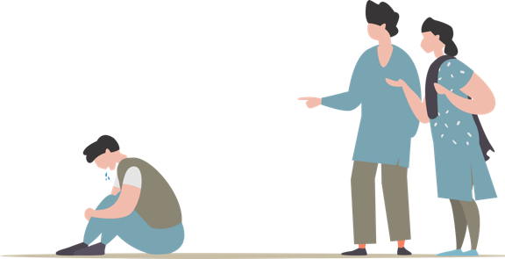
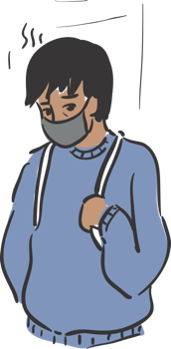
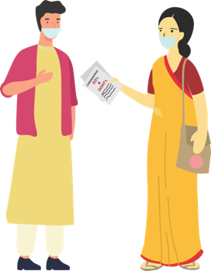
STIGMA & DISCRIMINATION
WHAT IS
STIGMA?
WHY IS THERE
STIGMA?
WHAT DOES
STIGMA DO?
WHAT CAN
TEACHERS DO?
25
Notes:
Social stigma is the disapproval of or discrimination against a person based on perceivable social characteristic's that serve to distinguish them from other members of the society

Slide 41
WHAT IS COVID-19 social STIGMA?
Social stigma is the disapproval of or discrimination against a person based on perceivable social characteristic's that serve to distinguish them from other members of the society example people who are affected or infected with COVID-19.
Notes:
WHAT IS SOCIAL STIGMA? Social stigma in the context of health is the negative association between a person or group of people who share certain characteristics and a specific disease. In an outbreak, this may mean people are labelled, stereotyped, discriminated against, treated separately, and/or experience loss of status because of a perceived link with a disease. Such treatment can negatively affect those with the disease, as well as their caregivers, family, friends and communities. People who don’t have the disease but share other characteristics with this group may also suffer from stigma. The current COVID-19 outbreak has provoked social stigma and discriminatory behaviours against people of certain ethnic backgrounds as well as anyone perceived to have been in contact with the virus.

Slide 42
Why there is a social stigma for covdi-19
The level of stigma associated with COVID-19 is based on three main factors:
COVID-19 is a new disease about which many things are still being discovered
When something is unknown people are worried which leads to fear
Rumours or fake news give wrong information and spreads the fear

Slide 43
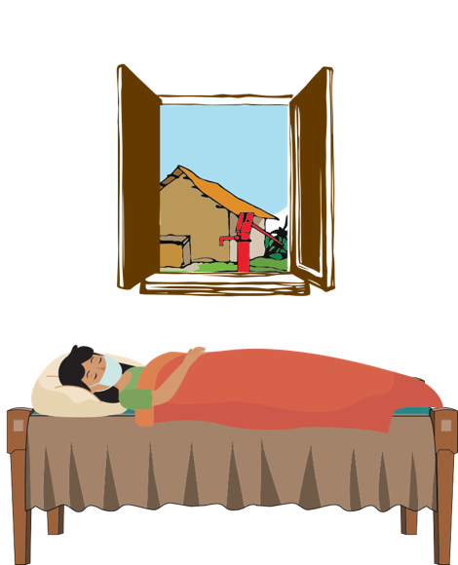
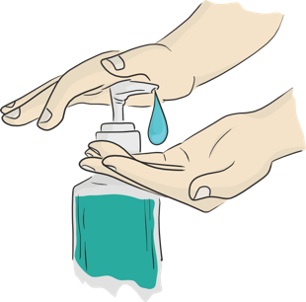
What is the impact of stigma ?
Discourages them &
may at times prevent
them from adopting
healthy behaviours
Makes people hide
their problems
Keeps people away
from accessing
health services and
seeking help
29
Notes:
WHAT IS THE IMPACT? Stigma can undermine social cohesion and prompt possible social isolation of groups, which might contribute to a situation where the virus is more, not less, likely to spread. This can result in more severe health problems and difficulties controlling a disease outbreak. Stigma can: • Drive people to hide the illness to avoid discrimination • Prevent people from seeking health care immediately • Discourage them from adopting healthy behaviours

Slide 44
What teachers can do to address social stigma
Sensitize people and help them to understand that it is a simple infection and 80% of the cases are mild cases.
COVID-19 can happen to anyone, speak to people, be available to listen to how they feel
Advise people to engage in relaxing activities like indoor games, reading, gardening, home-cleaning, etc.
Ask people to stay away from watching negative things on the TV and also fake news
Engage community influencers , Share correct information on COVID-19 with them. Brief them on specific support required by you. Guide WhatsApp groups to help in giving hope and positive news to help people handle stress.
Notes:
HOW TO ADDRESS SOCIAL STIGMA Evidence clearly shows that stigma and fear around communicable diseases hamper the response. What works is building trust in reliable health services and advice, showing empathy with those affected, understanding the disease itself, and adopting effective, practical measures so people can help keep themselves and their loved ones safe. How we communicate about COVID-19 is critical in supporting people to take effective action to help combat the disease and to avoid fuelling fear and stigma. An environment needs to be created in which the disease and its impact can be discussed and addressed openly, honestly and effectively. Here are some tips on how to address and avoid compounding, social stigma: 1. Words matter: dos and don’ts when talking about the new coronavirus (COVID-19) 2. Do your part: simple ideas to drive stigma away 3. Communication tips and messages.

Slide 45
What teachers can do to address social stigma
Engage community influencers , Share correct information on COVID-19 with them. Brief them on specific support required by you. Guide WhatsApp groups to help in giving hope and positive news to help people handle stress.
Publicly, use terms like people who have COVID-19 instead of “COVID-19 cases” or “victims”. Similarly, use terms like people who may have COVID-19 instead of “suspected cases”
emphasize that most people do recover from COVID-19, amplify the good news about local people . Who have recovered from COVID-19? Who have supported a loved one through recovery?
Make special efforts to reach out to high risk groups including senior citizens and younger children.
Notes:
HOW TO ADDRESS SOCIAL STIGMA Evidence clearly shows that stigma and fear around communicable diseases hamper the response. What works is building trust in reliable health services and advice, showing empathy with those affected, understanding the disease itself, and adopting effective, practical measures so people can help keep themselves and their loved ones safe. How we communicate about COVID-19 is critical in supporting people to take effective action to help combat the disease and to avoid fuelling fear and stigma. An environment needs to be created in which the disease and its impact can be discussed and addressed openly, honestly and effectively. Here are some tips on how to address and avoid compounding, social stigma: 1. Words matter: dos and don’ts when talking about the new coronavirus (COVID-19) 2. Do your part: simple ideas to drive stigma away 3. Communication tips and messages.

Slide 46
SESSION 6
HOW TO HANDLE STRESS DURING COVID-19 FOR TEACHERS AND OTHER EDUCATION STAFF
Notes:
In this session we are going identify stress drivers and possible means to prevent stress associated with COVID-19 pandemic. Also identify organisations that can provide support when the school or community is affected.

Slide 47
HOW TO HANDLE STRESS DURING COVID-19 FOR TEACHERS AND OTHER EDUCATION STAFF
Notes:
Teaching can be very stressful and isolated during such uncertainty and life-threatening situations in schools. A study conducted in 2019 those involved in education showed that 72% of people involved in education described themselves as stressed.
Check out the flowing techniques for teachers and educational staff on how to handle stress:
Here are some stress triggers:
Falling ill and dying
Avoiding approaching health facilities due to fear of becoming infected while in care
Fear of losing livelihoods, not being able to work during isolation, and of being dismissed from work
Fear of being socially excluded/placed in quarantine because of being associated with the disease
Feeling powerless in protecting loved ones and fear of losing loved ones because of the virus or being separated during quarantine
Feelings of helplessness, boredom, loneliness and depression due to being isolated and not working towards caring for a dependent
Stress is caused due to the above fears and being treated as an outcaste or blamed for spreading the disease
Teachers face three main bottle necks issues: (1) stress due to economic uncertainty, concern for the safety of loved ones, and anxiety about the future; (2) the daunting challenge of returning to schools where many students have dropped out or fallen behind ― and increased pressure on teachers to ensure catch-up with little professional development support; and (3) little access to the right technologies or the skills to use them (my son’s school gives all teachers and students ipads with a host of learning material pre-loaded).

Slide 48
Where you get support for covid-19
AUTHORITY TO CONTACT | WHAT DO THEY DO
Gauteng Department of Education Gauteng Department of Education Email: gdeinfo@gauteng.gov.za https.education.gove.za/covid19supportpackeage.aspx Telephone: 011 355 0000 Call centre: Call Centre: (011) 355 0966/0559/0198/0600 - Toll Free number: 0800 000 789 | Official guidance for schools on: Which dates for return to schools Which grades will return and when What are the SoPs for COVID--19 How to provide free meals How many exams will be done for 2020 Revised ATPs Provision of PPEs Extra education support Cancelling of certain activities for schools
SA Government #COVID-19 portal: http://www.sacoronavirus.co.za Covid-19 Call centre WhatsApp 0600 123456 Emergency Hotline: 0888 029 999 | Online resources and updates on COVID-19 Prevention of transmission updates FAQ South African Corona news and information updates
Department of Health (Gauteng) Telephone: 011 355 3000 | Online resources and updates on COVID-19 Prevention of transmission updates
Notes:
Further we have shared the comprehensive checklist that teachers should use to monitor COVID-19 at schools as a SOP tool to prevent transmission

Slide 49
PSYCHOSOCIAL support
AUTHORITY TO CONTACT | WHAT DO THEY DO
South African Depression, Anxiety, Depression and Suicide (SADAG) Email: www.sadag.org Telephone: 0800 456 789 Suicide Crisis Line 0800 567 567 SADAG Mental Health Line 011 234 4837 Pharmadynamics Police &Trauma Line 0800 20 50 26 ADHD Helpline 0800 55 44 33 For a suicidal Emergency contact us on 0800 567 567 24hr Helpline 0800 456 789 | Support, referrals and counselling

Slide 50
PSYCHOSOCIAL support
AUTHORITY TO CONTACT | WHAT DO THEY DO
Childline Gauteng Hotline : 08000 55555 https://childline Gauteng.co.za | Child Abuse prevention and referrals

Slide 51
Conclusion

