Slide 1


TRAINING MANUAL FOR LEARNERS
A GDE AND MGSLG LEARNER GUIDE
A critical pandemic to manage at school!
MAY 2020

Slide 2
PRESENTATION OUTLINE
Introduction
Why is this manual issued?
The role of schools in responding to COVID-19
Talking about your emotions or problems
What do I know about the Corona Virus?
How to stay safe and healthy inside and outside of the class
Stigmatization
What must I do on my way to school?
Arriving at school
What is screening for COVID-19
Who should be screened?
Who will conduct the screening?
Procedure for screening
Sport and other after school programmes
If you are sick
What if some learners are found to be infected on arrival?
Handy Hints for Learners
Contact Numbers
2

Slide 3

PURPOSE OF THIS BOOKLET FOR LEARNERS
This guide is for support for learners, namely “How To” Guide, is intended to provide clear guidance on:
How to help prevent the transmission of COVID -19 within the school, classroom, and surrounding communities?
A daily check-in.
How to support affected learners?
How to learn in COVID-19 and
How else can I learn under COVID-19?
This guide aims at capacitating learners (Grade R-12) in the best application to support the prevention and transmission of COVID-19. All learners need to feel that they are safe in the learning ecosystem. Teachers and caregivers need to support their emotional and physical well-being.

Slide 4
PURPOSE OF THIS BOOKLET
FOR LEARNERS...cntd
This guide will offer learners information and facts about COVID-19, which will help reduce their fears and anxieties around the disease. Through the support of the guide, learners will be able to cope, which will also help with other concerns, which might affect their lives.
This pandemic is like any other crisis that allows us to learn, grow, show compassion, extend a helping hand, and increase resilience, which builds a safer and caring community. This guide provides critical messages and considerations for learners in promoting safe and healthy environments.
Essential information about the psychological and physical aspects of how learners can cope is discussed. Furthermore, the guide shares support and information resources.

Slide 5
The role of schools in responding to COVID-19
Schools as education institutions play an essential role in preventing the COVID-19 pandemic from ensuring that learners have a safe and healthy learning environment. Schools serve communities throughout the society.
All these people may have close contact in the school setting, often sharing space, equipment, and supplies.

Slide 6

LEARNER CHECKINS – WELL-BEING OF LEARNER - TASK
It is a excellent practice to start with a check-in on your well-being. Look at the questions below and have an open discussion with your teacher, friend, parent, or caregiver.
The purpose of these check ins is to have a regular contact with your teacher and maintenance of a relationship with the school.
• How are you?
• What school work have you been working on?
• Do you have any questions about the work you have? Do you know how to ask your teacher for support?
• What’s working well studying from home?
• What is the hardest part of working away from school?
• Are you having breaks to eat, go outside for fresh air or a walk? Keeping in contact with friends?
Every class teacher will be expected to check in with every learner in their class at a minimum once per week.

Slide 7
TALKING ABOUT YOUR EMOTIONS OR PROBLEMS
It is essential to talk to someone who can help you through any emotional issues or problems that you are facing, especially during the uncertain times that we are experiencing.

Slide 8
TASK 2 ON EMOTIONS/PROBLEMS
Draw a bubble/ cloud or any shape that you like. In your bubble, write down five words that describe your emotions, emanating from Covid -19 crisis and school your work uncertainty,
In the next bubble, write down five words that can help you to cope with your emotions.
This you can share with the class if you are comfortable. The more you share about yourself, the more you see that you are not alone, but that we are all facing the same issues.

Slide 9

PRIOR TO DAY 1

Slide 10
What do I know about the virus?
On 31 December 2019, the World Health Organization (WHO) China country office reported a cluster of pneumonia cases in Wuhan City, Hubei Province of China. Severe acute respiratory syndrome associated with a novel coronavirus was confirmed. The virus has been named “SARS-CoV-2” and the disease caused “coronavirus disease 2019”, or COVID-19
• A virus is an illness, like flu or measles.
• There is a new virus in the world, called the Corona Virus, or COVID-19. This stands for Corona Virus Disease of 2019.
The virus spreads between people who are in close contact with one another, like when an infected person coughs or sneezes. It can also be spread when you touch a contaminated surface or object. For instance, if someone has sneezed on a table, then you touch the table you can transmit the virus to yourself through touching your mouth, nose or eyes.
• This virus affects people in different ways:
• Some people have the virus, but they don’t feel sick at all. We say they are asymptomatic (meaning producing or showing no symptoms).

Slide 11
What do I know about the virus?...
Most people feel sick for a week or two. They usually have a temperature, aches, and pains in their body, and may have a cough. Then, they recover and are completely fine.
• A small percentage of people become very ill and may need to go to the hospital for a while.
• Research suggests that people younger than 18 (Is it 18 or 9 years?) are less likely to have symptoms and less likely to get very sick. If they do get sick, they usually recover well.
Because this is a new virus, doctors and scientists need some time to learn about it, so that they can develop a vaccination and better treatments.
• To give the doctors and scientists time to learn about the virus, we all need to stay home for a while, wash our hands for 20 seconds regularly and follow all the Covid -19 restrictions).
• This lockdown period also gives our government time to prepare our public health system – to train hospital staff and put proper systems in place, to buy enough equipment for all hospitals, and to hire as many hospital staff as possible.
• Once the spread of the virus is under control, and our hospitals are ready to care for many sick people, the lockdown may slowly be lifted.
• Learners will start going back to school in a staggered manner – not all at once.

Slide 12

ACTIVITY 2 QUIZ
How much do you know about the virus?
Tick off the correct suitable answer/s. Make a x or a √ in the blocks
Quiz adapted from World Health Organization (WHO)
Complete the quiz and score yourself a mark out of 10

Slide 13
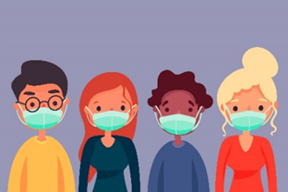

How to stay safe and healthy inside and outside of the class
Wear a mask at all times and do not use defective masks.
Make sure the mask is entirely secure.
Make sure it covers your nose and mouth so that the bottom edge is under your chin.
Stay at least 1.5m away from people
Make sure that you are not close to the next person, to keep yourself and them safe.

Slide 14
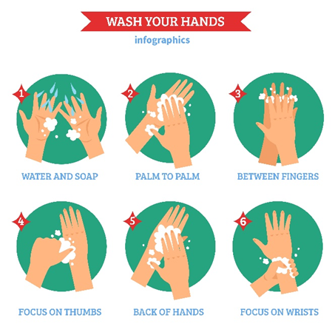
How to stay safe and healthy inside and outside of the class…
Wash your hands regularly
Preferably, on arrival to the school before and after meals and also before you go home. Hands could be washed using soap and water This should be either through washing hands with soap and water or using hand sanitiser.

Slide 15

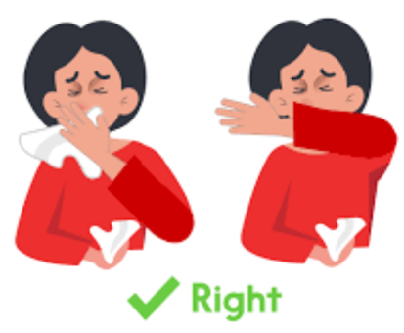
How to stay safe and healthy inside and outside of the class…
Do not touch your face
Your hands touch so many surfaces and objects, which could already be contaminated with Covid -19. When you touch your eyes, nose or mouth, you transfer the virus.
Coughing and Sneezing
Give others who are coughing/sneezing a mask
Practice sneeze or cough into your bent elbow or a tissue and dispose of immediately.
Wash your hands or use a sanitizer.

Slide 16
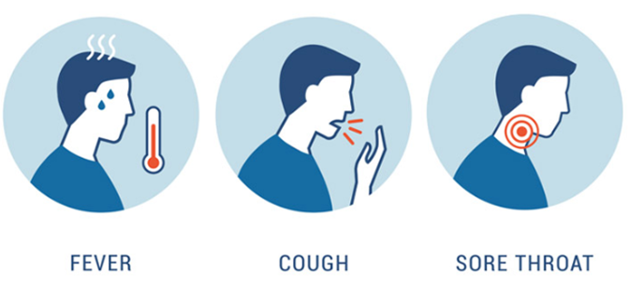
How to stay safe and healthy inside and outside of the class…
If you display symptoms like high temperature, cough, itchy throat, no sense of taste, smell alert your parents or teachers to contact medical doctor immediately.

Slide 17
Stigmatization
Stigma is a mark of disgrace that sets a person apart from others. When their illness labels a person, they are no longer seen as an individual but as part of a stereotyped group. Negative attitudes and beliefs toward this group create prejudice, which leads to negative actions and discrimination.

Slide 18
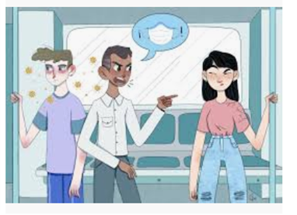
Stigmatization…
Stigma brings experiences and feelings of:
o shame
o blame
o distress
o secrecy
o loneliness,
o isolation and
o social exclusion
o misrepresentation in the media
o being treated differently than the rest of society

Slide 19
Stigmatization…

Slide 20

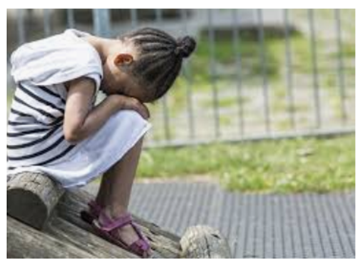
Activity 3
Think of a time in your life when you felt isolated (lonely) or rejected from being seen to be different from others. Write down a few notes or draw images on how you felt.
Explain to the class what effect the experience had on your life.

Slide 21

What must I do on my way to school?
Parents, guardians, and learners must ensure that providers of commuter transport services, including bus services, taxi services, and private cars transporting learners to school at all times, adhere to the Regulations issued in terms of Disaster Management Act 2002 (Act no 57 of 2002).
It is important to practice social distancing and good hygiene to prevent becoming infected if one is walking to school. COVID-19 is a droplet infection that can spread to those who are in close vicinity with an infected person. It is recommended that you keep at least 1.5-meter distance between yourself and another person walking to school.
It is equally essential to practice social distancing and good hygiene to prevent becoming infected if you are using public transport to school or sharing traffic (lift club) with a friend. It is crucial to adhere to the measures to prevent and combat the spread of COVID-19 in public and private transport services.
According to the Regulations, all public transport operators must put measures in place to adhere to social distancing, ensure that transport is sanitized before and after use and observe the new prescribed passenger capacity to curb the spread of COVID-19.

Slide 22
What must I do on my way to school?... Do’s
All operators of learner transport facilities must at regular intervals provide adequate sanitisers or other hygiene dispensers for washing of hands and disinfection equipment for learners.
All operators must ensure that public transport vehicles are sanitised before picking up and after dropping off learners. The sanitisers used to sanitise all learner transport vehicles must have a minimum of 60% alcohol content.
All operators must adhere to the regulations that apply to public transport.
Operators must ensure that all learner transport vehicles door and window handles, armrest, and handrails are sanitised before picking up and dropping off learners.
Operators must ensure that all learner transport vehicles are clean and tidy.
All learner transport operators must provide disinfection information materials and procedures.
All drivers must wear a mask.
All learners must wear a mask.

Slide 23
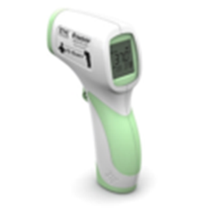
Arriving at School
When you arrive at school you will be screened.
5.1 What is screening for COVID-19?
Screening for COVID-19 in the school is a simple process. Screening involves use of a thermometer (preferably infra-red) and asking some standard questions to establish if symptoms are present. Below are the screening questions.
1. Do you have fever?
2. Do you have a headache?
3. Are you coughing?
4. Can you taste food?
5. Can you smell?

Slide 24
Who should be screened?
All school personnel and all learners will be screened. School personnel includes the school principal, school management teams (SMT), all educators, learner support agents (LSA), peer educators, food handlers, cleaners, other school staff, and all visitors to schools, including School Governing Bodies (SGB) and parents.
Screening should be done at least once per week in the morning.

Slide 25
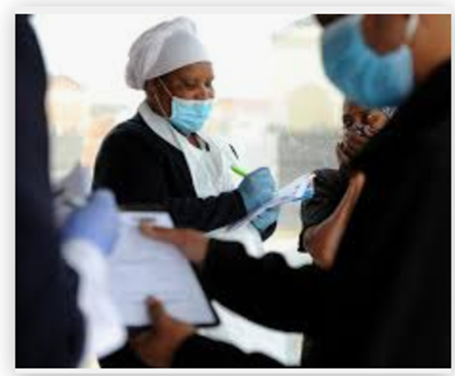
WHO WILL CONDUCT SCREENING?
The School Screening Team, depending on the local human resources available, can be comprised of the following cadres: Enrolled Nurses, Enrolled Nurse Assistants, Community Health Workers (CHW), the Ward Based Outreach Team (WBOT), Expanded Public Works Programme (EPWP), School Personnel (e.g. Education staff, school support staff, Learner Support Agents, etc.) and District level DoE officials (e.g. NSNP officials, De-worming programme officials)

Slide 26
PROCEDURE FOR SCREENING
School personnel must be screened first to can then assist with the screening of the learners.
The school personnel or learner should approach the table where the screener will be standing on the other side.
Collect the health questionnaire/consent form from the learners that have been completed by the parents/carers.
The screener will refer to the screening question checklist
The learner/school personnel’s temperature will be taken and recorded on the school register
The following table provides indicates the simple screening process to be followed:

Slide 27
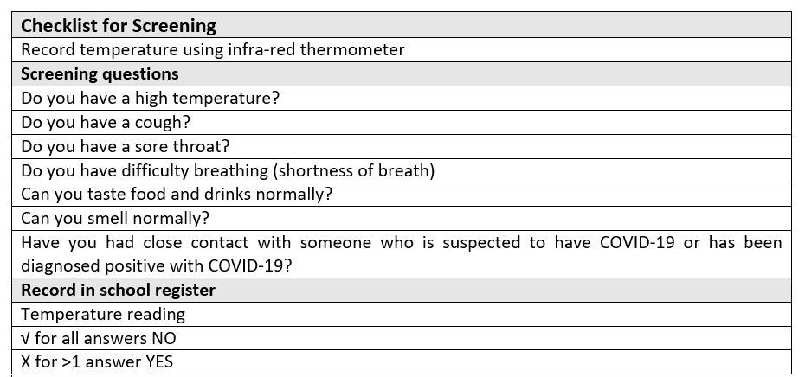
CHECKLIST FOR SCREENING

Slide 28

SPORT & OTHER ACTIVITIES
School Sport and other mass-based gathering events such as the South African Schools Choral Eisteddfod remain suspended in schools.
This is in line with the directive given by the Minister on 16 March 2020. The instruction will remain in force until further guidance is received from the Department of Health and Covid-19 Command Council.
Where sport equipment must be used during Life Orientation lessons, these must sanitised and social distancing must be maintained at all times.
When the ban on sport events is lifted, promotion of good hygiene and safe handling of sport equipment and other related objects must be promoted. School-based enrichment and other cultural activities must be kept to a minimum to allow schools to recover the lost teaching and learning time

Slide 29
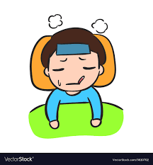
IF YOU ARE SICK.
Sick learners should not attend school, parents and staff must enforce this school policy more now than before due to Covid-19 transmission (where necessary such children will need to access health services at primary health care facilities).

Slide 30


HANDY HINTS FOR LEARNERS
Establish routine
o Be inspired to do as many regular activities as possible
o Work with your family and your teachers to structure a routine and stick to it.
Learning time
o Keep connected to school life through listening, reading and completing tasks whether at school or at home.

Slide 31


HANDY HINTS FOR LEARNERS
Effective usage of technology
o Take advantage of television, radio or any other on-line programs
o Discussion with your peers on social media on what you have learnt
Exercise
o It is very important for children to exercise every day.
o Exercise makes everyone feel better.
o Think of exercises and activities that can be done in your lockdown space. These can be simple activities, like running on the spot, jumping jacks, squats, and push-ups.

Slide 32
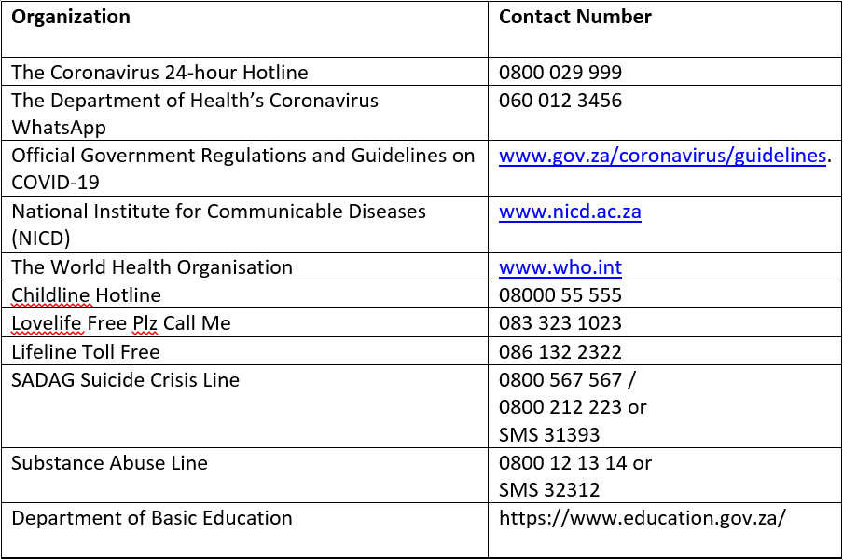
SUPPORT AND EMERGENCY CONTACT NUMBERS

