Slide 1

INTEGRATING TECHNOLOGY IN THE CLASSROOM
Module 3: The CoPAF Model
“A Guide for Subject Advisors”
“If we have a passion to keep learning, a will to innovate, and a capacity to problem-solve and collaborate, we can make great things happen for the children who we serve.”
(Will Richardson, 2012)
Notes:
[2 min]
Please read the whole workbook before you go through these slides
This year the focus for full ICT schools, is to ensure ICTs are integrated into teaching and learning in the classroom
Commend these Subject Advisors for the initiative they have made to support this process
Read the quotation on the slide and discuss what it means in the context of ICT in education

Slide 2
PROGRAM OF THE DAY: MODULE 3
Time | Detail
08:00-08:04 | Welcome and Introduction Slides 1-2
08:04-08:30 | Slides 3-10
08:30-09:35 | Slides 11-17
09:35-10:45 | Slides 18-21
10:45-11:00 | TEA BREAK
11:00-11:50 | Slides 22-27
11:50-12:30 | Slides 28-30
12:30-13:30 | LUNCH BREAK
13:30-14:00 | Slides 31-32
02:15-02:20 | PACK UP AND DEPART, Slide 33
Notes:
[2 min]
Discuss the program of the day with the participants
If the same group attends each day, only discuss slide 2
Module 3 will take 4.50 hours excluding tea and Lunch breaks

Slide 3
COPYRIGHT
This work is protected by the Copyright Act 98 of 1978. No part of this work may be reproduced or transmitted in any form or by any means, electronic or mechanical, including photocopying, recording or by any information storage and retrieval system, without permission in writing from Matthew Goniwe School of Leadership and Governance.
Notes:
[3 min]
Remind the participants that this applies to all Matthew Goniwe School of Leadership and Governance materials they receive. They must comply.

Slide 4
PURPOSE OF THE PROGRAM
The programme aims at capacitating Subject Advisors to drive and support curriculum delivery through technology-based teaching in the classroom
Their knowledge and role in the curriculum interpretation, delivery and assessment is the basis on which the technology must be utilised in supporting what happens in the classroom
Without this fundamental understanding, the use of digital technology in particular will remain trivial to the successful implementation of the of the curriculum
Notes:
[3 min]
Describe the purpose of the program to the Subject Advisors

Slide 5
Learning outcomes
The programme is intended to result in the following learning outcomes:
  Make clear what a curriculum specialist/subject advisor’s role is in the context of Information and Communication Technology (ICT)
  Provide Knowledge, Skills and Attitudes needed to operate in a digital environment as a subject specialist
  Give guidance on how best to support teachers in their delivery of the curriculum through ICT
Notes:
[3 min]
Discuss the Learning Outcomes with the Subject Advisors

Slide 6


THE 10:20:70 FRAMEWORK
FOR CONTINUOUS PROFESSIONAL TEACHER DEVELOPMENT
70% Work Integrated Learning
20 % Practice Based Learning
10% Formal Learning
Notes:
[3 min]
MGSLG uses the above framework for all its teacher professional development as an effort to promote continuous learning for its trainees.
On the right hand side of the model above, the trainer presents the theory and this is where concepts are introduced and explained.
Interaction at this level is encouraged to facilitate learning environments where learners actively participate in the learning experience.
This should occupy 10% of the time allocated for the training.
In the middle, is the practical part where learners actually practice what they have learnt in simulated or real life experiences?
Lastly, the trainee adopts the knowledge and skills in their work environment and integrates these into their practice

Slide 7
MODULES
 | MODULES/TOPICS | MODULES
1. | Introduction | Module 1
2. | What is ICT Pedagogical Integration? | Module 2
3. | The CoPAF Model | Module 3
4. | Available resources for subject teaching and learning | Module 4
5. | e-Assessment/ Automated Assessment | Module 5
6. | Managing an ICT classroom environment | Module 6
7. | How to support a teacher in a traditional and a digital classroom environment | Module 7
8. | Development of materials | Module 8
9. | Professional Learning Communities (PLCs) with ICTs | Module 9
Notes:
[4 min]
Discuss the different modules

Slide 8
Notional hours
 | MODULES | CONTACT SESSION | ASSESSMENT | NOTIONAL HOURS
1. | Module 1: Introduction and orientation of Subject Advisors in their roles and responsibilities as curriculum specialists in a digital environment | 1 day | Class activity
2. | Module 2: What is ICT Pedagogical Integration? | 1 day | Class activity
3. | Module 3: The CoPAF Model/TPACK | 1 day | Application in subject area
4. | Module 4: Integrating e-Content into subject teaching and learning | 1 day | Class activity – Peer assessment
5. | Module 5: e-Assessment/ Automated Assessment | 1 day | Creation and evaluation of an assessment online
6. | Module 6: Managing an ICT classroom Environment | 1 day | Class activity
7. | Module 7: How to support a teacher in a traditional and a digital classroom environment | 1 day | Steps and tools for supporting a teacher with an identified challenge with ICTs
8. | Module 8: Exposure and Development of materials | 1 day | A lesson developed on a learning management system of your choice
9. | Module 9: Professional Learning Communities with ICTs | 1 day | Evidence of participation in your subject PLC on social media
 | TOTAL NUMBER OF HOURS
Notes:
[5 min]
Read through the table and explain the notional hours to the participants

Slide 9
Glossary of terms
WORD/S | EXPLANATION
SMART/ Paperless Classrooms | Highly digitalized learning environments where learners use the internet, e-books or school network to learn
Notes:
[5 min]
Read through the glossary of terms which the participants will find in their workbook

Slide 10
Acronyms and abbreviations
GDE Gauteng Department of Education
HOD Head of Department
ICTs Information and Communications Technology
SGB School Governing Body
SMT Senior Management Team
Notes:
[5 min]
Go through the Acronyms and abbreviations which the participants might find in their workbook

Slide 11
Module 3: theoretical background
Teachers are agents through whom the use of ICT for learning can help achieve our educational goals
There are different models and frameworks available that can help us understand what they need in order to effectively integrate ICTs into teaching and learning
Notes:
[5 min]
This Module will focus on three of them with two developed globally and the other locally.
The third framework will deal with change management in the context of ICT in education. In the ever changing global village with an ever evolving global economy, every country needs to align their education with the changes and this component should be included in interventions meant to promote change in the teaching practice

Slide 12
Aim of this module
To engage with selected frameworks that help in establishing our understanding of what ICT in education entails.
Notes:
[5 min]
Explain to the participants the aim of module 3

Slide 13
objectives
to understand the knowledge domains which teachers need to effectively integrate ICTs through TPACK
to capture the key components that teachers need to integrate ICT in order to achieve curriculum goals through CoPAF
to determine what teachers need as change agents
to know how to apply these understandings to carry out Subject Advisor’s responsibilities
Notes:
[10 min]
Read through the objectives and explain to the participants

Slide 14
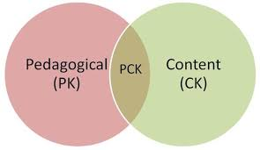
TECHNOLOGICAL PEDAGOGICAL CONTENT KNOWLEDGE (TPACK)
How to teach
What I teach
Teaching children Maths
Notes:
[10 min]
In our understanding of what ICT pedagogical integration is, we were made to realise the importance of the role of the teacher in engineering the experience that brings about learning in any classroom. Schulman describes the knowledge teachers have and use to teach as Pedagogical Content knowledge (PCK) - illustrated and simplified here.

Slide 15
SHULMAN’S DEFINITION
That which makes the learning of a topic easy or difficult. This includes,
for the most regularly taught topics in one's subject area, the most useful forms of representation of those ideas, the most powerful analogies, illustrations, examples, explanations, and demonstrations-in a word, the ways of representing and formulating the subject that make it comprehensible to others
(Schulman, 1986:09)
Notes:
[10 min]
Read through Schulman’s definition

Slide 16
CURRICULUM STATEMENT’S GENERAL AIM
identify and solve problems and make decisions using critical and creative thinking;
work effectively as individuals and with others as members of a team;
organise and manage themselves and their activities responsibly and effectively;
collect, analyse, organise and critically evaluate information;
communicate effectively using visual, symbolic and/or language skills in various modes;
use science and technology effectively and critically showing responsibility towards the environment and the health of others; and
demonstrate an understanding of the world as a set of related systems by recognising that problem solving contexts do not exist in isolation.
(DBE, 2011:04)
Notes:
[10 min]
Our focus as Subject Advisers are supporting teachers such that they are able to ‘manufacture’ (for a lack of a better word) effective learning. The teacher should not only know his or her content, but should also know how to teach it in such a way that learners understand it well. Our curriculum statement’s general aim (d) advocates for learners who are able to,…(bullets on slide)
This demonstrates the level at which teaching must happen.
Learner understanding should be such that their thinking is developed to a level where they can manipulate the knowledge and skills to solve problems. PCK should therefore enable the teacher to achieve this goal if successful learning has occurred.
In-service teachers are supposed to have this knowledge and where it is not evident, us as Subject Experts or Subject Advisors should intervene.

Slide 17
Activity 3.1
Attend to Activity 3.1 on page 28 of your workbooks
Notes:
[15 min]
Ask the participants to turn to page 26 of their workbooks
Let them do Activity 3.1

Slide 18
Activity 3.2
Attend to Activity 3.2 on page 28 of your workbooks
Notes:
[15 min]
Ask the participants to turn to page 27 of their workbooks
Let them do Activity 3.2

Slide 19
Activity 3.3
Attend to Activity 3.3 on page 28 of your workbooks
Notes:
[15 min]
Ask the participants to turn to page 27 of their workbooks
Let them do Activity 3.3

Slide 20
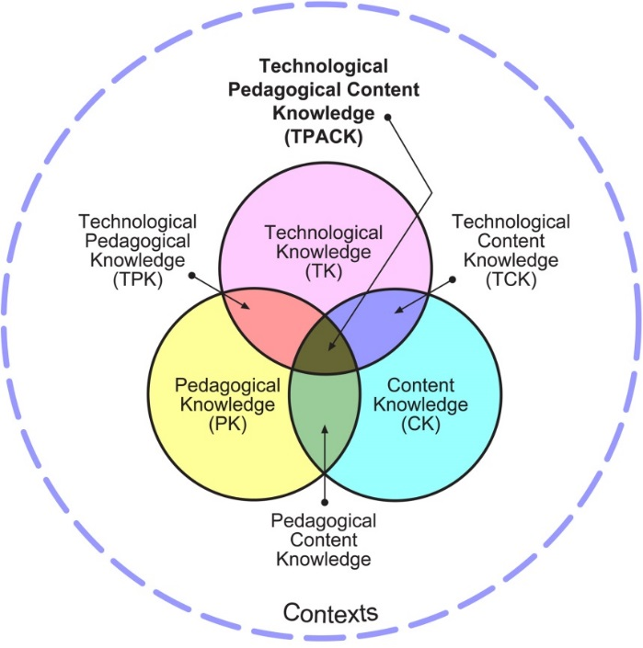
TPACK MODEL
Notes:
[15 min]
You will notice Technology Knowledge has been added to PCK, shifting the teaching area to TPACK.
This meant to make visible the presence of this powerful technology that has numerous affordances that can be used in any given teaching and learning experience.
Like any technology, users, in this case teachers, need to have knowledge of how to use ICTs for teaching.
Before they know how to, they need to know
what the technologies are
what affordances each has
to what extent these technologies can be used for educational purposes
why they would use them

Slide 21
Activity 3.4
Attend to Activity 3.4 on page 30 of your workbooks
Notes:
[15 min]
Ask the participants to turn to page 27 of their workbooks
Let them do Activity 3.4

Slide 22
Copaf
The model is based on an attempt to:
  acknowledge all levels of TPACK or ICT integration
  ensure ICT trainings apply skills and knowledge needed for the use of digital technology in a complete teaching and learning experience
Notes:
[5 min]
Teachers have gone through ICT training and a few of them have been proven to be adequate to prepare them to use these digital devices for teaching and learning. The Gauteng province has received similar reports after the training of its teachers. It is for that reason that Matthew Goniwe School of Leadership and Governance decided to develop a training model.

Slide 23
Copaf process of integration
TEACHER BAHAVIOUR
CoPAF PROCESS OF INTEGRATION
LEARNING
Full ICT Integration
What is the most appropriate technology to use for the integration of content to enhance teaching, learning and assessment?
Teacher redefines the teaching and learning environment through the integration of ICTs.
Teacher extends the repertoire of assessment methods to determine if learning has taken place.
Assessment
How will you assess if learning has happened?
TEACHING
Pedagogy
Teacher extends the repertoire of teaching methods to deliver content.
How do you plan to teach it?
Content
Teacher uses ICT as a platform for presenting content.
What content do you want to teach?
CHANGE MANAGEMENT
Notes:
[10 min]
The model was developed after observing the training of e-SSIP (Secondary School Improvement Project) offered by MGSLG.
The aim of this training is to support teachers who have been identified as having challenges with PCK and as a result, their learners are underperforming.
It is therefore important that this training tightens both CK and PK. With the influx of ICTs in Gauteng province schools, it became inevitable that this training be offered in a way that the two bullets above are captured

Slide 24
content
 | The model explains itself. To support teachers with CK, search engines and methods can be introduced to the teacher to identify different representations of the concepts which teachers are weak in. Providing instant access to information is the affordance of ICTs that can help enrich teachers’ knowledge of their subject matter. At higher levels of proficiency, teachers would create their own content using both offline and online digital resources. E-books can be accessed from laptops and the SMART Boards available in schools.
CONTENT
Notes:
[10 min]
You must have noticed that the first two components of the model have a focus on teaching and the last two has learning on the left hand side.
At content and pedagogy level the teacher is in charge and takes the position of a source and disseminator of subject matter.
The third and fourth are at a level where the learner is evidently participating in their learning by giving feedback to the teacher through assessment.
At the fourth level learners should be given new opportunities to engage with knowledge at higher thinking levels through digital technology

Slide 25
pedagogy
 | To support teachers with pedagogy, online and offline resources and models can be accessed from digital technology. In a case where pedagogical knowledge is inadequate, the following link has 50 sites you can access for guidance https://teach4theheart.com/50-best-websites-for-teachers/. Most of these provide subject specific tips that your teachers might need. In fact, you can harvest some that might work for your teacher contexts. There are a number of local sites like Mind-set that have content that is curriculum compliant
PEDAGOGY
Notes:
[10 min]
Follow the hyperlink and discuss with the participants
https://teach4theheart.com/50-best-websites-for-teachers/

Slide 26
assessment
 | Assessment is core in confirming successful teaching and learning. You know by now that there are different types of assessment. At the beginning of a learning experience, diagnostic assessments such as the following link for English can be accessed for free http://www.ef.com/test2/#/options and is handy in measuring learner prior knowledge. At a higher level, teachers can develop their own tests online using available assessment tools for different types of assessment (e.g. formative or summative assessment). Clickers and many other online tools can be used for formative assessment. Such options provide teachers and learners with immediate feedback that they can use to modify teaching and lead to better performance.
ASSESSMENT
Notes:
[10 min]
Follow the hyperlink and discuss with the participants
http://www.ef.com/test2/#/options

Slide 27
Full ict integration
 | Once the above three teaching components have been integrated, it is our belief that a teacher that has gone through this training will be able to make responsible decisions before and when using ICTs for teaching and learning. Full ICT integration at that level is achieved. It is important to note that integration at any of these levels would vary depending on the need to use them, proficiency or by choice
FULL ICT INTEGRATION
Notes:
[5 min]

Slide 28
Teacher change management
Creating a Vision
ICT readiness assessment
Sustainability processes for ICT
Stakeholder Management - Sommunication strategies
CoPs for reflection and new knowledge
Integration and learner improvement
Set and reflect on change targets
Consolidate gains for ICT change
Notes:
[15 min]
Wikipedia describes change management as “a collective term for all approaches to preparing and supporting individuals, teams, and organizations in making organizational change”.
Your work entails supporting teachers and where necessary, schools as organisations in the implementation of ICT integration.
Think about where your role would fit into this Change Management model currently used in schools.

Slide 29
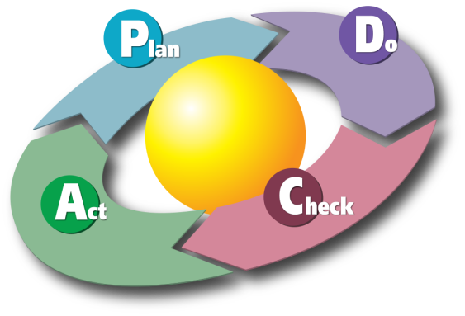
Pdca cycle coined by deming
Notes:
[15 min]
While there are many change management models that are used as guides to successful outcomes, we will use the PDCA Cycle coined by Deming.
It is a repetitive four steps that can be used to control a progressive improvement of processes.
In our case, enhancement of teaching and learning is what we should be managing.
Look at the model and start thinking about what actions you can take to ensure your teachers implement ICTs effectively

Slide 30
Activity 3.5
Attend to Activity 3.5 on page 33 of your workbooks
Notes:
[10 min]
Ask the participants to turn to page 33 of their workbooks
Let them do Activity 3.5

Slide 31
How to apply the pdac model
Full ICT Integration
What do teachers need to create learning environments that develop higher levels of thinking
Identify literature and skills needed to advance teacher integration profeciency
Assessment
Diagnose what feedback teachers need to address learning needs
Pedagogy
Identify pedagogical elements each teacher is struggling with
Content
Identify each teacher's weaknesses in subject matter
Identify online assessment tools that can help respond to learning needs
Identify websites with relevant content representations
Notes:
[10 min]
The above are just examples of what you can have in your plans to support your teachers.

Slide 32
Activity 3.6
Attend to Activity 3.6 on page 34 of your workbooks
Notes:
[20 min]
Ask the participants to turn to page 34 of their workbooks
Let them do Activity 3.6

Slide 33

The End
Thank you for participating in this module.
We trust you gained much to set the pace in integrating ICTs in learning and teaching in your school.
Notes:
[5 min]
Thank the Subject Advisors for taking part in this training

