Slide 1

INTEGRATING TECHNOLOGY IN THE CLASSROOM
Module 5: E-assessment/ Automated Assessment
“A Guide for Subject Advisors”
“If we have a passion to keep learning, a will to innovate, and a capacity to problem-solve and collaborate, we can make great things happen for the children who we serve.”
(Will Richardson, 2012)
Notes:
[2 min]
Please read the whole workbook before you go through these slides
This year the focus for full ICT schools, is to ensure ICTs are integrated into teaching and learning in the classroom
Commend these Subject Advisors for the initiative they have made to support this process
Read the quotation on the slide and discuss what it means in the context of ICT in education

Slide 2
PROGRAM OF THE DAY: MODULE 5
Time | Detail
08:00-08:04 | Welcome and Introduction, Slides 1-2
08:04-08:30 | Slides 3-10
08:30-09:30 | Slides 11-18
09:30-10:30 | Slides 19-23
10:30-10:45 | TEA BREAK
10:45-11:55 | Slides 24-29
11:55-12:35 | Slides 30-33
12:35-13:35 | LUNCH BREAK
13:35-14:25 | Slides 34-37
14:25-14:30 | PACK UP AND DEPART, Slide 38
Notes:
[2 min]
Discuss the program of the day with the participants
If the same group attends each day, only discuss slide 2
Module 5 will take 4.45 hours excluding tea and Lunch breaks

Slide 3
COPYRIGHT
This work is protected by the Copyright Act 98 of 1978. No part of this work may be reproduced or transmitted in any form or by any means, electronic or mechanical, including photocopying, recording or by any information storage and retrieval system, without permission in writing from Matthew Goniwe School of Leadership and Governance.
Notes:
[3 min]
Remind the participants that this applies to all Matthew Goniwe School of Leadership and Governance materials they receive. They must comply.

Slide 4
PURPOSE OF THE PROGRAM
The programme aims at capacitating Subject Advisors to drive and support curriculum delivery through technology-based teaching in the classroom
Their knowledge and role in the curriculum interpretation, delivery and assessment is the basis on which the technology must be utilised in supporting what happens in the classroom
Without this fundamental understanding, the use of digital technology in particular will remain trivial to the successful implementation of the of the curriculum
Notes:
[3 min]
Describe the purpose of the program to the Subject Advisors

Slide 5
Learning outcomes
The programme is intended to result in the following learning outcomes:
  Make clear what a curriculum specialist/subject advisor’s role is in the context of Information and Communication Technology (ICT)
  Provide Knowledge, Skills and Attitudes needed to operate in a digital environment as a subject specialist
  Give guidance on how best to support teachers in their delivery of the curriculum through ICT
Notes:
[3 min]
Discuss the Learning Outcomes with the Subject Advisors

Slide 6


THE 10:20:70 FRAMEWORK
FOR CONTINUOUS PROFESSIONAL TEACHER DEVELOPMENT
70% Work Integrated Learning
20 % Practice Based Learning
10% Formal Learning
Notes:
[3 min]
MGSLG uses the above framework for all its teacher professional development as an effort to promote continuous learning for its trainees.
On the right hand side of the model above, the trainer presents the theory and this is where concepts are introduced and explained.
Interaction at this level is encouraged to facilitate learning environments where learners actively participate in the learning experience.
This should occupy 10% of the time allocated for the training.
In the middle, is the practical part where learners actually practice what they have learnt in simulated or real life experiences?
Lastly, the trainee adopts the knowledge and skills in their work environment and integrates these into their practice

Slide 7
Aim of this module
To to understand the benefits of e-assessment in teaching and learning
Notes:
[5 min]
Explain to the participants the aim of module 5

Slide 8
objectives
to understand what e-assessment entails
to identify suitable online assessment tools
to meaningfully engage with online assessment tools
to know how to apply these understandings to carry out Subject Advisor’s responsibilities
Notes:
[5 min]
Read through the objectives and explain to the participants

Slide 9
Assessment of learning
Assessment of learning is usually the final phase of lesson delivery but in all honesty, it should happen before, during and then at the end of the lesson
Planning
Preparation
Lesson delivery
Evaluation of the lesson
Assessment of learning
Diagnostic
Assessment
Formative Assessment
Notes:
[10 min]
E-Assessment is the use of digital technology or ICTs for different forms of assessment.
ICTs can be used for diagnostic (before the lesson), formative (during the lesson) and in the end (summative) on the lesson.
The main advantage of e-assessment is immediacy – depending on how it is designed and for what purpose.
The information that follows provides general information on assessment, a new skill in setting multiple choice assessment questions and then introduces tools that can be used to track trends in assessment results.

Slide 10
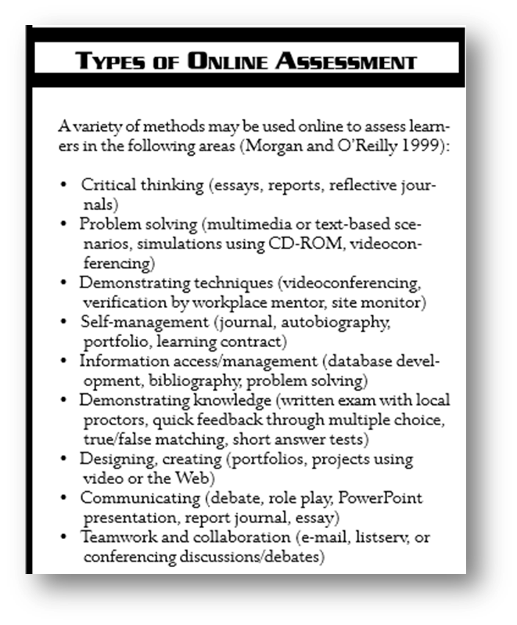
TYPES OF ONLINE ASSESSMENT

Slide 11
Online assessment tools
Today’s generation of learners are social beings who communicate, collaborate, create, co-create and connect using online technologies. This Net Generation, or Net Gens as Tapscott (2008) defines them, are a generation whose modus operandi is networking where they can let their voices be heard in the crowd. They want to be active learners rather than consumers of information. Digital platforms allow them to be prosumers rather consumers!

Slide 12
Online assessment tools
e-Assessment definitions?
Definition | Source
the use of information technology for any assessment-related activity.’ | Wikipedia: http://en.wikipedia.org/wiki/E-assessment
e-assessment as a single term describes a range of learning and assessment activities that have distinct meanings in their own contexts e.g. electronic marking, online assessment, computer-aided assessment and direct on-screen testing are all referred to as e-assessment.’ | e-Assessment Association: http://eaadev.ecomscotland.net/e-assessment-toolkit
e−Assessment is often seen as providing a partial solution to providing assessment for increasing numbers of students and declining staff to student ratios (Sim et al., 2004). | cited in Effective use of VLEs: http://www.jiscinfonet.ac.uk/InfoKits/effective-use-of-VLEs/index_html

Slide 13
Online assessment tools
e-Assessment definitions?
JISC (2007) define e-Assessment as:
‘the end-to-end electronic assessment processes where ICT is used for the presentation of assessment activity, and the recording of responses’ (p6).

Slide 14
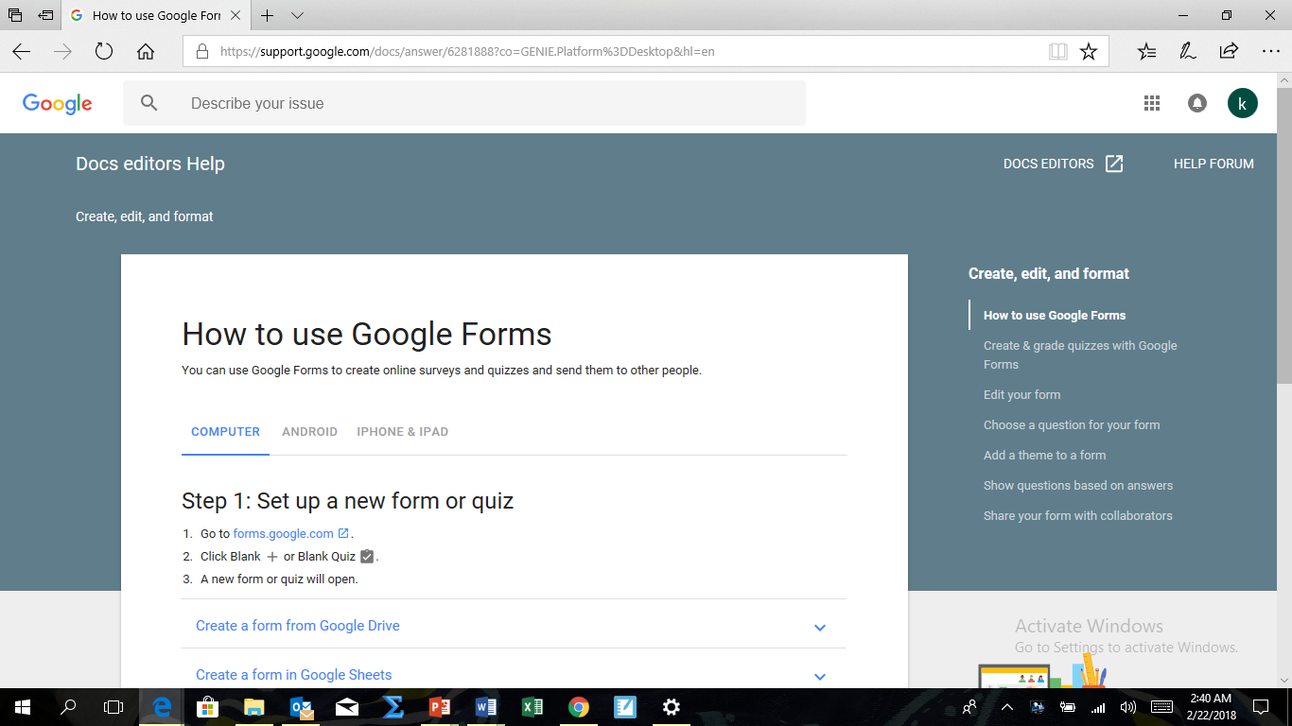
Online assessment tools
Google Forms

Slide 15
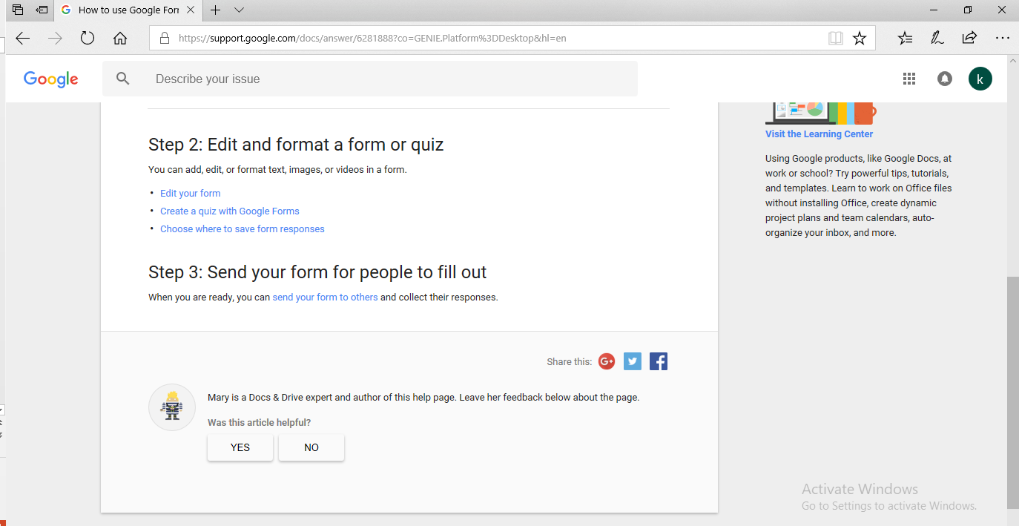
Online assessment tools
www.forms.google.com

Slide 16
Online assessment tools
Siyavula online resources
Siyavula practice service is an online tool for high school learners to practise maths and science, with:
questions that are tailored according to learners' individual ability, becoming more difficult as they improve;
immediate feedback on the questions learners tackle;
step-by-step explanations of every exercise;
a dashboard for each learner, so that they can set their own goals and track their progress; and
a teacher dashboard, so that you can track the progress of individual learners and your whole class.
All you need to access Siyavula's practice service is a computer, tablet or phone with access to the internet.

Slide 17
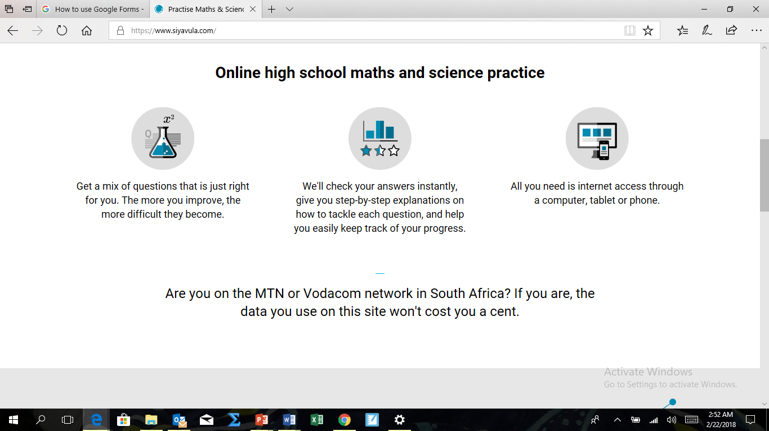
Online assessment tools
www.siyavula.com

Slide 18
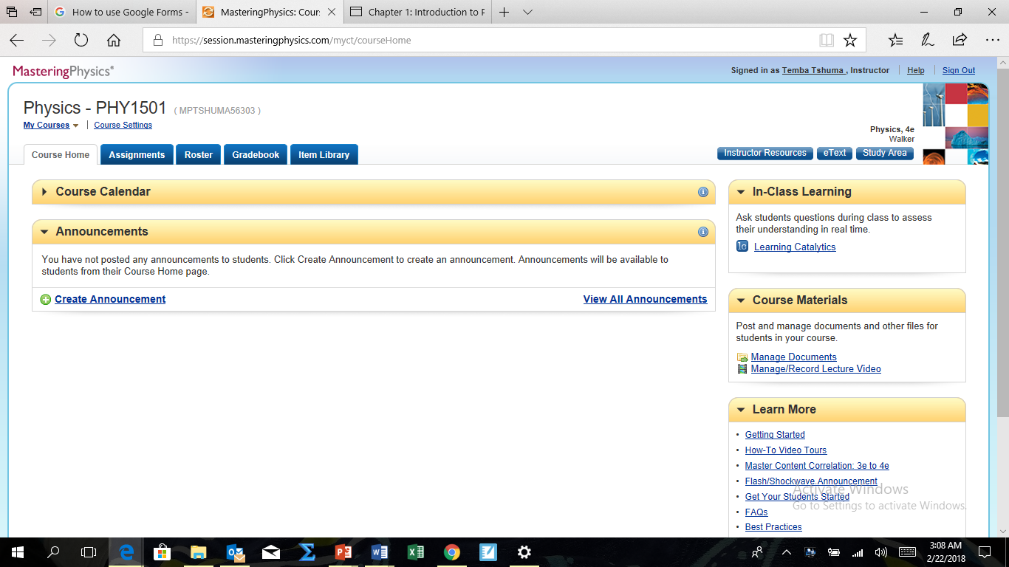
Online assessment tools
Mastering Physics/Chemistry
Based on cognitive science research, Mastering with Adaptive Learning assesses student performance and activity in real time and, using data and analytics, personalizes content to reinforce concepts that target each student’s strengths and weaknesses.
www.pearsonmylabandmastering.com/masteringphysics

Slide 19
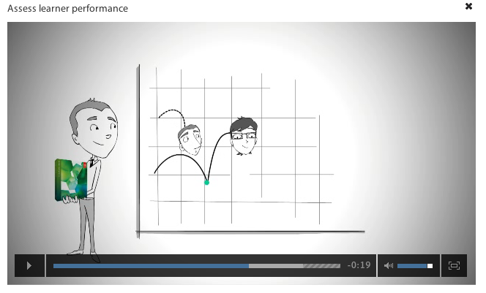
Online assessment tools
Adobe Captivate
Adobe Captivate allows educators to capture on-screen action, build quizzes and create interactive activities.
http://www.adobe.com/products/captivate.html

Slide 20
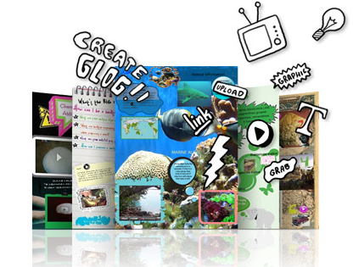
Online assessment tools
Glogster
Glogster is a tool to create online multimedia posters that incorporate multimedia.
Has a mobile app as well
http://edu.glogster.com/what-is-glogster-edu/

Slide 21
Online assessment tools
Blogs & Wikis
Blogs(logbook/diary, e-portfolio, authentication) and wikis (used for collaborative writing, projects, research findings, group work) can be used as tools for learners to record their learning journeys, reflect upon learning and evidence content. These tools can be used as a method of tutor, peer or self assessment.
http://www.slideshare.net/jasondenys/wikis-and-blogs-in-education

Slide 22
Online assessment tools
Mindmaps
A Mind Map is a highly effective way of assimilating external information, in the format of symbols, words, colours and images, into the brain's memory system. A Mind Map also works the opposite way by enabling internal thoughts and information to be transferred into a highly organised visual diagram. Originated in the late 1960s by Tony Buzan, Mind Maps are now used by many in all areas and stages of Education to enable users to visualise their thinking.

Slide 23
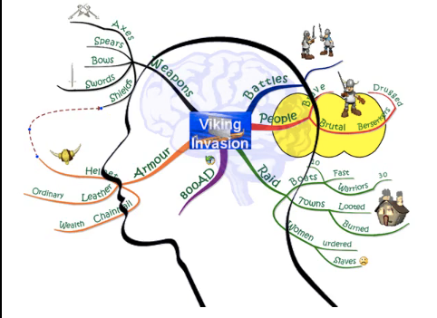
Online assessment tools
Mindmaps
Explore the different online Mind Mapping tools:
http://www.gliffy.com ; https://bubbl.us; http://creately.com/
http://www.exploratree.org.uk

Slide 24
Online assessment tools
VoiceThread
A VoiceThread is an online media album that can hold essentially any type of media (images, documents and videos) and allows people to make comments in 5 different ways – using voice (with a microphone or telephone), text, audio file, or video (with a webcam) – and share them with anyone they wish. A VoiceThread allows group conversations to be collected and shared in one place, from anywhere in the world.
http://webinars.voicethread.com/

Slide 25
Online assessment tools
Wallwisher
Wallwisher is an Internet application that allows learners to post their thoughts on a common topic using electronic sticky notes on a shared digital wall. Learners can type a maximum of 160 characters per electronic sticky note that can incorporate an image, audio or video using the appropriate web address link.
Wallwisher provides a collaborative area online where learners can contribute to learning anonymously or authored. Learners’ contributions can be made synchronously (during teaching inputs) and displayed immediately to the whole cohort or asynchronously (anytime, anyplace, anywhere) with the added bonus of learners being able to access the collaborative area after the input to assimilate the information gathered

Slide 26
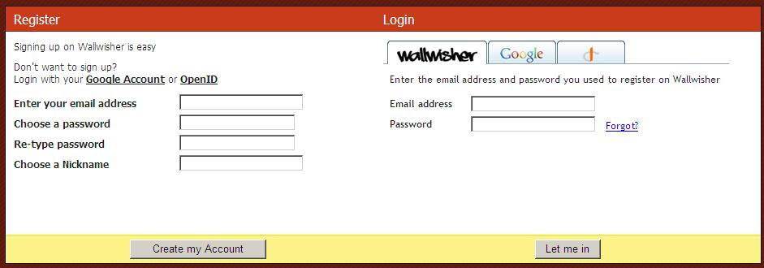
Online assessment tools
Wallwisher
http://wallwisher.com/

Slide 27
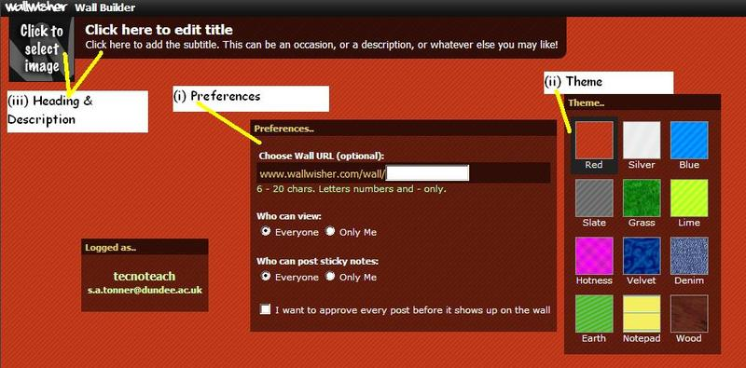
Online assessment tools
Wallwisher
http://wallwisher.com/

Slide 28
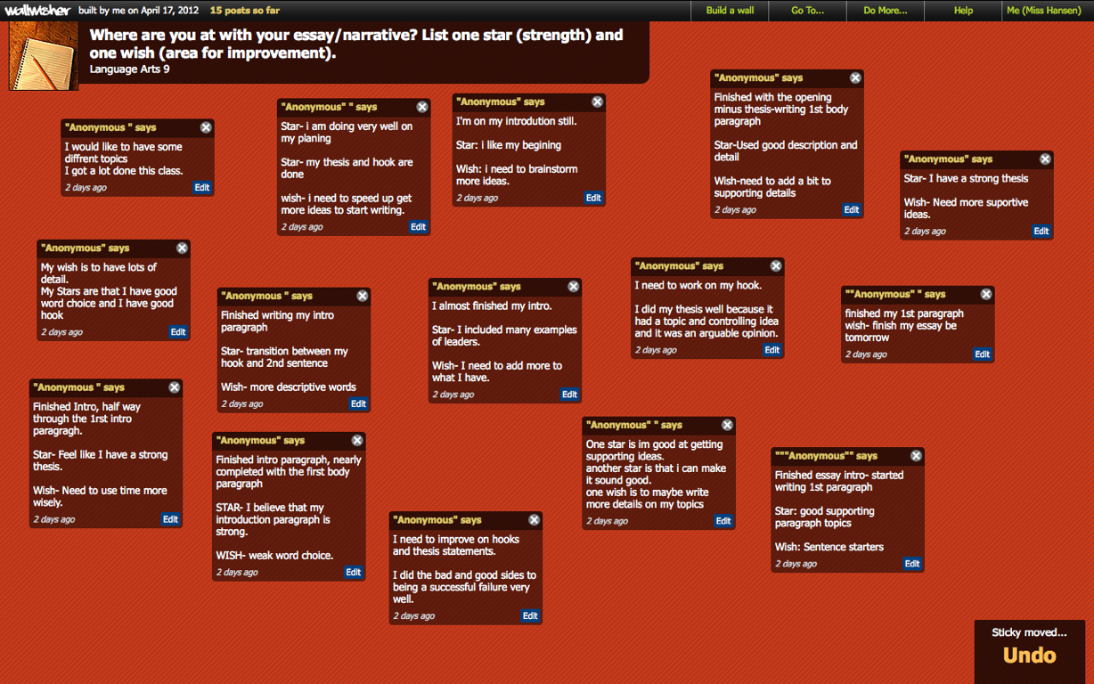
Online assessment tools
Wallwisher
Wallwisher allows learners to provided collaborative feedback in the format of electronic post-its.
http://www.freetech4teachers.com/2011/10/using-wall-wisher-in-classroom.html#.Wo4CSUxuLIU
http://wallwisher.com/

Slide 29
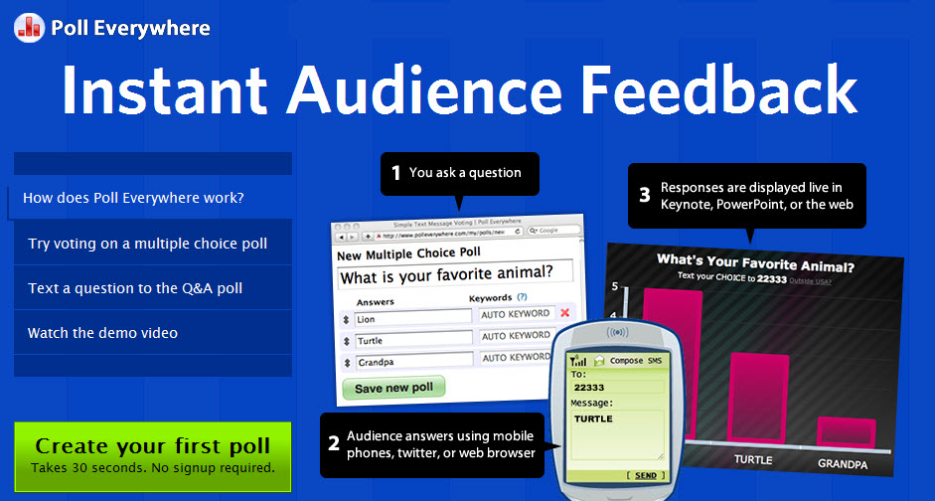
Online assessment tools
Response System
Poll Everywhere is an online question and response application that allows teachers to post questions to students during a lecture scenario and receive live feedback through students using portable devices that have internet capability.
http://www.polleverywhere.com/

Slide 30
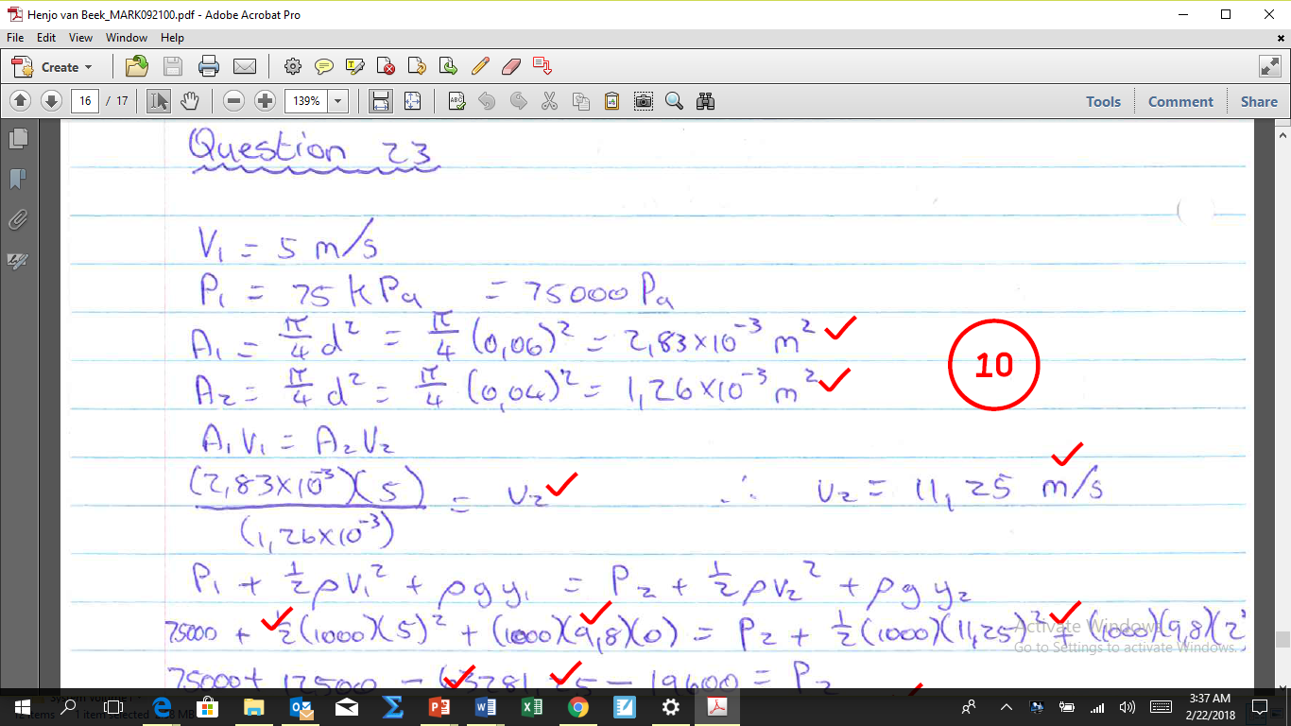
Online assessment tools
Adobe Acrobat Pro & J-router
This is an online and offline marking tool that works with pdf documents and allows paperless assessment of learners’ work.

Slide 31
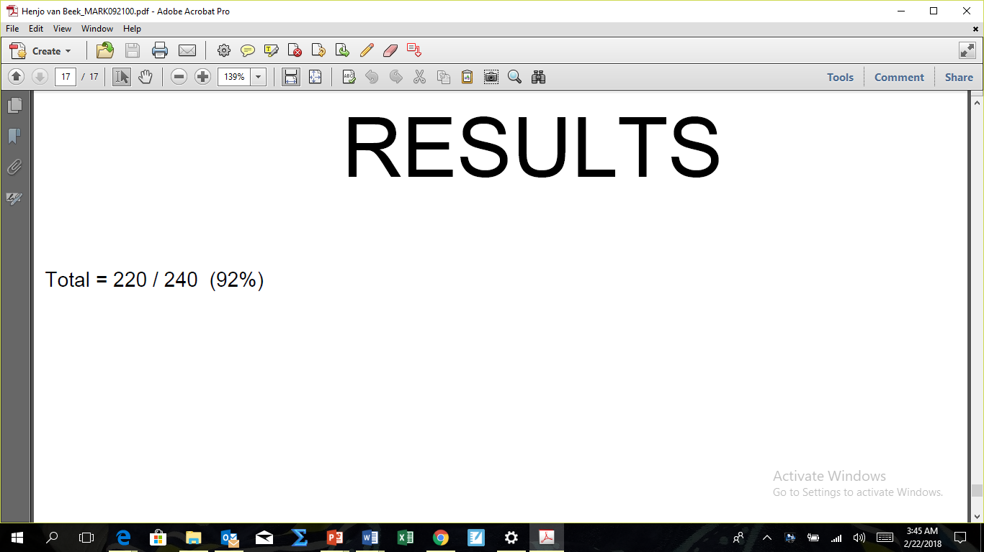
Online assessment tools
Adobe Acrobat Pro & J-router

Slide 32
Online assessment tools
e-Assessment: Tools
Activity
Explore , categorise and evaluate the variety of e-Assessment tools in the table below
Tool | Formative/Summative/ Diagnostic? | Evaluation

Slide 33
Online assessment tools
Advantages & Disadvantages of e-Assessment
Advantages (Assesses) | Disadvantages(Barriers)
Metacognition | Reliability
Group projects | Plagiarism
Creativity | Equity
Communication skills | Technical Skills
 | ICT infrastructure
 | Examination process

Slide 34
Online assessment tools
Self Assessment Task
Through undertaking this module you should have knowledge and understanding of:
1. What is e-Assessment;
2. What, why and how to assess;
3. Different online tools for assessment purposes;
4. Advantages and disadvantages of e-Assessment.
Your task is now to choose one of the e-Assessment tools to reflect upon the today’s learning outcomes in relation to your personal development of e-Assessment.

Slide 35
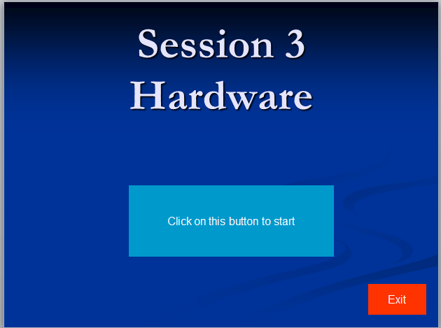
Offline assessment tool
Claudette’s PPP

Slide 36
Advantages of ICTs when used for assessment
Automatic scoring
Variety of test methods can be used
Repetitive marking is a thing of the past
Once the test is set, can be used again
Learners get immediate feedback
Storage of completed assessments on the server
Timing of assessment, if speed is important
Notes:
[10 min]
Discuss some of the advantages of ICTs when used for assessment

Slide 37
ASSESSMENT TASKS SUITABLE FOR ICTS
indicate if an answer is ‘true’ or ‘false’
matching columns
fill in the missing word
drag and drop the correct answer
circle or underline the correct answer or cross out the incorrect answer
label a diagram or map
add the missing information to a document
enter data into a spreadsheet and
multiple choice
Notes:
[10 min]
A number of test formats can be set and used very effectively by the teacher. These include:

Slide 38
Assessment tasks - concern
Can online assessment test higher cognitive levels?

Slide 39
MCQs: definition
A multiple choice test item consists of the following:
  An incomplete statement (the stem)
  Four or five possible answers of which only one is correct and that is called the key
  The incorrect answers are called distractors. They must be definitely but not obviously wrong
  The learner must choose the answer he or she regards as correct
Notes:
[5 min]

Slide 40
Criteria for multiple questions
STEM | Must be clearly formulated Avoid giving grammatical clues in the stem The stem and possible answers should flow grammatically Should contain as much of the wording as possible
ANSWERS | Only one correct answer Incorrect answers should be plausible There should be 3-5 options
AVOID | Do not use the option "none of the above" Do not use the option "all of the above" Do not write a question in the negative (E.g. Which of the following is NOT ...)
Source: Kühn. 2014
Notes:
[5 min]
Herewith a guide on how to set good questions

Slide 41
Setting up multiple questions
ANIMALS AND US
Why do people love watching the monkeys in the zoo? Do we perhaps laugh because we recognise ourselves in them? Man is himself an animal, after all, and some animals can be all too human. | 1
Have you ever wondered what our pets think when they watch us? Do they see us as humans, or do they, perhaps, regard us as big cats or dogs or canaries? | 2
Take cats, for instance. They say that the relationship of the human to the domestic cat is that of the mother cat to the kitten. When a cat is hungry, it rubs up against the legs of its owner, like in the wild, thirsty kittens rub up against the mother’s legs to get her to lie down and nurse. | 3
Wild dogs, unlike the wild cats that hunt alone, are pack animals. They like to follow a strong leader. The domesticated dog seems to take his owner as the pack leader rather than as a mother, and if allowed, will follow him everywhere | 4
Tame animals are followers, not leaders. In the wild, however, many animals reveal great responsibility, particularly when it comes to education their young. | 5
Foxes go to much trouble to educate their cubs. The father plays with them, teaching them how to co-ordinate their muscles and senses. The mother makes them jump to “catch” food from her mouth while moving her head up and down. Later she takes them hunting and shows them how to make a kill. | 6
Hippo mothers are very caring. When foraging for food, they leave their babies in the care of a “baby-sitter” to enable them to find food on their own. | 7
Unfortunately, not all animals are good parents. Some species neglect their young. In this, too, animals seem all too human. | 8
Notes:
[10 min]
The information provides guidance in setting multiple choice questions for assessment.
These are based on a short piece of information so that you can see very clearly how the questions are devised

Slide 42
Hints for multiple questions
Choose the distractors carefully so that they will appear correct to candidates who do not have the knowledge to answer the question correctly. Include the mistakes you know the weaker learners are likely to make.
Resist the temptation to describe the correct answer better and in more detail than the distractors. Answers should be more or less the same length.
Notes:
[10 min]
Discuss the examples on page 45-46 of the workbook in terms of multiple questions

Slide 43
Engaging higher levels of thinking
Webquest Template

Slide 44
Activity 5.1 – e-Portfolio
Reade through Page 46 and 47 (5.4.8 – 5.4.9) first
Attend to Activity 5.1 on page 47 of your workbooks
Due date: 27 October 2017
Notes:
[30 min]
Ask the participants to turn to page 47 of their workbooks
Let them do Activity 5.1

Slide 45

The End
Thank you for participating in this module.
We trust you gained much to set the pace in integrating ICTs in learning and teaching in your school.
Notes:
[5 min]
Thank the Subject Advisors for taking part in this training

