Slide 1
MGSLG Course Manager's Training
MG Online Course Delivery
Andrew Moore
2021/02/24

Slide 2
Getting started with an online synchronous meeting or webinar
MGSLG: Course Manager's Training

Slide 3
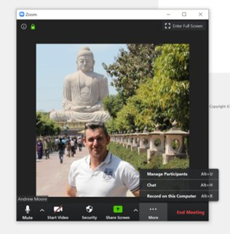
Meeting protocols
Note: Your microphone has been automatically turned OFF. Please leave it off.​
Note: Your video cam has been automatically turned ON, we want to see you.​
If you have a question, type it in the chat facility and the back-channel manager or Facilitator will respond.
Note we will also be using Zoom’s Polls and Breakout Rooms
3
1
2
MGSLG: Course Manager's Training​

Slide 4
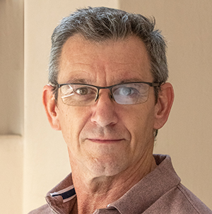
Introductions I
Your Facilitator
Andrew Moore completed a M.Ed. degree specialising in Computer Assisted Education at the University of Pretoria in 2002. He also has 14 years' experience of teaching secondary education in Cape Town (Westerford High), Durban (Kearnsey College) and Johannesburg (St Stithian's College) where he was appointed Director of IT (Academic). He is a senior manager at Neil Butcher and Associates (NBA), an educational technology consultancy firm based in Johannesburg South Africa. He has worked as an author, materials developer, instructional designer, web interface designer and educational technology trainer. He is currently a project manager supporting projects that exploit Open Education Resources (OER), the UNESCO ICT Competency Framework for teachers (CFT) and technology for Education Ministries, and both Higher and Primary Education institutions. These institutions have been spread around the developing world including West, East and Southern Africa, India, the Philippines, Oman and the Caribbean.
Access
Access
Andrew Moore
E-learning Specialist
Course Coordinator
Access
MGSLG: Course Manager's Training​
MGSLG: Course Manager's Training​

Slide 5
Introductions II
You and your colleagues
Turn your cam on introduce yourself to the facilitator and your peers:
Who are you?
What MGSLG course are you connected to?
Rate your proficiency with supporting remote learning.
Tell us something personal that others don’t know?
MGSLG: Course Manager's Training​
MGSLG: Course Manager's Training​

Slide 6
Expectations
MGSLG: Course Manager's Training​

Slide 7
Terminology
Asynchronous learning
Synchronous learning
Learning management system (LMS)
Bichronous
Moodle
MG Online
MGSLG: Course Manager's Training​

Slide 8
Why go Blended Learning or Bichronous?
MGSLG: Course Manager's Training

Slide 9
Rationale for course managers
COVID-19 / social distancing (When will this one end and when will the next pandemic arise?)
School closures / strikes (Professional development can proceed in spite of physical disruptions.)
Attract broader audience from outside GP (New business model frees MGSLG from GDE procurement constraints.)
Allow for greater flexibility for teachers (…particularly those educators who cannot make scheduled workshops.)
Provides time for consolidation of skills (PD done over a longer period allows for the assimilation and consolidation of skills.)
Cost effective (Despite initial costs of development – cost effective in the long run.)
MGSLG Managers’ Training

Slide 10
What does the asynchronous training (MG Online) look like?

Slide 11
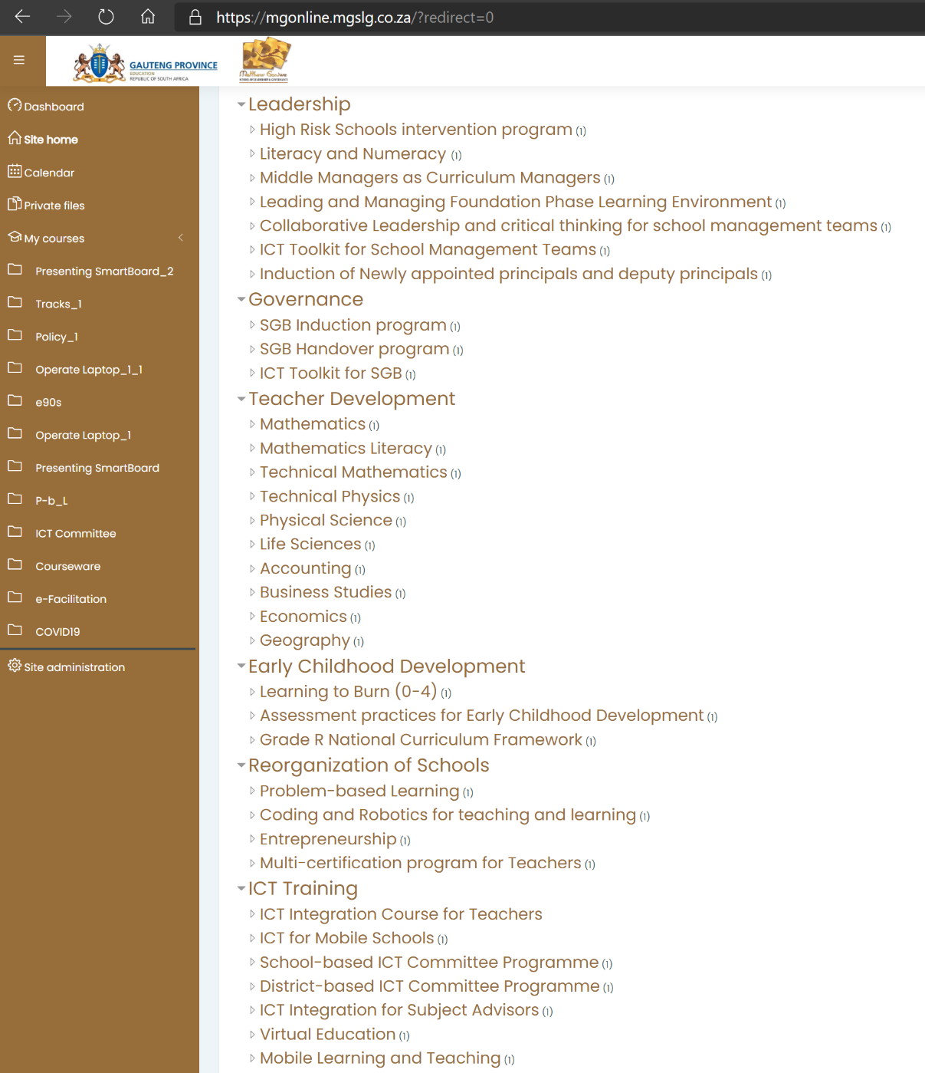
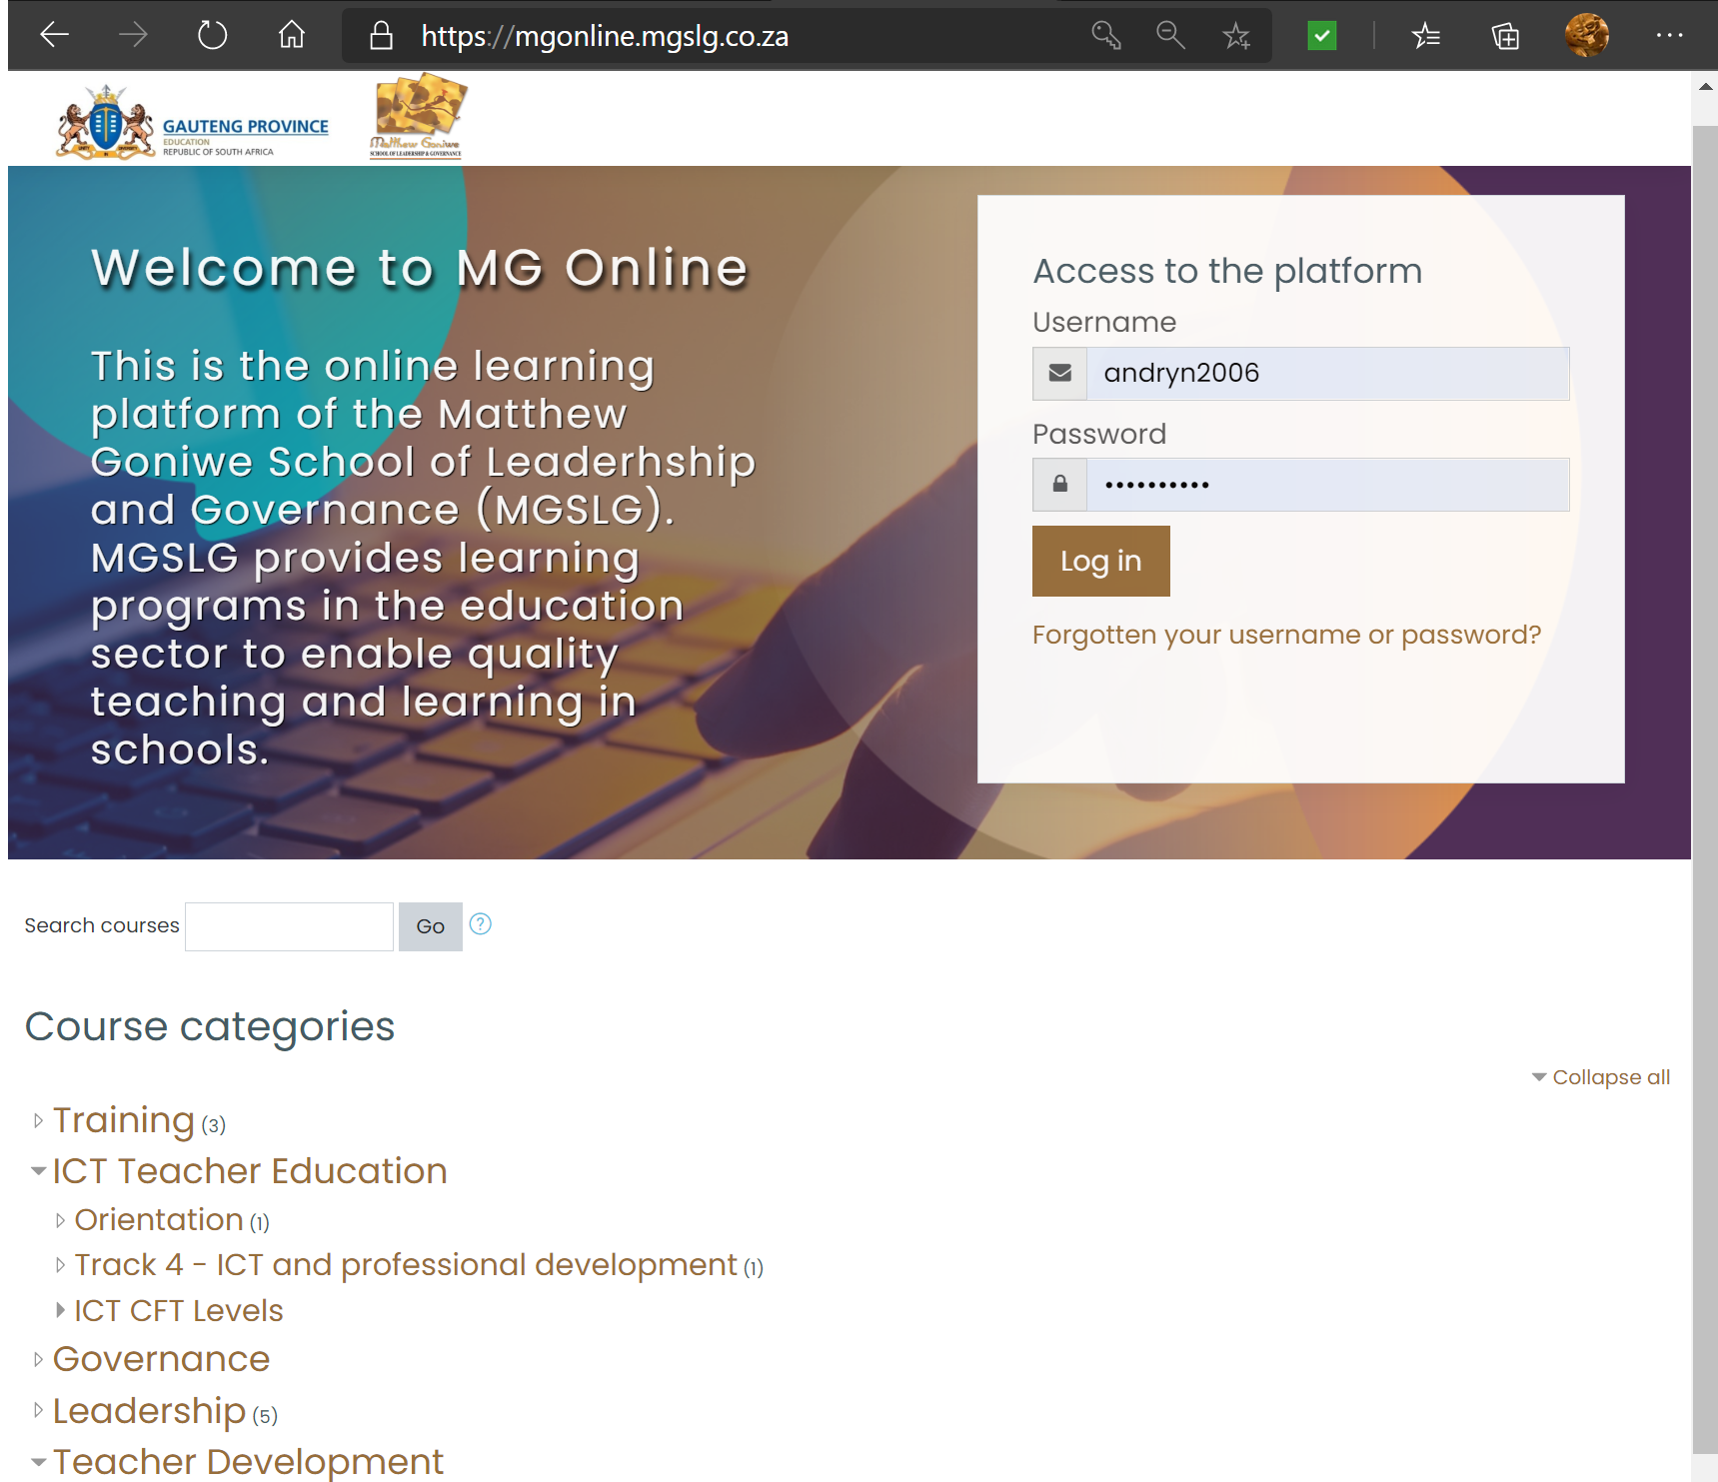
MG Online Moodle interface
MG Online’s web address
New categories: waiting for MGSLG list of divisions and potential courses to be offered. Categorisation is adaptable as new courses are available
Authentication of all users
MGSLG Managers’ Training

Slide 12
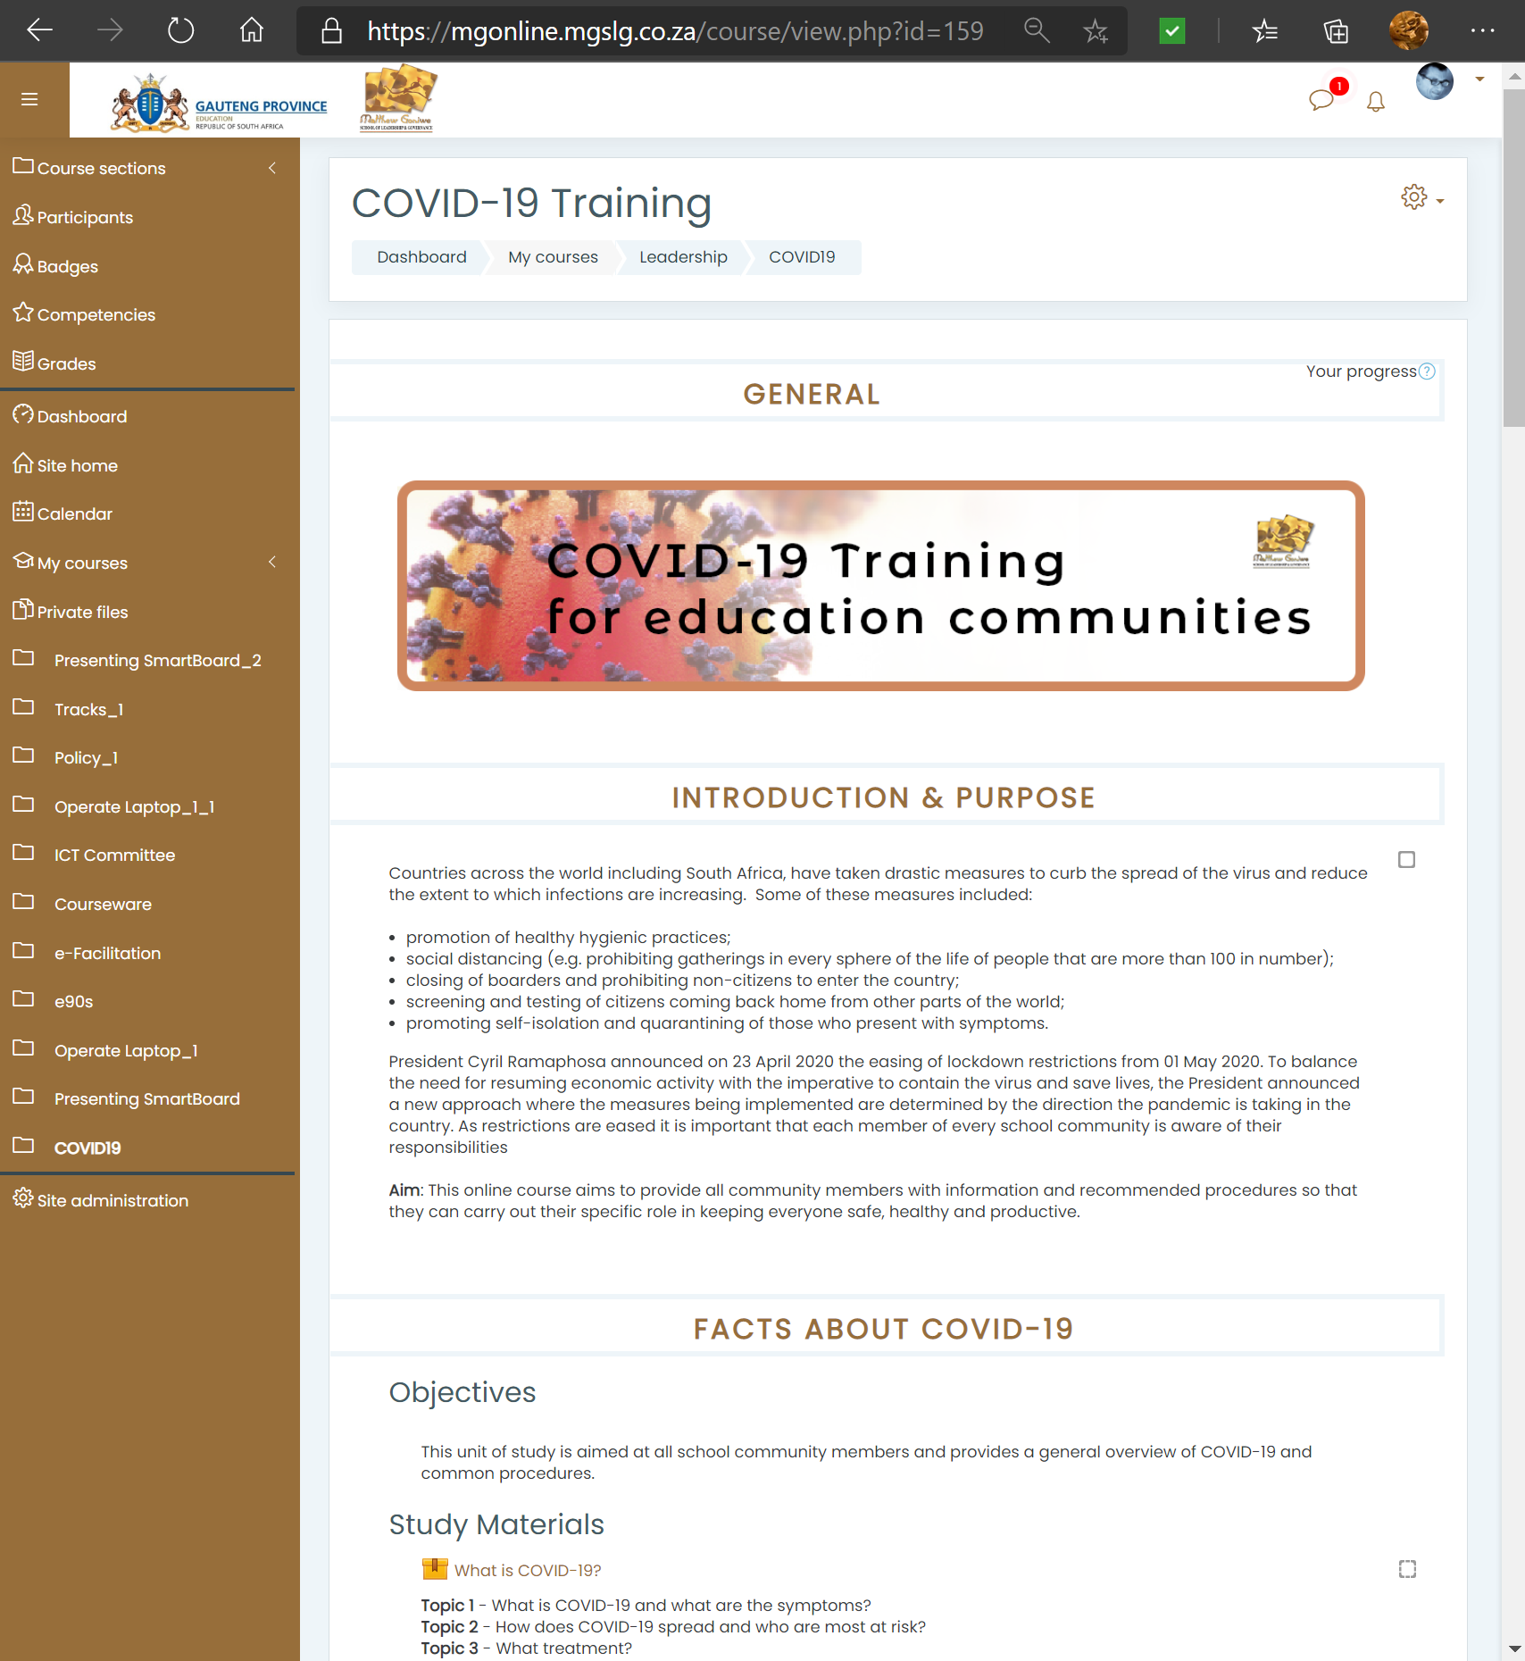
MG Online’s Moodle interface
Users are ‘authenticated’ and tracked
Typical course landing page and navigation panel
Course ‘learning pathway’ with content and activities
MGSLG Managers’ Training

Slide 13
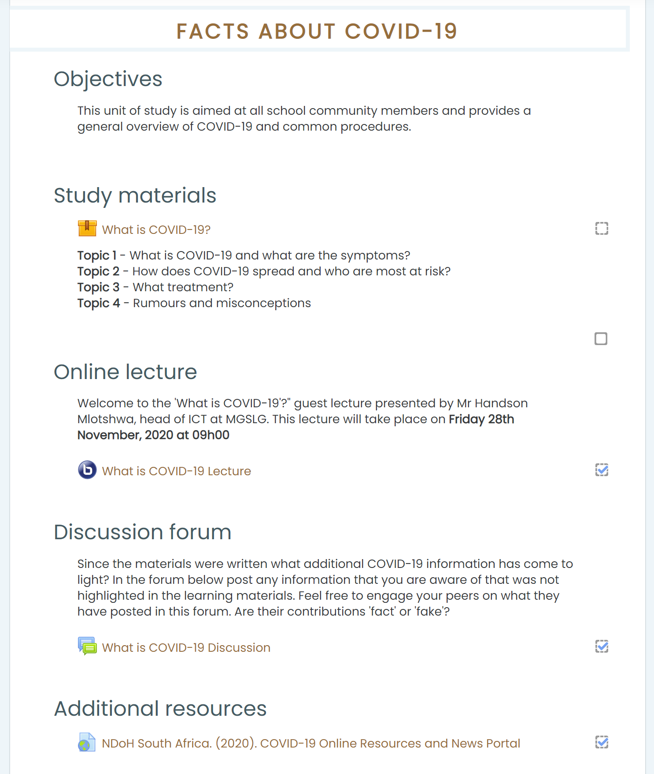
Moodle interface
Additional functionality (not shown in diagram):
Tests and exams
Submission of assignments
Chats
Grading and term marks
Automated certificates
Interactive learning materials with online tasks, quizzes, videos and animations authored in Articulate Rise360
Real time, ‘synchronous’, sessions using BBB or Zoom. Recordings available in Moodle after live session
Participant tracking for logged in users. Possible to determine progress and unlock specific features such as certificates.
‘Asynchronous’, discussions for logged in users
MGSLG Managers’ Training

Slide 14
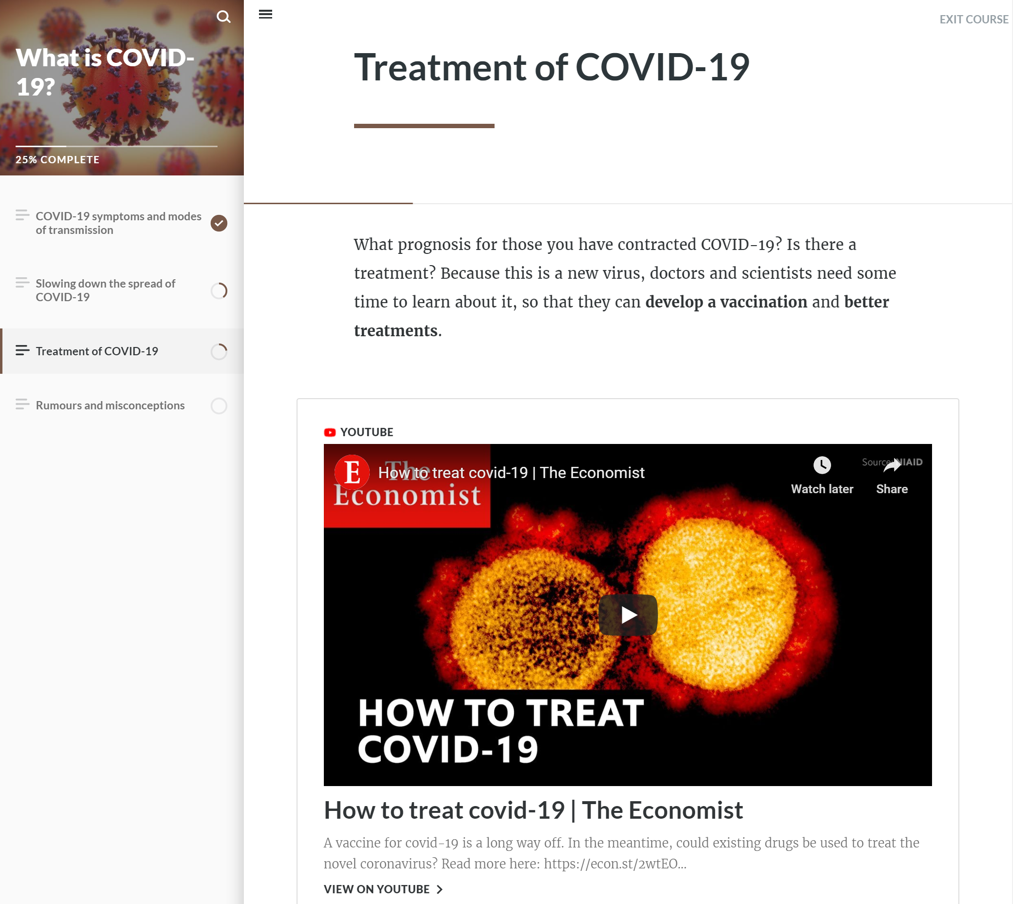
Rise360 interface
Progress indicators
Navigation panel
Video clips from YouTube/Vimeo.
Can also include graphics, images, Vyond animations etc.
MGSLG Managers’ Training

Slide 15
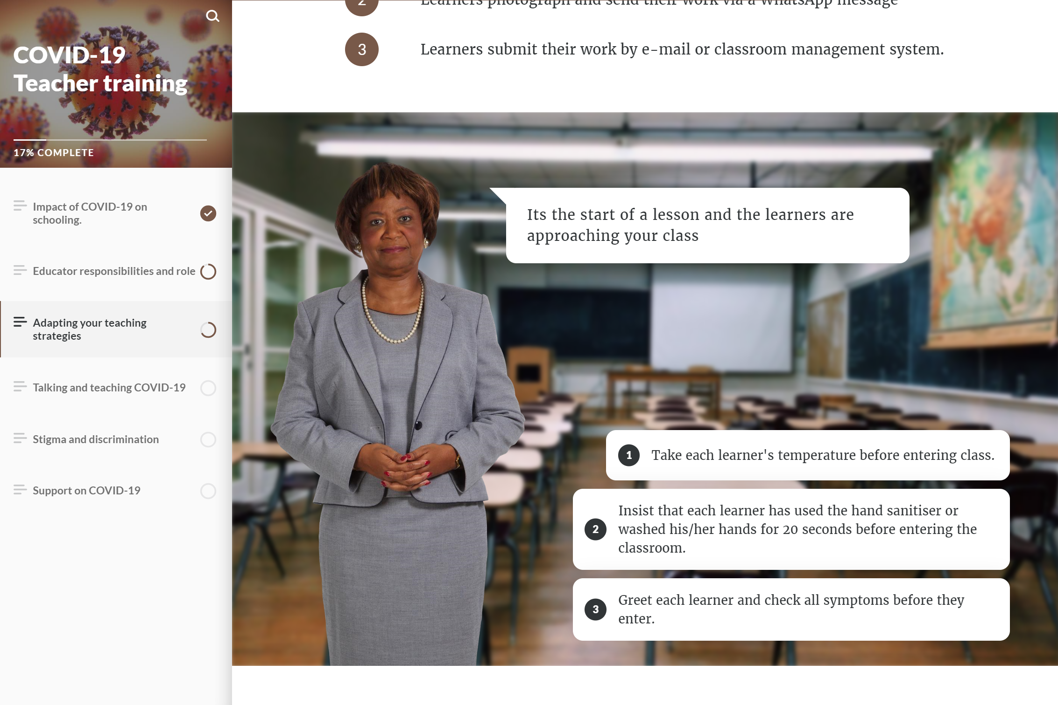
Rise360 interface
Scenario activity uses branching questions
MGSLG Managers’ Training

Slide 16
Rise360 interface
Interactive elements such as sorting activities, flip cards, and quizzes
MGSLG Managers’ Training

Slide 17
Vyond animations
MGSLG Managers’ Training

Slide 18
Breakout room discussion
Any fresh ideas about how you might host your course online? Discuss ideas and then report back to the whole group
MGSLG Managers’ Training

Slide 19
Introduction to the asynchronous component of the study

Slide 20
Asynchronous study requirements
Can you access the course materials?
Username and password?
Four hours of asynchronous study
Progress tracking – Forum, Quiz, Questionnaire
Do you want a certificate? (Poll)
Course: MG Online Course Manager's Training (mgslg.co.za)
MGSLG Managers’ Training

Slide 21
Meet you back in Zoom at 15h00 tomorrow for the final synchronous meeting.

Slide 22
MG Online Course Manager’s Training

