Slide 1
SSIP April – May 2020
LIFE SCIENCES
Topic(s) :GENETICS
Venue:

Slide 2
SSIP AIMS/GOALS
The four interconnected outcomes that drive the professional development activities for SSIP are:
Enhancing Teachers knowledge: deep understanding of subject matter knowledge and students ideas on the content
Enhancing quality teaching and assessment for learning: effective instructional approaches that teachers may use to ensure improved understanding by most learners.
Developing ICT integration skills :Use of ICT to improve teaching and learning
Building professional learning communities: allow teachers to start collaborating and form professional networks in non-formal settings in context of their schools

Slide 3
MODULE 1
Overview of Module 1
In this module we will look at the basic concept of genetics
Content
You will study this module through the following units:
Unit1: How do we take images from past papers and use it in our own worksheets and/or question papers?
Unit 2: How do we teach terminology and what are the different kind of monohybrid crosses?
Unit 3: What are sex linked diseases and how do we determine sex?
Unit 4: What are the different blood groups and the genetics behind it?
Unit 5: What are dihybrid crosses and how do we solve it?
Unit 6: What are pedigree diagrams and how do we solve it?
Unit 7: What are mutations and genetic engineering and what are the applications of this?
Notes:
Give an overview of the module and give the key content and or index that you will be covering in the Module

Slide 4
OUTCOMES OF THIS MODULE
By the end of the session, participants will be able to:
Be able to take a diagram from pdf document, modify it and insert it into new document.
Solve monohybrid crosses for complete, incomplete, co-dominance, sex-linked diseases and blood groups.
Calculate ratios and percentages of the genotype and phenotype of the F₁ and F₂ generations.
Solve dihybrid crosses.
Read and solve pedigree diagrams
Classify questions on the different levels of Bloom’s taxonomy and degrees of difficulty.
Administer and assess the gr.12 SBA task on genetics.
Answer questions on mutations and genetic engineering.
Introduce genetics as a topic in a fun way to learners.
Notes:
Please state these very simple and explicit and in the FG you may ask one participant to read those out loud and make sure they are linked to the activities that you have in the Manual.

Slide 5
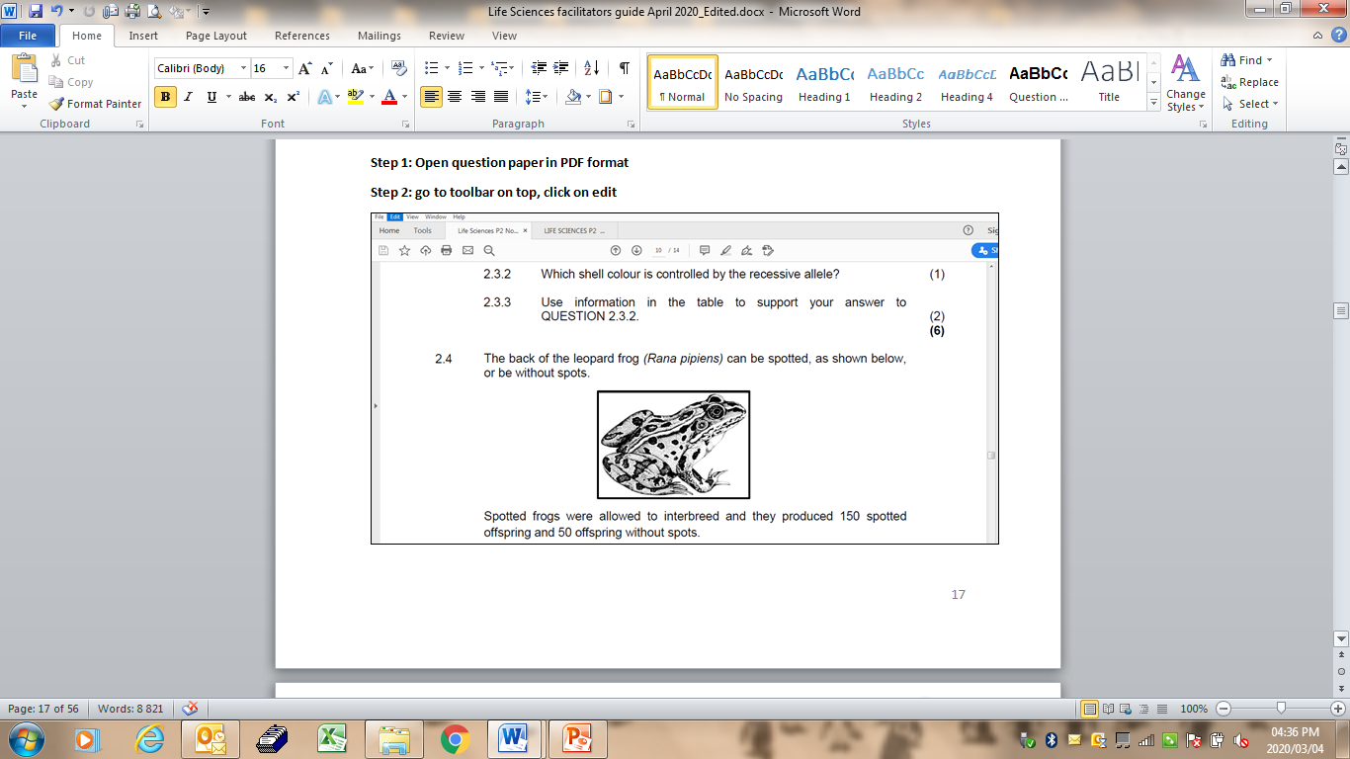
UNIT 1 - How do we take images from past papers and use it in our own worksheets and/or questions papers?
Refer to page 15 in your participants manual.

Slide 6
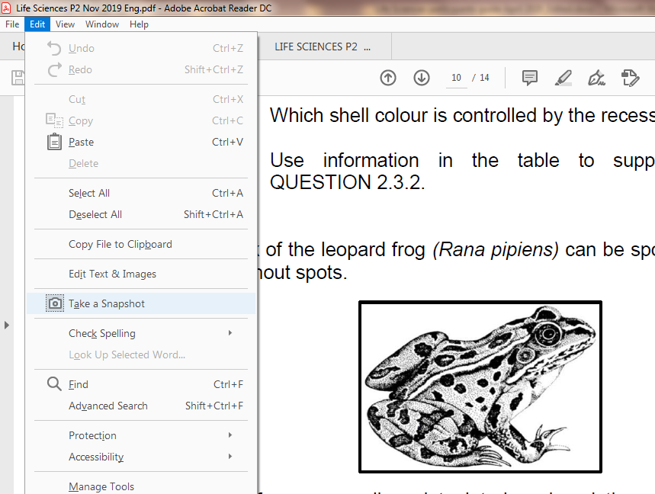
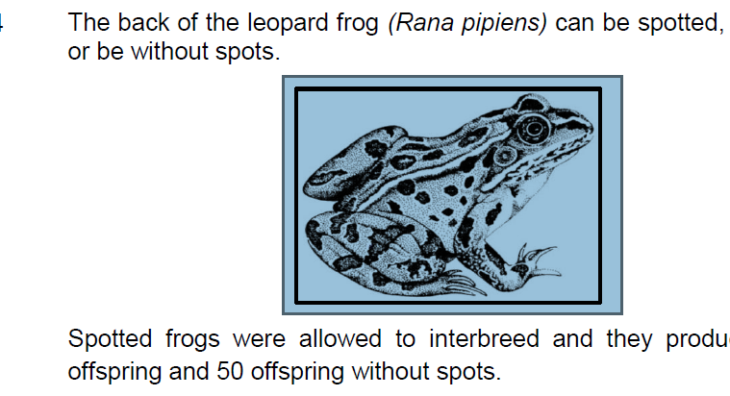
Step 3: Click on snapshot
Step 4: Highlight the diagram
Step 5: Open Paint on your computer

Slide 7
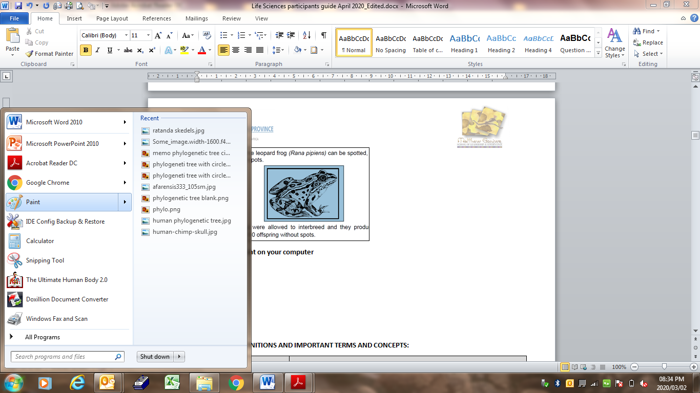

Step 5: Open Paint on your computer

Slide 8
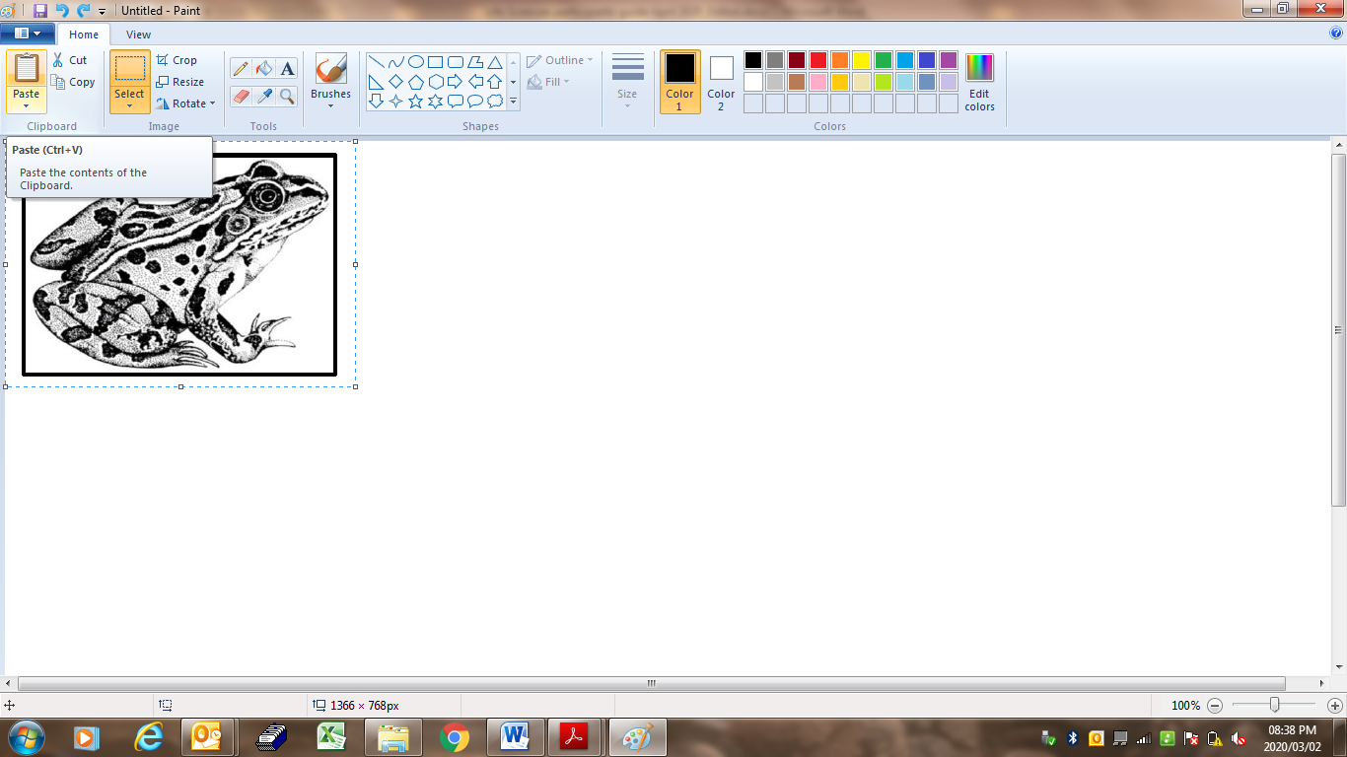
Step 6: Click on Paste
You can do many things with this program.
you can add a shape, colour in certain parts.
You could rotate it and type in labels and add label lines.
All you have to do is click on the icon in the toolbar.

Slide 9
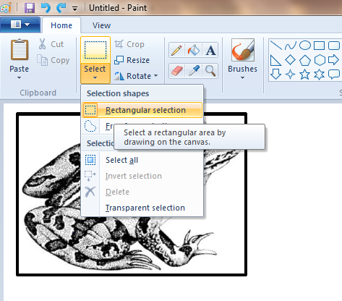
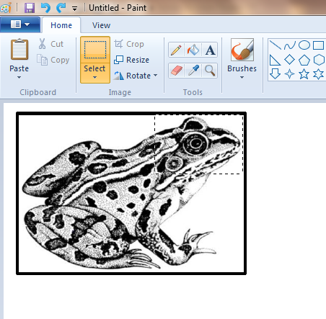
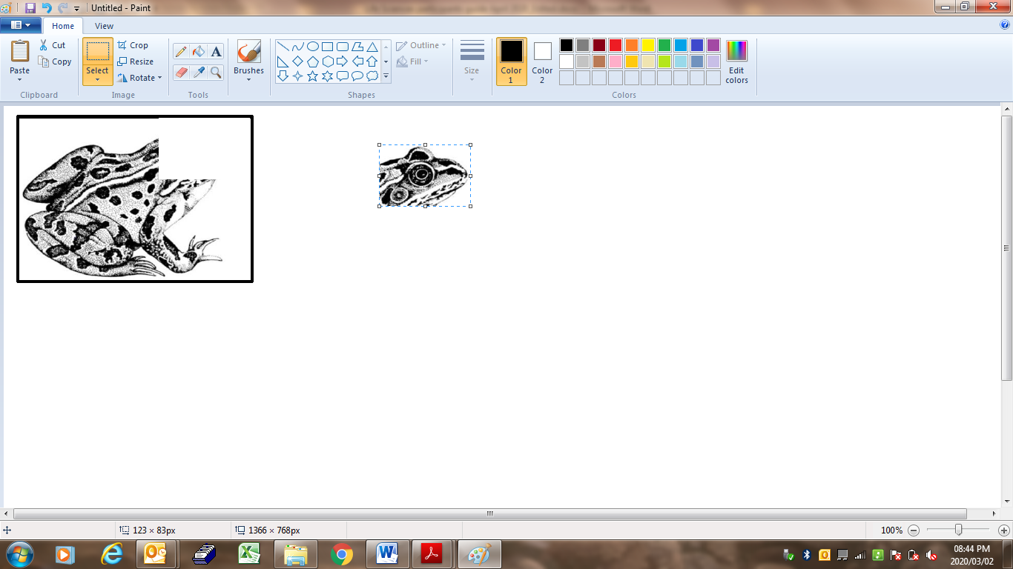
Step 7: Now you can make the desired changes.
Say for example we are only interested in the head of the frog.
Click select, rectangular
and highlight the head.
Then move the selection to the side

Slide 10
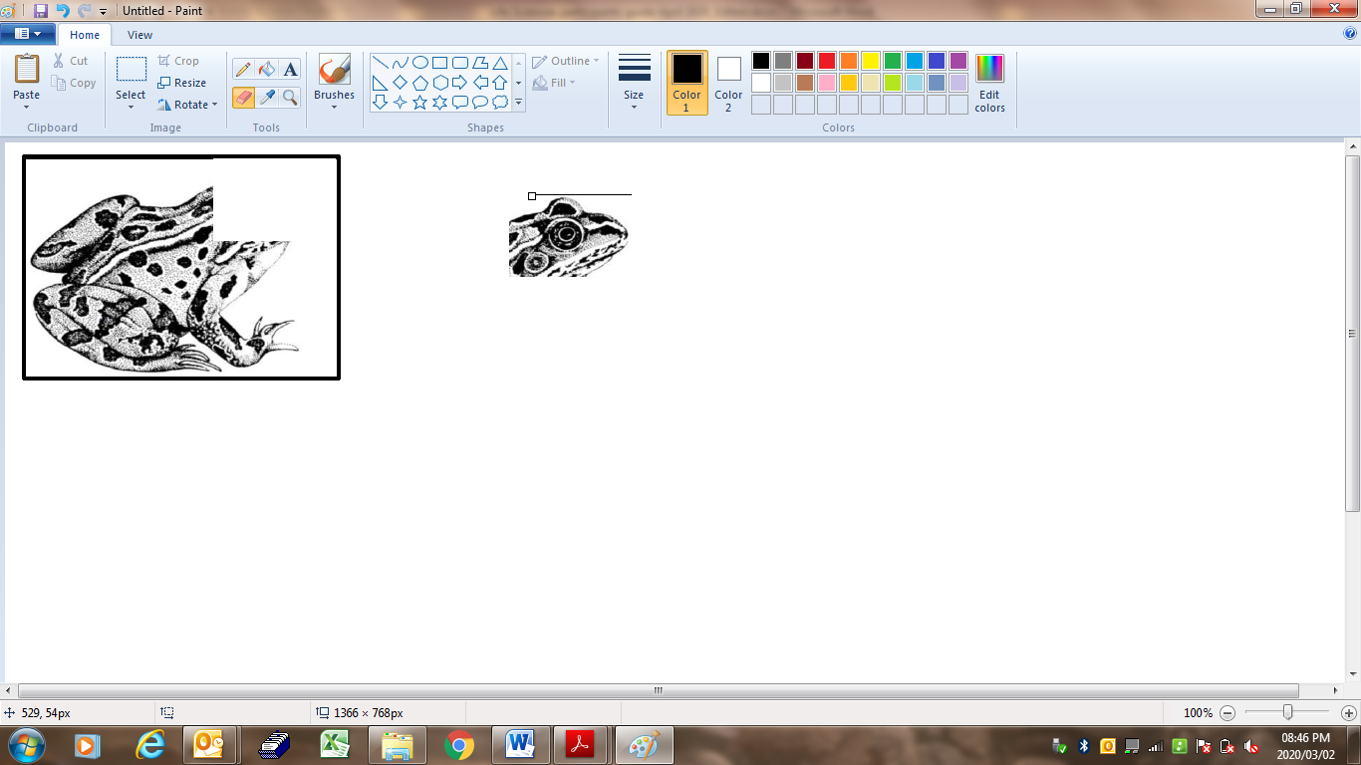
Step 8: There is a line, rub the line out with the rubber.
Select the rubber and rub the line out.

Slide 11
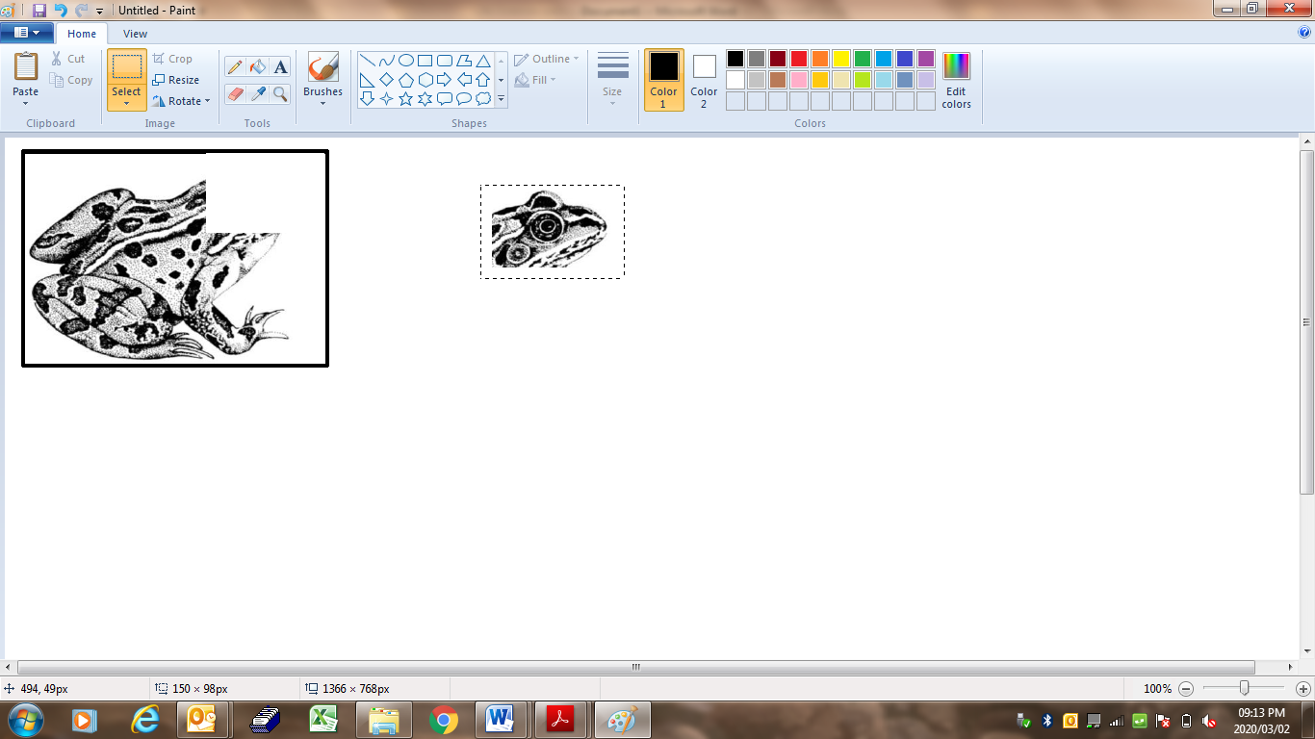
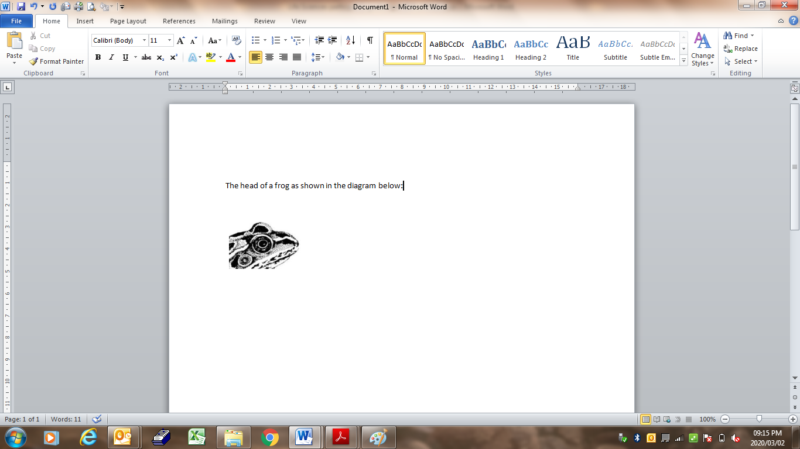
Step 9: Select the head and click on copy
Step 10: Go to the document where you want to insert the diagram
(head) and paste it in the position where you want it

Slide 12
ACTIVITY 1.1 (p.22)
Select a diagram or graph from a question paper. Insert it into paint.
Make any changes on the diagram and paste it onto a word document (or blank word page).

Slide 13
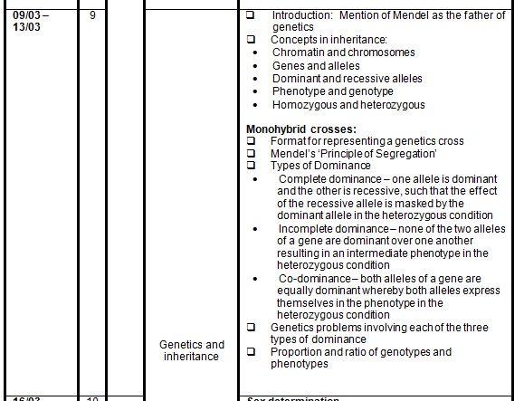
ATP

Slide 14
UNIT 2: GENETICS TERMINOLOGY
Monohybrid cross
Only one characteristic/hereditary trait is investigated at a time.
Mendel’s Law of Segregation
Each characteristic is regulated by two alleles/factors which separate during meiosis so that each gamete contains only one of the alleles/factors.
Mendel’s Principle of Dominance
When two individuals with pure breeding contrasting characteristics are crossed,the F₁-generation all display the dominant characteristic.

Slide 15
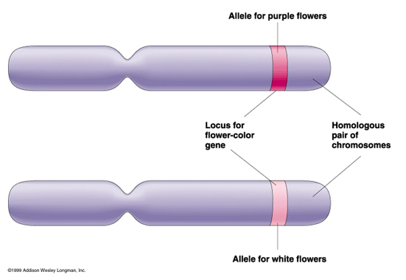
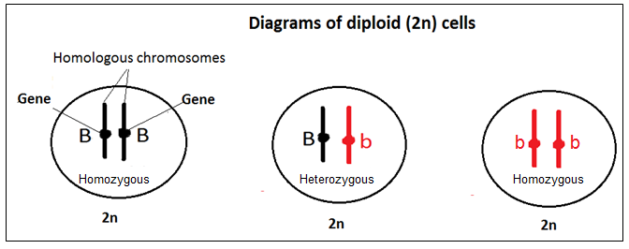
Terminology
Allele: alleles are alternate forms of a gene localised on the same locus on homologous chromosomes.
If alleles of the same characteristic are both the same, the organism will be homozygous for that characteristic. If the alleles for a characteristic are different the organism is described as heterozygous for that characteristic.

Slide 16
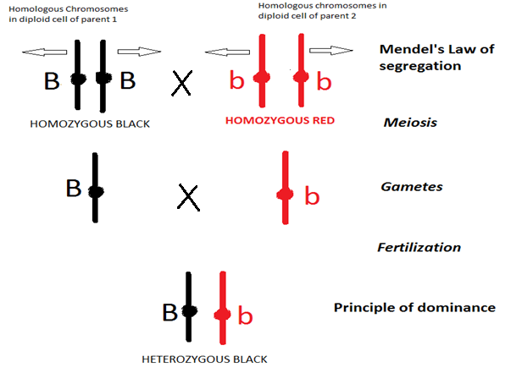
MONOHYBRID CROSS
P₁ Generation
F₁ Generation

Slide 17
Steps in Solving Monohybrid Genetic problems
Determine the dominant characteristic.
Determine the key i.e. symbol/letter to be used.
Determine the phenotypes and genotypes of the parents.
Determine the genes of each gamete after meiosis
Determine the alleles of the zygote after fertilization – F₁ - genotype
Describe the phenotypes of the F₁- generation

Slide 18
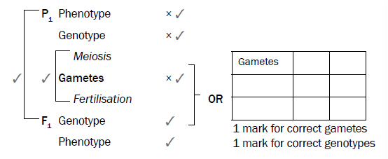
Template
Remember: you get two marks if you just write down the “recipe”

Slide 19
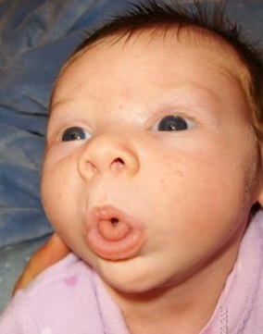
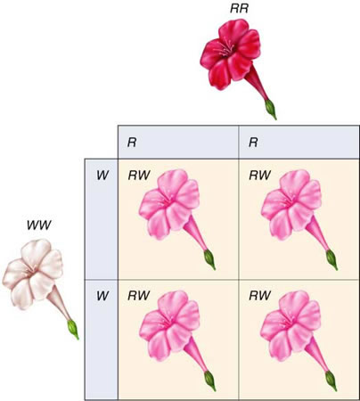
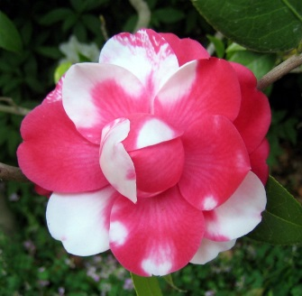
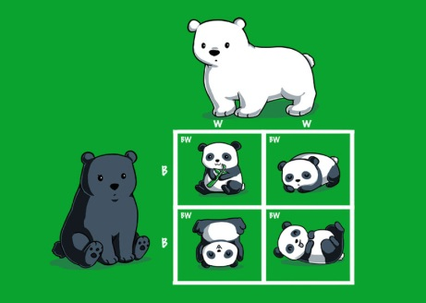
Types of monohybrid crossings
Complete dominance
A genetic interaction where one allele of a gene supress the expression of an alternative allele in the F₁ heterozygote (e.g. Bb) so that the phenotype is the same as that of the dominant allele.
Incomplete dominance
A pattern of inheritance in which a cross between two phenotypically different parents produces an offspring different from both parents but containing partial features of both - intermediate.
Co-dominance
Both alleles are equally dominant and therefore both are expressed in the phenotype.

Slide 20
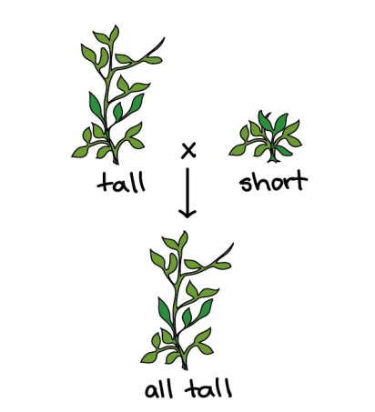
Complete dominance
P₁ phenotype Tall x Short
genotype TT x tt
Meiosis (Mendel’s Law of Segregation)
Gametes T , T x t , t
Fertilisation
F1 Tt Tt Tt Tt
Genotype: Tt (Principle of dominance)
Phenotype: Tall
(Individuals of F₁ all display the dominant characteristic)
gametes | T | T
t | Tt | Tt
t | Tt | Tt

Slide 21
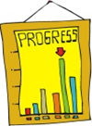
ACTIVITY 1.2 (p.29)
In humans, the ability to roll the tongue is because of a dominant gene. Use the letters (R) to represent rolling and (r) for non-rolling and show diagrammatically, by means of a genetic cross, how a man who is a roller, who marries a woman who is also a roller, may have a girl who cannot roll her tongue.

Slide 22
Memo Activity 1.2
P₁ Phenotype Roller x Roller
Genotype Rr x Rr
Meiosis
Gametes R , r R , r
Fertilisation
F₁
Genotype: RR, Rr, Rr, rr
Ratio: 1 : 2 : 1
Phenotype: Roller Roller Roller Non- roller
Ratio: 3 : 1
 | R | r
R | RR | Rr
r | Rr | rr

Slide 23
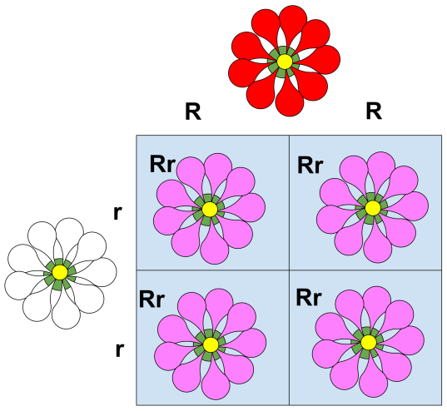
Incomplete dominance
P₁ phenotype Red x White
genotype RR x WW
Meiosis
Gametes R , R x W , W
Fertilisation
F₁ RW RW RW RW
Genotype: RW
Phenotype: Pink
(Offspring have intermediate forms of traits of parents)
gametes | R | R
W | RW | RW
W | RW | RW
W
RW
RW
RW
RW
W

Slide 24
Activity 1.3 (p.30)
Incomplete Dominance
SpongeBob loves growing flowers for his pal Sandy! Her favourite flowers, Poofkins, are found in red, blue and purple. Use the information provided and your knowledge of incomplete dominance to complete each section below.
1. Write the correct genotype for each colour if R represents a red gene and B
represents a blue gene.
Red: _____________ Blue: ______________ Purple: _______________
2. Draw a genetic cross to indicate what the genotypes of the resulting flowers if SpongeBob crossed a Poofkin with red flowers with a Poofkin with blue flowers.

Slide 25
Memo Activity 1.3
1.
Red: RR
Blue: BB
Purple: RB
2. P1 Phenotype Red flowers x Blue flowers
Genotype RR x BB
Meiosis
Gametes R ; R x B ; B
Fertilisation
F1 Genotype RB RB RB RB
Phenotype 100% purple

Slide 26
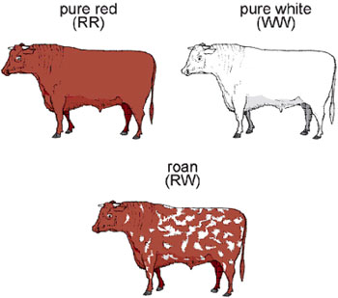
Co-dominance
Cows with white fur (W) were crossed with bulls with red fur (R):
P₁ phenotype Red x White
genotype RR x WW
Meiosis
Gametes R , R x W , W
Fertilisation
F₁ RW RW RW RW
Genotype: RW
Phenotype: Roan (both red and white)
(Both alleles are equally dominant and are expressed in the phenotype)
 | R | R
W | RW | RW
W | RW | RW

Slide 27
Activity 1.4 (p.31)
In certain marine invertebrates the colour of the shell is under the control of one gene with three alleles. In different combinations, the three alleles produce four phenotypes: orange, yellow, orange-yellow and black.
The table below shows the results of the offspring produced from crosses involving parents of different phenotypes.
CROSS | PHENOTYPES OF SHELLS
 | PARENTS | OFFSPRING
1 | Yellow x yellow | 27 yellow: 9 black
2 | Black x black | All black
3 | Orange x orange | 30 orange: 10 black
4 | Orange x yellow | All orange- yellow
1. Name and describe the type of dominance shown by cross 4. (3)
2. Which shell colour is controlled by the recessive allele? (1)
3.Use information in the table to support your answer to QUESTION 2. (2)

Slide 28
Answers: Activity 1.4
Co-dominance √
-The phenotypes/alleles of the parents are equally dominant√ (orange and yellow)
-and are both expressed in the phenotype of the offspring √
2. Black √
3.
In cross 1 both parents are yellow√/ none of the parents are black
But black appears in the phenotype of the offspring√
OR
-In cross 3 both parents are orange√/none of the parents are black
-but black appears in the phenotype of the offspring√
OR
- The ratio of the offspring in cross 1 ( yellow and yellow/ cross 3 (orange and orange) is 3 yellow/orange:1 black√
- The smaller proportion represents the recessive allele/black√

Slide 29
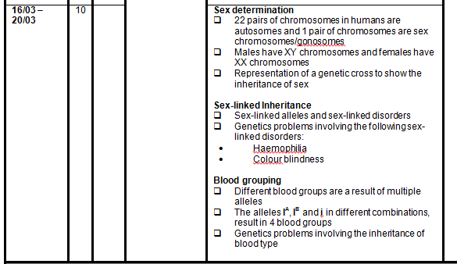
ATP

Slide 30

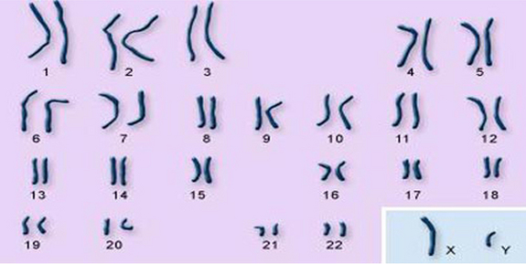
UNIT 3: SEX-LINKED INHERITANCE
Autosomes
Gonosomes/sex chromosomes
Genes located on a sex chromosome are called sex linked genes.
In humans the term usually refers to X-linked characteristics: genes located only on X chromosomes.
Fathers can pass X-linked alleles to their daughters, but not sons.
Mothers can pass sex-linked alleles to both sons and daughters.

Slide 31
SEX LINKED INHERITANCE - HAEMOPHILIA
Haemophilia is caused by a recessive allele on the X-chromosome. Males have only one X-chromosome – they mainly suffer from this disorder.
Cross a mother who is normal but a carrier, with a haemophiliac father.
P₁ phenotype Male haemophiliac x Female normal
genotype X^{h}Y x X^{H}X^{h}
Meiosis
Gametes
Fertilisation
F₁ Genotype: X^{H}X^{h}, X^{h}X^{h}, X^{H}Y, X^{h}Y
Phenotype: Normal Haemophilic Normal Haemophilic
female female male male
X^{h}
Y
X^{H}
X^{h}
Gametes | X^{h} | Y
X^{H} | X^{H}X^{h} | X^{H}Y
X^{h} | X^{h}X^{h} | X^{h}Y

Slide 32
Activity 1.5: Sex-linked (p.34)
4.1. Haemophilia is a genetic disorder caused by a recessive allele on the X chromosome.
A haemophiliac female marries a normal male. Explain why all their sons will be haemophiliacs.

Slide 33
Memo Activity 1.5
An individual inherits one allele from each parent√
The Y chromosome was inherited from the father√
And the recessive allele was inherited from the mother√
Since the mother has two recessive alleles√
A son only needs to get one recessive allele to be haemophiliac√
Since the y chromosome does not carry any allele to mask the haemophilia allele√

Slide 34
Activity 1.5 Colour blindness
Colour blindness is a genetic disorder caused by a recessive allele on the X chromosome. A Colour blind man marries non-carrier women. Do a genetic cross to show the possible genotypes of their children.
Use B for normal and b for colour blindness. (6)

Slide 35
Memo: Colour blindness
P₁ Phenotype Colour blind man x Normal non carrier female
Genotype X^{b}Y x X^{B}X^{B}
Meiosis
Gametes X^{b} Y X^{B} X^{B}
Fertilisation
F1 Genotype: 50 % X^{B} X^{b} ; 50% X^{B} Y
Phenotype 50% female carriers, 50% normal males
 | X^{b} | Y
X^{B} | X^{B} X^{b} | X^{B} Y
X^{B} | X^{B} X^{b} | X^{B} Y

Slide 36
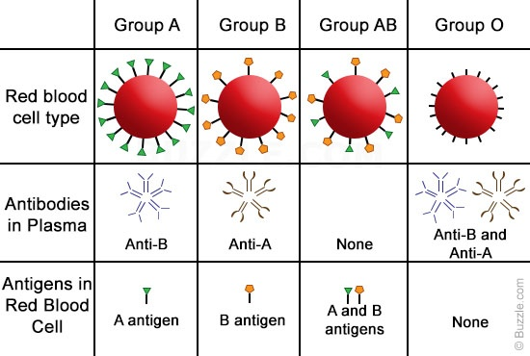
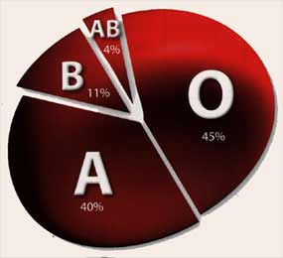
UNIT 4: Blood groups
Blood group (Phenotype) | Alleles (Genotype)
A | I^{A}I^{A} or I^{A}i
B | I^{B}I^{B} or I^{B}i
AB | I^{A}I^{B}
O | ii
1-2-3-4 Rule
-You can only have one blood group
- You can only have two alleles for a blood group
- But there are three different alleles
- And there are four blood groups

Slide 37
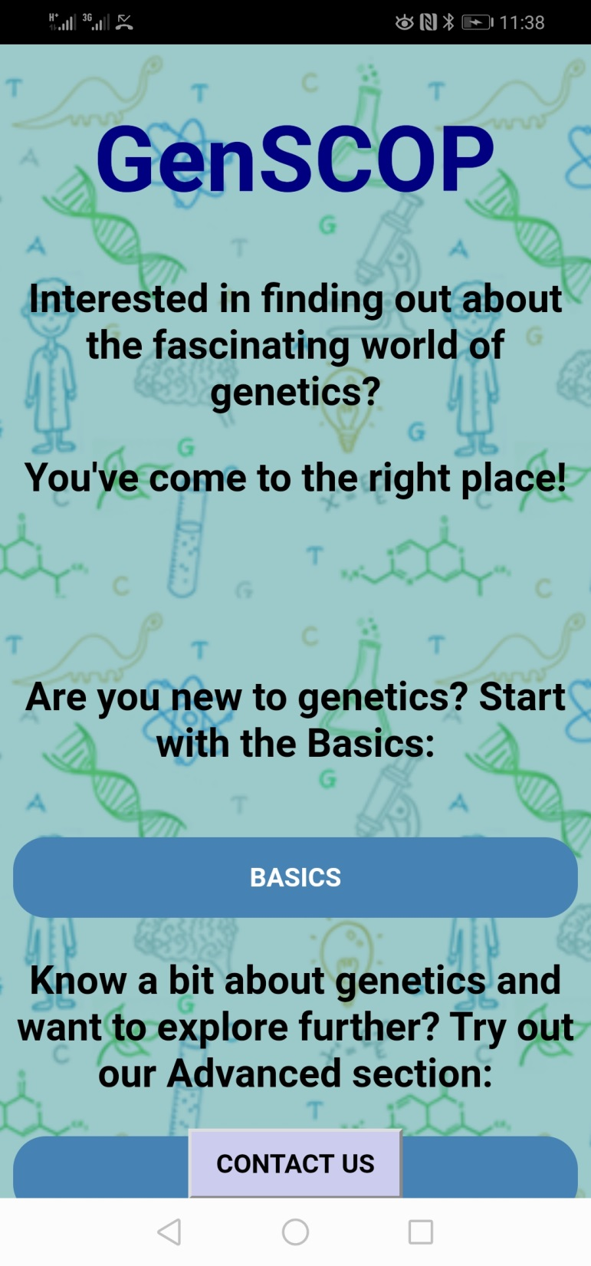
App for blood groups
Wits genetic students have created a genetics app. It is designed as a library containing simple explanations of genetic concepts.
It provides more information to school learners.
It is available for Android devices. Download it from Google play store.
It is called GenSCOP
https://play.google.com/store/apps/details?id+scopinggnetics&hl=en

Slide 38
Blood Groups
EXAMPLE: A man with blood group AB marries a woman with blood group O.
Predict the nature of their possible offspring
P₁ Phenotype AB x O
Genotype I^{A}I^{B} x ii
Meiosis
Gametes
Fertilisation
F₁ Genotype: I^{A}i and I^{B}i
Ratio: 1 : 1
Phenotype: Blood group A and Blood group B
Ratio: 1 : 1
i
i
I^{A}
I^{B}
i
i
Gametes
I^{B}
Gametes | I^{A} | I^{B}
i | I^{A} i | I^{B} i
i | I^{A} i | I^{B} i
I^{A}
^{A}i

Slide 39
ACTIVITY 1.6 Blood group activity (p.36)
1.1 Human blood groups are controlled by multiple alleles.
How many alleles control blood groups?
3
Which TWO alleles are co-dominant in the inheritance of blood
groups?
A and B
A man is heterozygous for blood group A and marries a woman who has
blood group O. Use a genetic cross to show the phenotypic ratio of their
offspring.

Slide 40
Memo Activity 1.6
P₁ Phenotype Blood group A x Blood group O√
Genotype I ^{A}i x ii√
Meiosis
Gametes I^{A} , i x i , i√ OR
F₁ Genotype I^{A}i I^{A}i ii ii√
Phenotype 2 blood group A: 2 blood group O
Phenotypic ratio is 1:1√*
Marking
P₁ and F₁ √
Meiosis and fertilisation√
* compulsory mark
Gametes | I^{A} | i
i | I^{A}i | ii
i | I^{A}i | ii
Fertilisation

Slide 41
ACTIVITY 1.6 -2
A baby was kidnapped from a hospital immediately after she was born. Fifteen years later it was discovered that Mr and Mrs Thomas, who were raising her, were not her biological parents. Mr and Mrs George, whose baby was born around the same time, claimed that she was their child.
The blood groups of both families are shown in the table below.
INDIVIDUAL | BLOOD GROUPS
Child | O
Mr Thomas | O
Mrs Thomas | AB
Mr George | B
Mrs George | A
2.1 How many genes control the inheritance of blood groups?
2 .2. Name the individual whose blood group shows co-dominance.
2.3 Explain why Mr and Mrs George could possibly be the parents of this
child. (3)

Slide 42
ACTIVITY 1.6.2 MEMO
2.1One/ 1
2.2. Mrs Thomas
2.3- The child has the genotype ii/ is homozygous recessive and
- if both parents are heterozygous/ have the genotypes I^{A}i or I^{B}i - she inherits one recessive allele from each parent

Slide 43
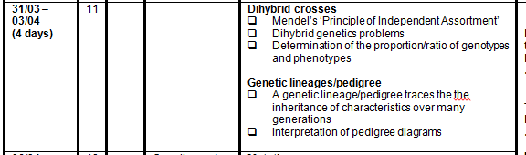
ATP

Slide 44
Unit 5: Dihybrid crosses
This is genetic crosses where two traits are crossed (two=di)
Traits are inherited independently
Mendel’s Law of Independent Assortment Alleles of a gene for one characteristic segregate independently of the alleles of a gene of another characteristic.
The genes are on different chromosomes.
When you cross a Heterozygous organism with a heterozygous organism(for both traits) you will always get the following genotypic ratio in the offspring: 9:3:3:1

Slide 45
DIHYBRID CROSS - EXAMPLE
A heterozygous tall plant with yellow flowers is crossed with a heterozygous tall plant with orange flowers. Do a genetic cross to show the possible offspring.
Steps to follow | What to do
Step 1 | Identify the phenotypes of the two organisms for each of the two characteristics. Tall yellow flowers x Tall orange flowers
Step 2 | Look for the letters that represent each trait in the questions. In this case it is: Tall =(T); Short = (t) ; Yellow (Y); orange (y)
Step 3 | Write the genotypes of each parent. for this question: TtYy x Ttyy
Step 4 TtYy x Ttyy | • Determine the possible gametes that each parent can produce. • Remember that each parent will have two alleles for each gene. • The gametes of each parent will have only one allele for each gene because of segregation during meiosis.
STEP 1
STEP 2
STEP 3
STEP 4
 | T | t
Y | TY | tY
y | Ty | ty
 | T | t
y | Ty | ty
y | Ty | ty

Slide 46
Dihybrid cross
Steps to follow | What to do
 | Remember that because of Mendels principle of Independent assortment an allele for one gene could appear in the same gamete with any of the alleles for the other gene.
Step 5 | Enter the possible gametes at the top and side of a Punnett square.
STEP 5
 | TY | ty | Ty | tY
Ty
Ty
ty
ty

Slide 47
Step 6 | • Because of random fertilisation, gametes from both parents could fuse in different combinations to form the offspring. • In the Punnet square, write down the genotypes of the offspring that will result from each possible combination of gametes.
Step 7 | Determine the phenotypes of the offspring from the genotypes obtained in the Punnet square.
STEP 6
 | TY | ty | Ty | tY
Ty | TTYy | Ttyy | TTyy | TtYy
Ty | TTYy | Ttyy | TTyy | TtYy
ty | TtYy | ttyy | Ttyy | ttYy
ty | TtYy | ttyy | Ttyy | ttYy
STEP 7

Slide 48
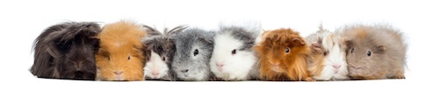
Example of a dihybrid cross
A guinea pig with black (B), long fur (L) is crossed with a guinea pig with brown (b), short fur (l). Both parents are homozygous. The F1 offspring were interbreed, use a diagrammatic cross to show the genotype and phenotypes of the F2 generation and as well as the phenotypic ratio.

Slide 49
Memo Example:
P2 Phenotype:
black and long fur x black and long fur
Genotype: BbLl x BbLl
Meiosis
Gametes: BL, Bl, bL, bl x BL, Bl, bL, bl
Fertilisation
F2 genotype:
 | BL | Bl | bL | bl
BL | BBLL | BBLl | BbLL | BbLl
Bl | BBLl | BBll | BbLl | Bbll
bL | BbLL | BbLl | bbLL | bbLl
bl | BbLl | Bbll | bbLl | bbll
Phenotype ratio

Slide 50
Memo Example
Phenotype 9 black long
3 black short fur
3 brown long fur
1 brown short fur
Black long : black short : brown long : brown short
9 : 3 : 3 : 1

Slide 51
Activity 1.7 (p.39)
Number of seeds per pod Leaf shape
P: one seed L: normal shape
p: three seeds l: wrinkled shape
The table below shows the results of the offspring produced by a genetic cross between two plants of this species.
1.1. How many genes of the plant are considered here? (1)
1.2 Name the dominant phenotypes of the plant. (2)
1.3 Give the:
(a) Genotype of each parent (2)
(b)Number of offspring that are homozygous recessive for both characteristics (1)
PHENOTYPE | NUMBER OF OFFSPRING
One seed and wrinkled leaves | 100
One seed and normal leaves | 290
Three seeds and wrinkled leaves | 32
Three seeds and normal leaves | 96

Slide 52
Answers Activity 1.7
1.1. 2√
1.2 – Normal leaf√/normal shape
- one seed √per pod
1.3. a) PpLl√√
OR
PpLI √ x PpLl√/ PpLl√ ; PpLl√
b) 32√

Slide 53
UNIT 6: GENETIC PEDIGREE DIAGRAMS
Follow the following steps when interpreting pedigree diagrams:
Study any key and opening statement/s and look for dominant characteristics and phenotypes
Fill in the genotype of all the individuals with the recessive condition- it has to have 2 lower case letters e.g. ff
For every individual in the diagram that has the recessive condition, it means that each gene was obtained from each of the parents. Work backwards and fill in one recessive gene for each parent.
If the parents showed the dominant characteristic fill in the second letter which has to be a capital letter.
Any other individual showing the dominant characteristic will most likely be homozygous dominant – two capital letters.

Slide 54
Example – earlobes
Please note: Unattached earlobes are dominant (F) and Attached earlobes are recessive (f)– complete missing genotypes
ff
Ff
Ff
ff
ff
Ff
Ff
ff
Ff
ff
Key:
Recessive
Recessive
Male with attached earlobes
Male with unattached earlobes
Female with attached earlobes
ff
Ff
Female with unattached earlobes

Slide 55
EXAMPLE 2- LIPS
The diagram below shows the inheritance of broad/thin lips in humans. Broad lips (B) is dominant over thin lips(b). Individual 2 is homozygous. Use the letters B and b and write down the phenotypes and genotypes of the individuals.
2
Key:
Male with broad lips
Female with blue eyes
Male with thin lips
Female with broad lips
Female with thin lips

Slide 56
Memo Example 2
Complete the following activity in pairs
The diagram below shows the inheritance of broad or thin lips in humans. Broad lips (B) is dominant over thin lips(b).
Individual 2 is homozygous. Use the letters B and b and write down the phenotypes and genotypes of individuals
bb
BB
thin
broad
Bb
Bb
bb
Broad
Broad
Broad
Key:
Male with broad lips
Recessive
Recessive
Male with thin lips
Female with broad lips
bb
Bb
Bb
bb
bb
Female with thin
thin
Broad
thin
thin
Broad

Slide 57
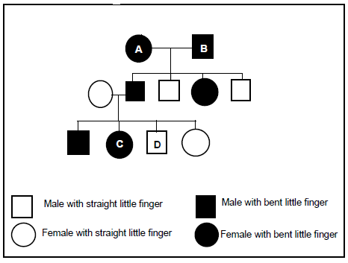
Activity 1.8 (p.41)
A dominant allele causes the last joint of the little finger to bend inwards towards the fourth finger (B) and is called ‘bent little finger’. The recessive allele (b) causes the little finger to be straight.
The pedigree diagram below shows the inheritance of a ‘bent little finger’ in a family.
1.1.1. Explain why individuals A and B are definitely heterozygous for this trait.
1.1.2. Individual C has a child with a partner that has straight little fingers.
Use a genetic diagram to show the possible genotypes and phenotypes of
the child.

Slide 58
Memo
1.1.1. The parents have the dominant phenotype/have one dominant allele
- To have children with the recessive characteristic/bb
- The other allele of each parent must be recessive
1.1.2. P1 Phenotype Bent little fingers x Straight little fingers
Genotype Bb x bb
Meiosis
G/gametes B, b x b, b
Fertilisation
F1 Genotype Bb; bb; bb; Bb
Phenotype bent little finger; straight little fingers
OR
P1 Phenotype Bent little fingers x Straight little fingers
Genotype Bb x bb
Meiosis
Gametes B, b x b, b
Fertilisation
F1 Genotype Bb; Bb; bb; bb
Phenotype bent little finger straight little fingers
 | b | b
B | Bb | Bb
b | bb | bb

Slide 59
Question 2
The following pedigree diagram is for colour blindness. Determine the possible
genotypes for number 1-15. Colour blindness is a sex linked condition. Use X^{b} to
indicate the affected allele and X^{B} to indicate the normal allele.
1
2
3
4
5
6
7
8
9
10
11
KEY:
= Affected male
= Normal male
= Affected female
= Normal female
12
13
14
15

Slide 60
Question 2 ANSWERS:
4
X^{B}X^{b}
X^{B} Y
X^{B}X^{b}
X^{b}Y
6
8
X^{B}X^{b} or
X^{B}X^{B}
X^{b}Y
X^{B}X^{b}
X^{b}Y
X^{B}X^{b}
X^{B}X^{b}
X^{B}Y
X^{b}Y
12
X^{B}X^{b}
X^{B} Y
X^{B}X^{b}

Slide 61
Question 3
Tay-Sachs disease is caused by an autosomal recessive allele (n). Children with Tay-Sachs disease lose motor skills and mental functions. Over time, the children become blind, deaf, mentally retarded and paralysed. Tay-Sachs children die by the age of five.
The pedigree diagram below shows the inheritance of Tay-Sachs disease in a family.
3.1. Give:
(a) Charly's phenotype
(b) Portia's genotype
(c) Bill's genotype
3.2 Explain why Patrick is normal, but a carrier of Tay-Sachs disease.
3.3 Classify the above questions according to Bloom’s Taxonomy. Explain your answer.

Slide 62
Answer
3.1.
Male√ with Tay- sachs disease √ (level B)
Nn √ √ (level C)
Nn √ √ (level C)
3.2.
- Since Elizabeth has Tay-Sachs disease √ she had to inherit one recessive allele from each of her parents √
-Patrick’s genotype in Nn √ /heterozygous which means he is a carrier but normal (level D)

Slide 63

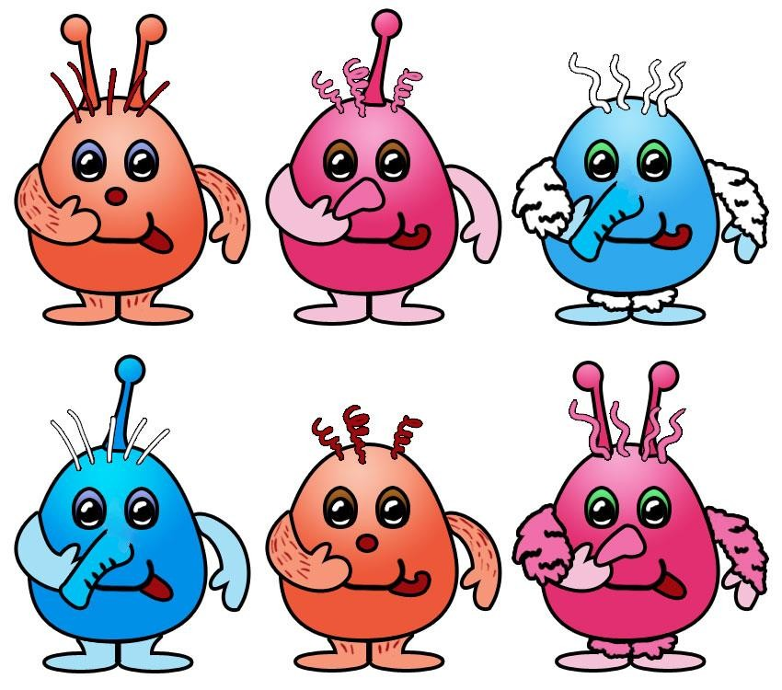
Activity 1.9 SBA
Refer to page 43 in participant’s guide

Slide 64
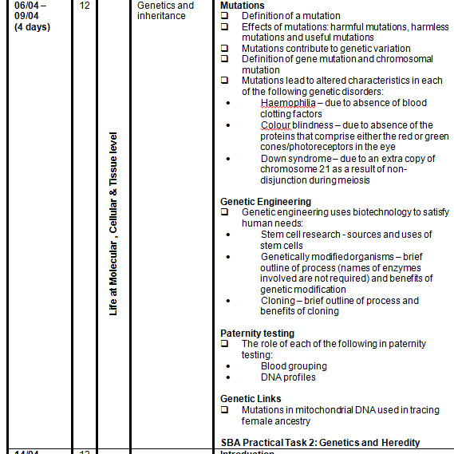
ATP

Slide 65
UNIT 7: GENE MUTATIONS
• Haemophilia: Absence of the protein needed for the formation of blood clots
due to a mutant gene.
• Colour blindness: Absence of the proteins that make up either the red or green
cones/photoreceptors in the eye.
CHROMOSOMAL ABERRATIONS
Down syndrome: There is an extra chromosome (47 instead of 46) in the zygote.

Slide 66
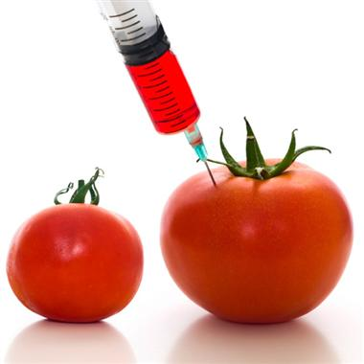
GENETIC ENGINEERING
Genetic engineering
Genetic engineering is the process whereby the genes on the DNA are changed, transferred or manipulated to produce a different organism.
Genetic counselling
Couples with a risk of a genetic disease can undergo genetic counselling to enable them to make informed decisions on whether they want to have children or not.

Slide 67
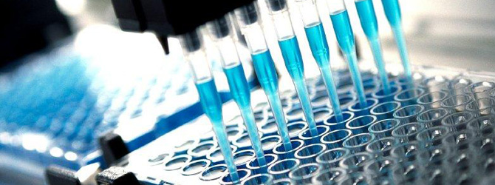
Biotechnology
Biotechnology is the use of living systems and organisms to develop or make products, or "any technological application that uses biological systems, living organisms or derivatives thereof, to make or modify products or processes for specific use" (UN Convention on Biological Diversity, Art. 2).

Slide 68
Stem cell research
What are stem cells?
Cells that have the potential to develop into many different cell types in the body.
Sources
Embryonic stem cells derived from embryos and somatic stem cells which are derived from adult tissue
Uses
Used for treating diseases (like diabetes and heart disease)

Slide 69
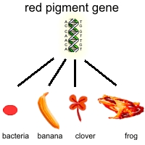
Genetic Modification
Genetic engineering, also called genetic modification, is the direct manipulation of an organism's genome using biotechnology. It is a set of technologies used to change the genetic makeup of cells, including the transfer of genes within and across species boundaries to produce improved or novel organisms.

Slide 70
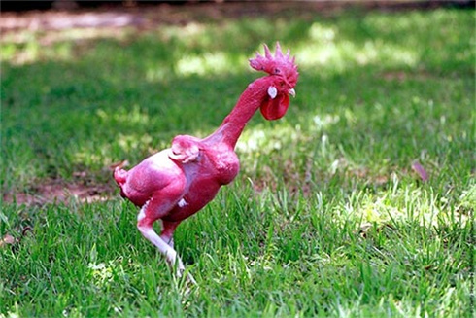
GMO
GM plants
-Between 70% and 80% maize in SA is GMO
-Bt crops – contain the protein (Bt) which kills bugs if they digest it. Less pesticide needed.
GM animals
Enviropig, featherless chicken, sudden death mosquitoes, fast growing salmon. Each has it own benefits.
Objections
- Playing with nature/God
- Not safe (health wise)
- Not good for the environment

Slide 71
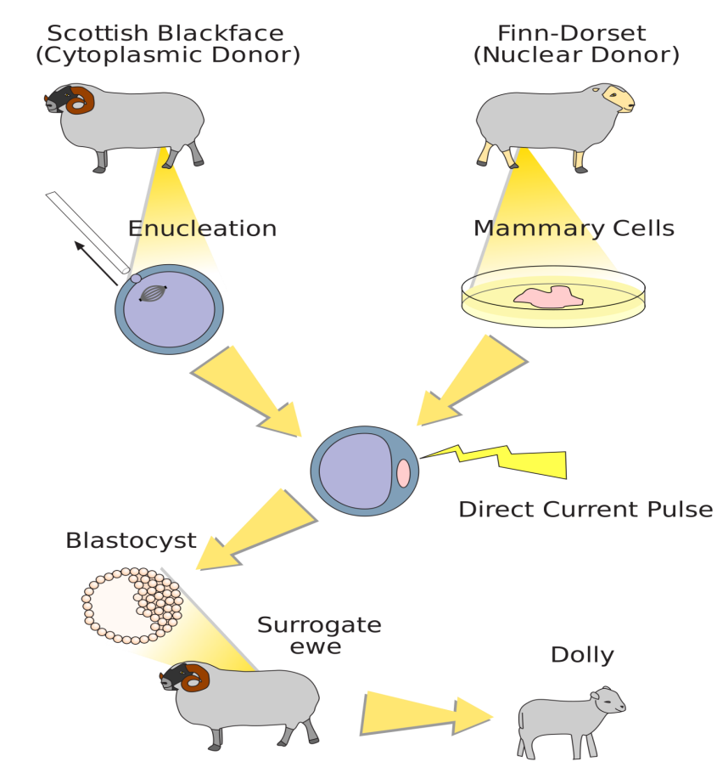
Cloning
In biology, cloning is the process of producing similar populations of genetically identical individuals that occurs in nature when organisms such as bacteria, insects or plants reproduce asexually.

Slide 72
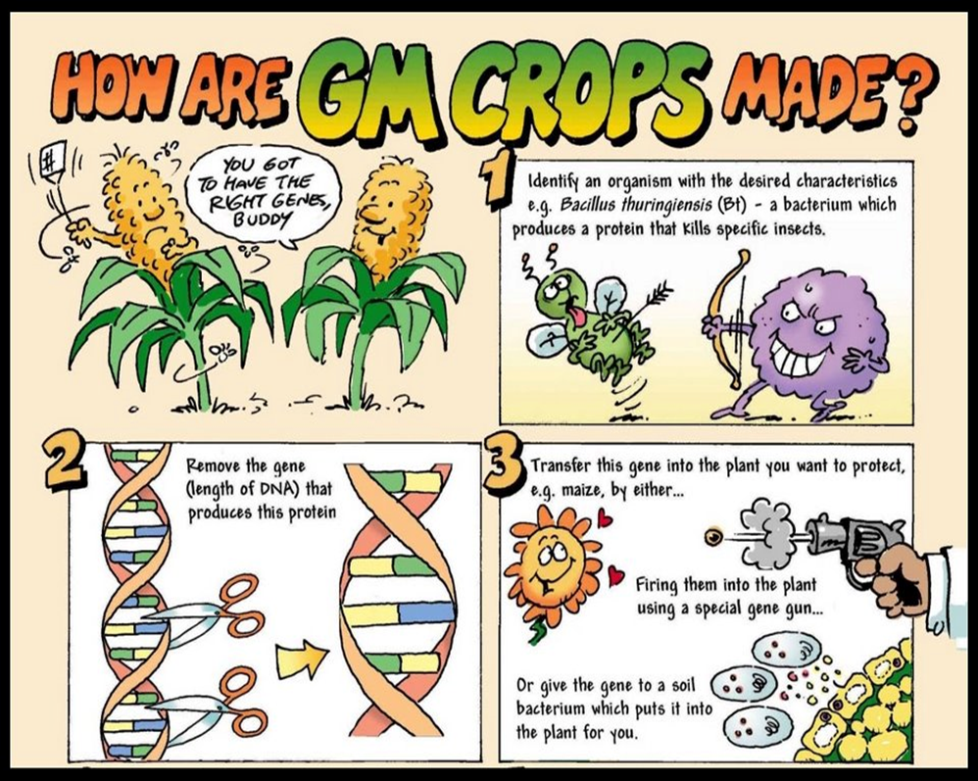
Genetically modified organisms

Slide 73
PATERNITY TESTING
An analysis, usually of the DNA or blood type of a mother, child, and putative father, to estimate the probability that the man is the biological father of the child.
Blood grouping
Genotypes of the mother and the suspected man's blood groups are compared with those of the child
If the genotypes for the blood groups of the man and the mother could not lead to the blood group of the child the man is not the father of the child
If the genotypes for the blood groups of the man and the mother could lead to the blood group of the child it cannot be said with certainty that the man is the father of the child because other males have the same blood group.
DNA profiles
Every person except identical twins has her/his own unique DNA profile.
It can be described as an arrangement of black bars representing DNA
fragments of the person.
It is used to:
• Identify paternity

Slide 74
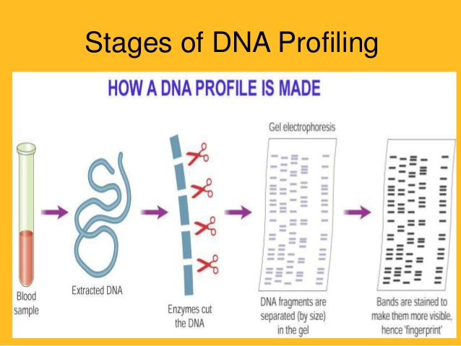

Slide 75
ACTIVITY 1.10 (p.51)
Essay question:
Sometimes the paternity of a son or a daughter is disputed.
Describe sex determination in humans and explain how blood grouping and DNA profiling are used in paternity testing.

Slide 76
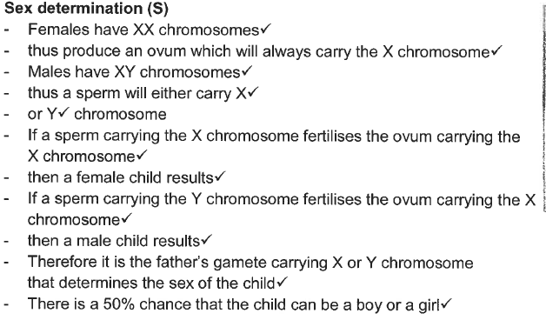
Answer Activity 1.10

Slide 77
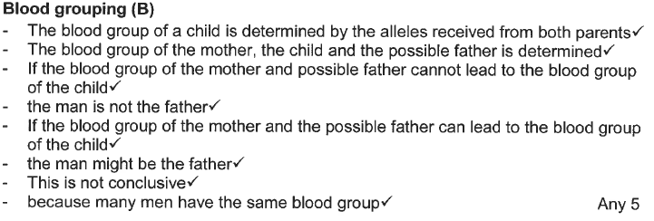
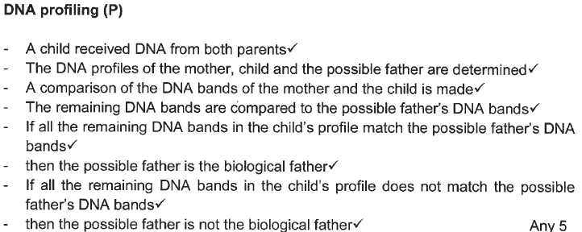

Slide 78
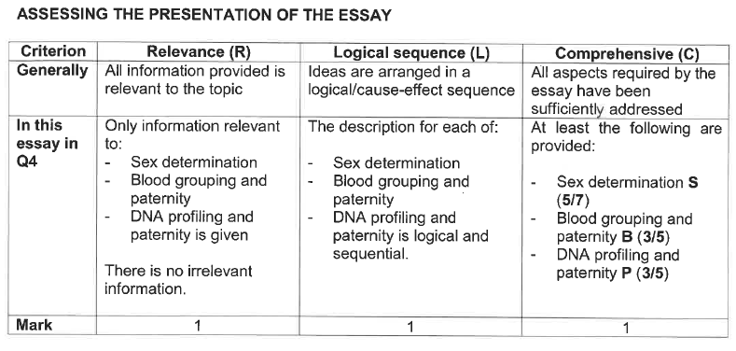

Slide 79
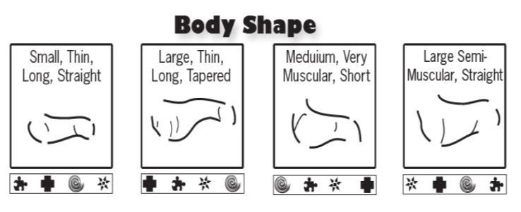
ACTIVITY 1.11 DOG DNA (p.51)

Slide 80
KEY POINTS FOR THE MODULE
The terms allele, gene and chromosome are used interchangeably and therefore incorrectly by many learners – ensure differentiated understanding .
Mendel’s Law of Dominance and the Law of Segregation must be learnt by heart.
The process of cloning must be studied.
Care must be taken on the position of meiosis and fertilisation in the format of a genetic cross.

