Slide 1
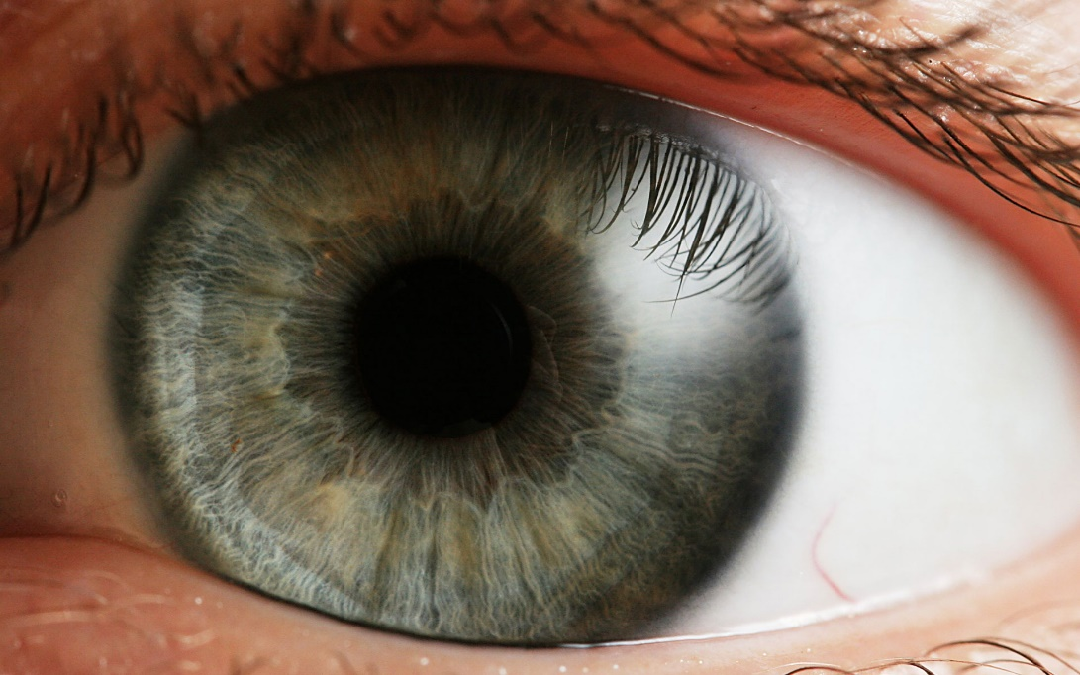
SSIP April – May 2020
LIFE SCIENCES
Topic(s) : EYE
Venue:

Slide 2
SSIP AIMS/GOALS
The four interconnected outcomes that drive the professional development activities for SSIP are:
Enhancing Teachers knowledge: deep understanding of subject matter knowledge and students ideas on the content
Enhancing quality teaching and assessment for learning: effective instructional approaches that teachers may use to ensure improved understanding by most learners.
Developing ICT integration skills :Use of ICT to improve teaching and learning
Building professional learning communities: allow teachers to start collaborating and form professional networks in non-formal settings in context of their schools

Slide 3
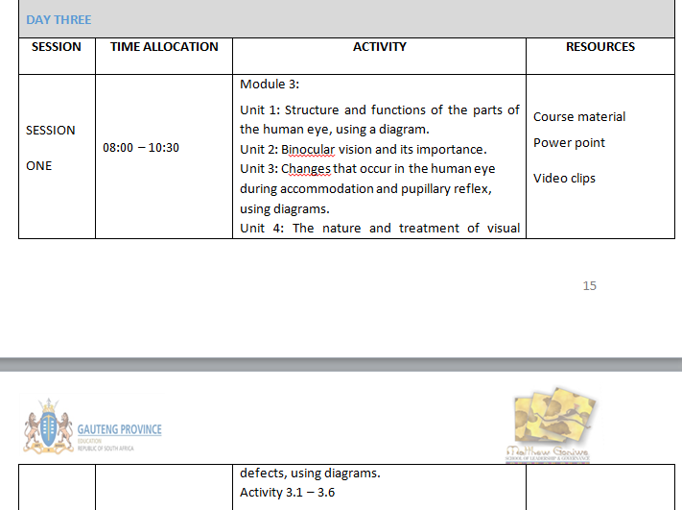
PROGRAMME

Slide 4
ATP FOR TERM 2
28/04 – 30/04 (3 days) | 15 |  |  | Receptors Functions of receptors, neurons and effectors in responding to the environment The body responds to a variety of different stimuli such as light, sound, touch, temperature, pressure, pain and chemicals (taste and smell). (No structure and names necessary except for names of the receptors in the eye and ear). Human eye Structure and functions of the parts of the human eye, using a diagram Binocular vision and its importance The changes that occur in the human eye for each of the following, using diagrams: Accommodation Pupillary mechanism The nature and treatment of the following visual defects, using diagrams: Short-sightedness Long-sightedness Astigmatism Cataracts Practical worksheet 7 |  |  | 60

Slide 5
MODULE 3
Overview of Module 3
In this module we will look at the concept of ‘The Eye’
Content
You will study this module through the following units:
Unit 1: structure and functions of the parts of the human eye, using a
diagram
Unit 2: binocular vision and its importance
Unit 3: changes that occur in the human eye during
accommodation and pupillary reflex, using diagrams
Unit 4: the nature and treatment of visual defects, using diagrams
Notes:
Give an overview of the module and give the key content and or index that you will be covering in the Module

Slide 6
OUTCOMES OF THIS MODULE
Statement of the learning outcomes/objectives
When you complete this module you will be able to:
Draw and label the parts of the eye.
Describe the functions of the different parts.
Briefly explain the changes occurring in the eye during accommodation and pupillary reflex
Identify and describe the various defects of the eye
Conduct a dissection of the eye
Notes:
Please state these very simple and explicit and in the FG you may ask one participant to read those out loud and make sure they are linked to the activities that you have in the Manual.

Slide 7
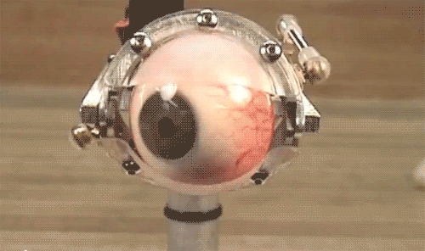
Unit 1 - The human eye (structure and function)

Slide 8
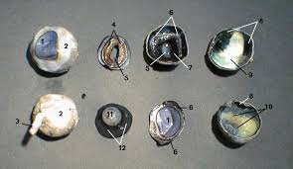
Activity 3.1
Practical activity
  Dissection of sheep’s eye (worksheet 7)

Slide 9
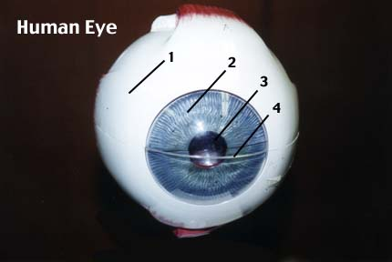
Memo
Question 1
1 - Lens
2 - Cornea
3 - Sclera
4 - Vitreous Humor
5 – Blind spot
6 – Optic nerve
7 - Choroid Coat
8 - Retina
9 - Ciliary Body
10- Suspensory Ligaments
11 – Iris
Question 2
1. Sclera
2. Iris
3. Pupil
4. Cornea

Slide 10
Question 3
Fatty tissue: protects the eyeball against mechanical damage.
Muscles: move the eyeball
Optic nerve: transmit nerve impulses towards the brain.
Question 4
  4.1 The retina
  4.2

Slide 11
  4.3
  Yes, the numbers will change with time because people age, visual defects become more common
  4.4
  Accurate diagnoses, enough samples (learners).

Slide 12
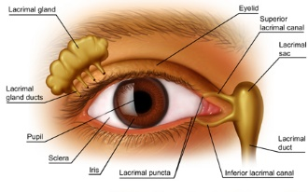
STRUCTURE OF THE EYE
EXTERNAL STRUCTURE
Notes:
There are several definitions of PBL found in literature and here are some of the key definitions of PBL as a teaching and learning strategy.

Slide 13
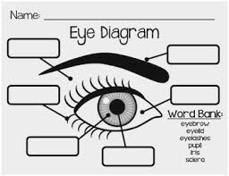
Protection of the eye
Orbit
Adipose tissue
Eyebrows
Eye lashes
Eyelid
Lacrimal fluid
Glands of Meibum
Sclera
Conjunctiva

Slide 14
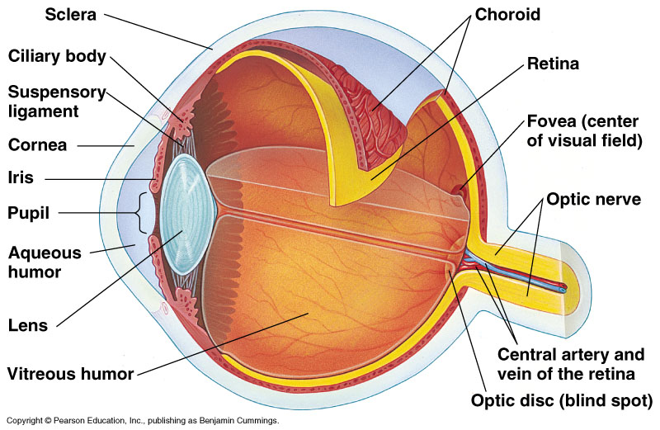
INTERNAL STRUCTURE OF THE EYE

Slide 15
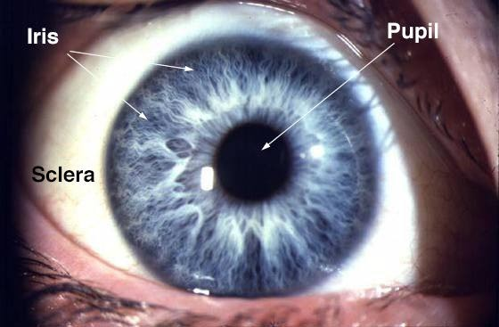
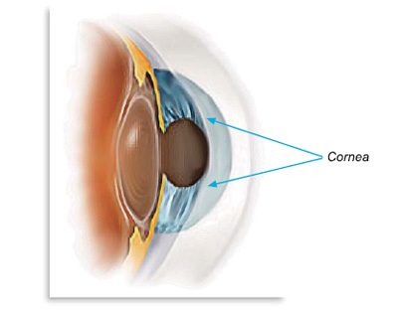
PARTS OF THE EYE
SCLERA
  white of the eye
  supports eyeball
  provides attachment for muscles
CORNEA
  transparent bulge over pupil
  focuses light (refracts) onto retina
IRIS
  coloured part of eye
  controls light entering
PUPIL
  black hole in iris
  where light enters

Slide 16
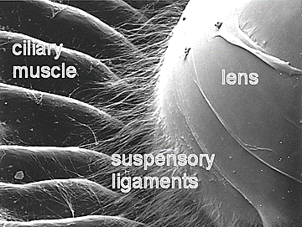
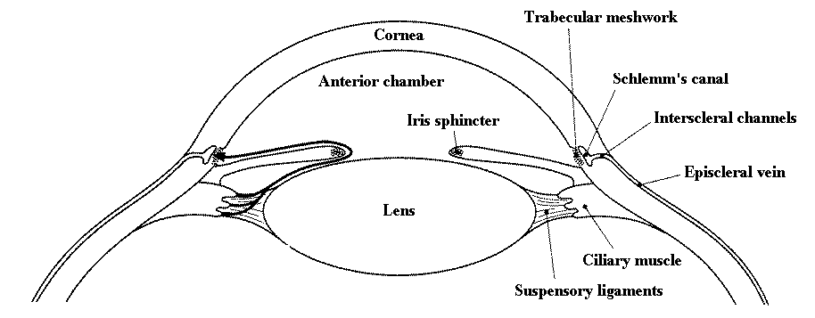
LENS
  Flexible disc of transparent cells
  converging lens
  allows us to see objects near and far

Slide 17
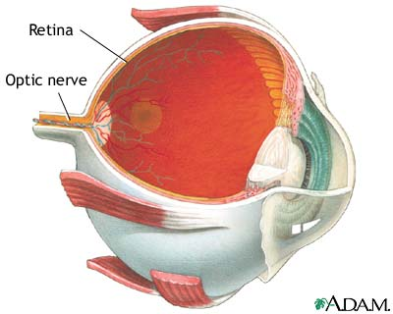
RETINA
  internal membrane
  contain light-receptive cells (rods & cones)
  converts light to electrical signal

Slide 18
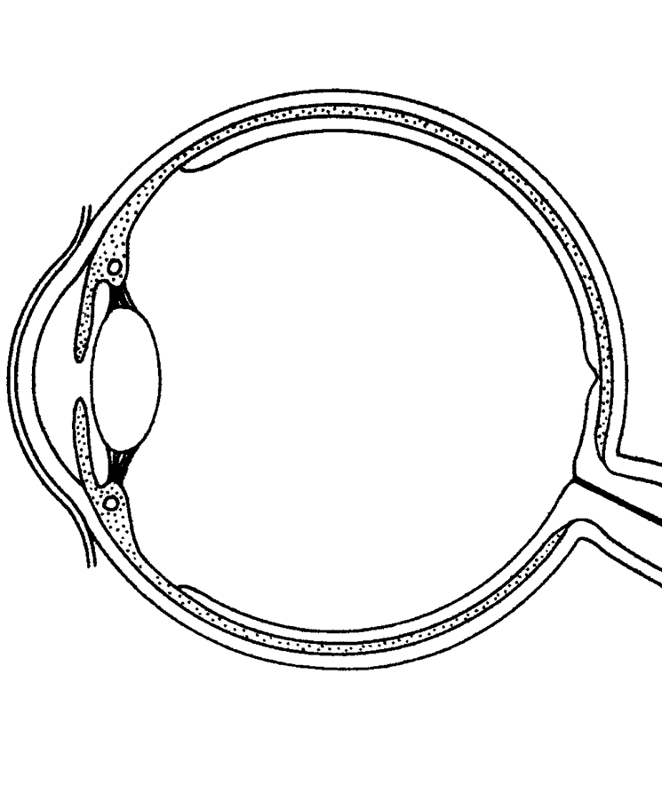
Activity 3.2
Label the parts of the eye in blue and add the functions of each part in red

Slide 19
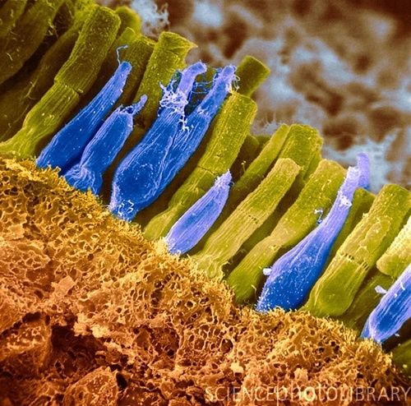
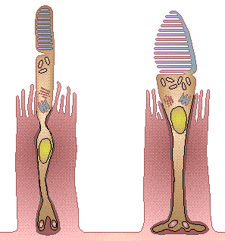
rod
cone

Slide 20
Dark Adaptation
After about thirty minutes, your eyes are completely dark adapted and can see an amount of light equivalent to a candle 16 km away.
Dark adaptation is a slow process, but allows us to see in a huge range of light levels
16 km

Slide 21
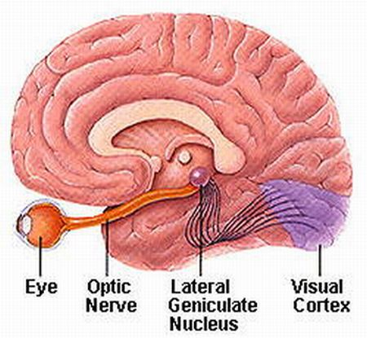
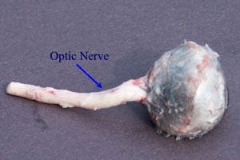
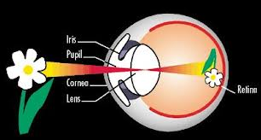
OPTIC NERVE
Transmits electrical impulses from retina to the brain
Creates blind spot
Brain takes inverted image and flips it so we can see

Slide 22
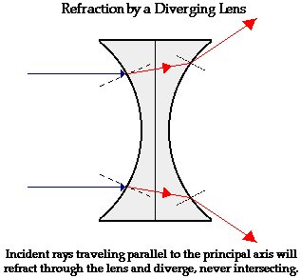
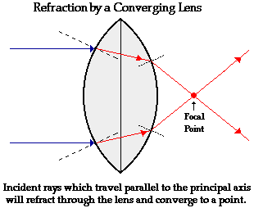
Refraction by concave & convex lenses

Slide 23
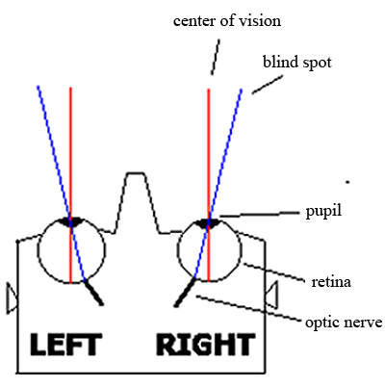
Blind Spot
On retina where the optic nerve leads back into the brain
No rod or cone cells occur
Other eye compensates for this area
Try this test to prove you have a blind spot…

Slide 24

ACTIVITY 3.3 (p.91)

Slide 25
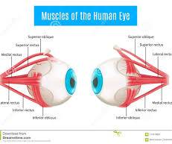

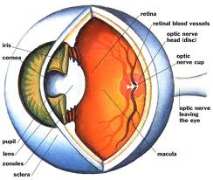
Unit 2:
Binocular vision
What it is
Refers to the ability to focus on an object with both eyes, creating a single image
During binocular vision the three pairs of muscles on the outside of each eye enable the eye to see three dimensionally.
The ability to perceive depth is known as stereoscopy or stereoscopic vision
Significance
Depth of perception enables us to walk up/ down stairs.
It gives a wider field of view
gives precise depth perception
Binocular vision helps with performance skills such as catching, grasping, and locomotion.

Slide 26
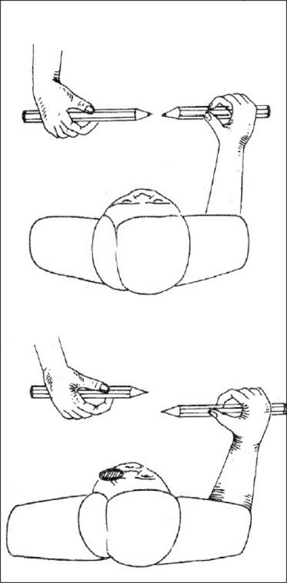
Activity 3.4 (p.92)

Slide 27
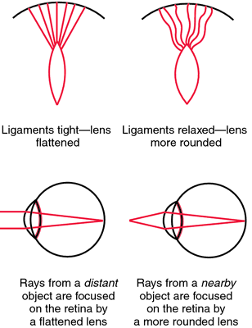
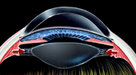
Unit 3:
Accommodation
Accommodation is the focusing of light in the retina.
Mammals focus by changing the shape of the lens.
The lens is flattened for distant objects.
The lens is rounded for near objects.

Slide 28
Accommodation
Near vision
Far vision
When an object is less than 6 m away.
  the ciliary muscles contract
  the sclera is pulled forward
  the suspensory ligaments slacken (loosen)
  the tension on the lens decreases
  the lens becomes more convex
  the refractive power of the lens increases
  a clear image is formed on the retina
When an object is 6m away and more
  Ciliary muscles relax
  Sclera goes back to normal position
  Suspensory ligaments become taut (tight)
  Tension on the lens increases
  The lens becomes less convex
  The refractive power of the lens decreases
  The clear image is formed on the retina
CC-SS-TD

Slide 29
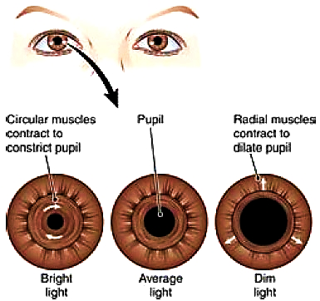
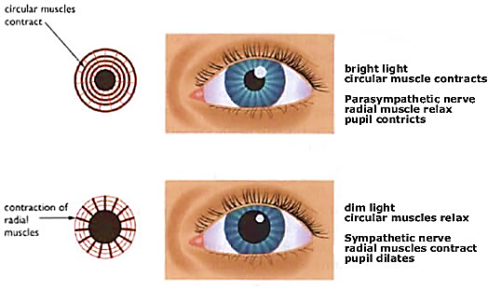
Pupillary reflex

Slide 30
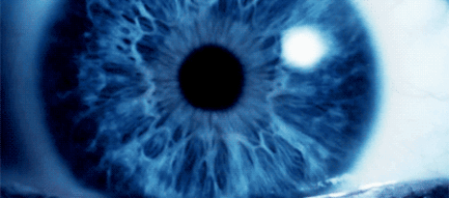
PUPILLARY MECHANISM
In bright light
The circular muscles of the iris contract
The radial muscles relax
The pupil constricts
The amount of light entering the eye is reduced
In dim light
The radial muscles of the iris contracts
The circular muscles relax
The pupil dilates
The amount of light entering the eye is increased.
BCCRR

Slide 31
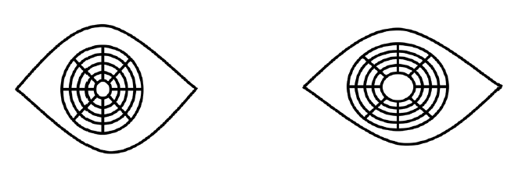
Activity 3.5 (p.94)
Annotate the diagrams to describe the two processes taking place in the eye

Slide 32
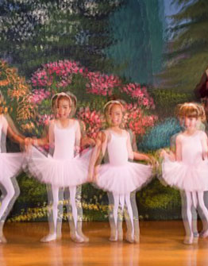
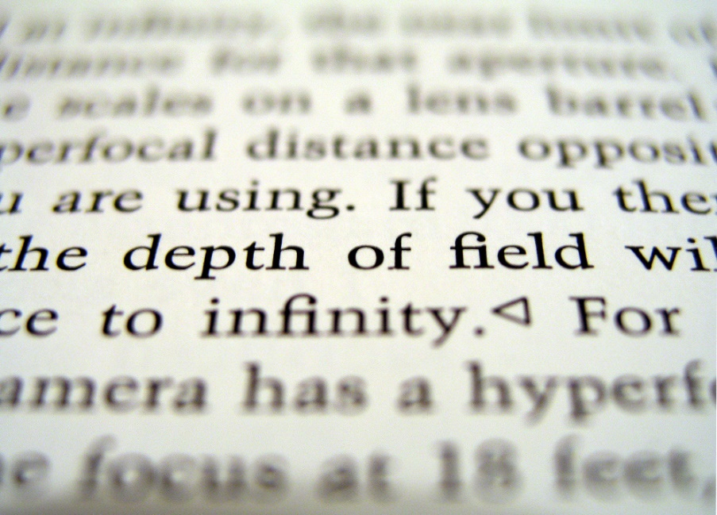
Unit 4: Defects of the eye

Slide 33
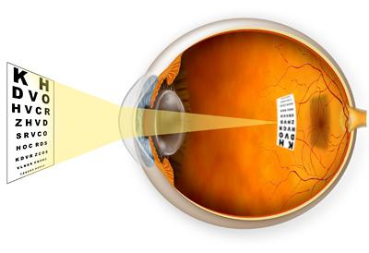
Focusing Problems
MYOPIA
Near-sightedness
Problem seeing objects far away
Distance between lens and retina too large
Light focused in front of retina
Correct with diverging lenses

Slide 34
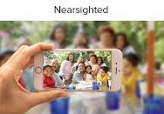
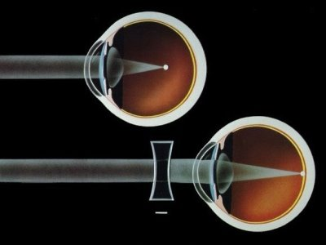
Near-Sighted (Myopia)

Slide 35
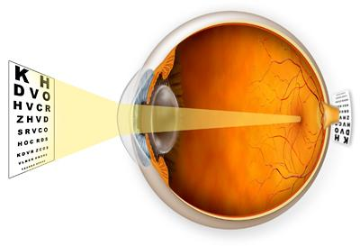
HYPEROPIA
Far-sightedness
Problem seeing close objects
Distance between lens and retina too small
Light focused behind retina
Corrected with converging lenses

Slide 36
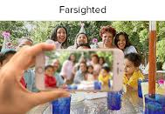
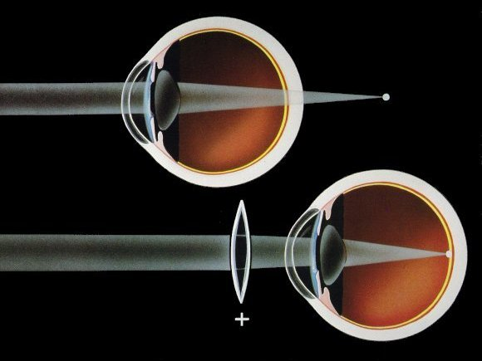
Far-Sighted (Hyperopia)

Slide 37
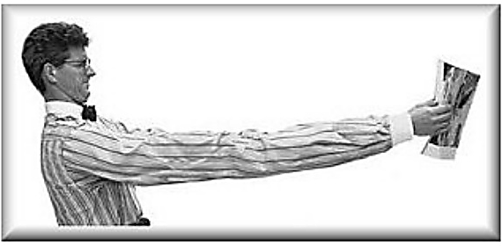

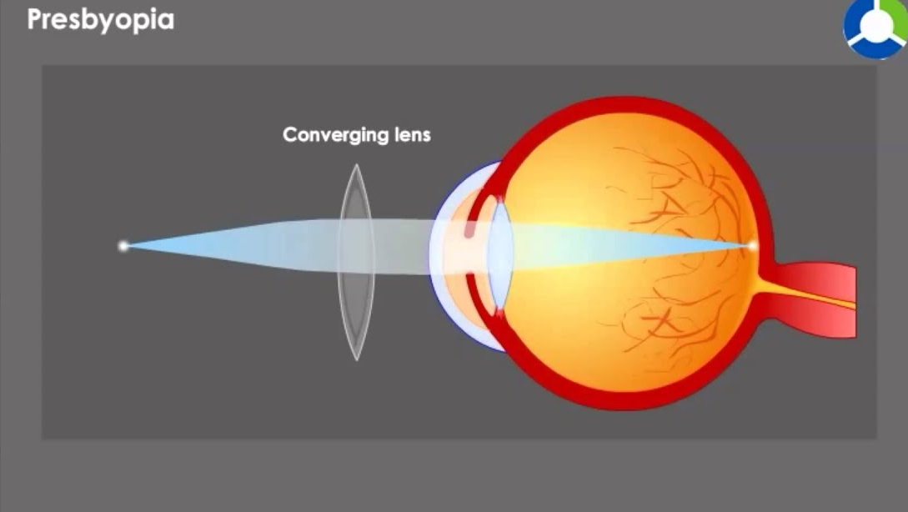
PRESBYOPIA
Form of far-sightedness
Harder for people to read as they age
Lens loses elasticity
Corrected by glasses with converging lenses

Slide 38
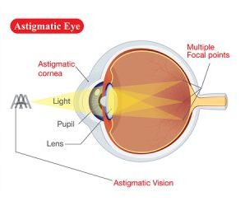
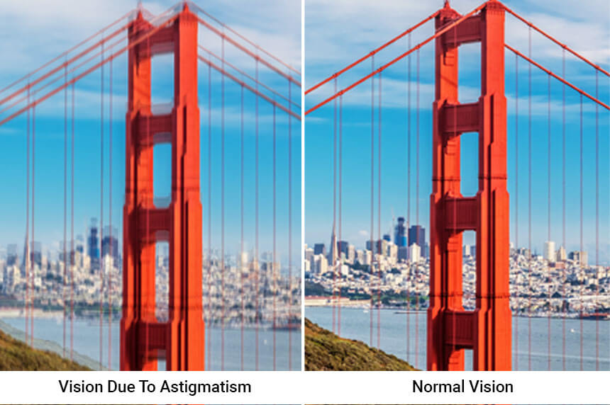
ASTIGMATISM
Eye cannot focus an object’s image on a single point on retina
Cornea is oval instead of spherical
Causes blurred vision
Some types can be corrected with lenses

Slide 39
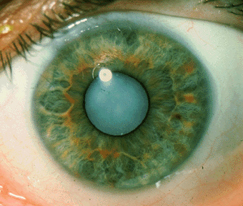
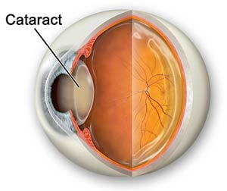
Diseases of the Eye
CATARACTS
Clouding forms in the lens due to denaturing of lens protein
Obstructs passage of light
Caused by age, chronic exposure to UV, or due to trauma
Removed by surgery

Slide 40
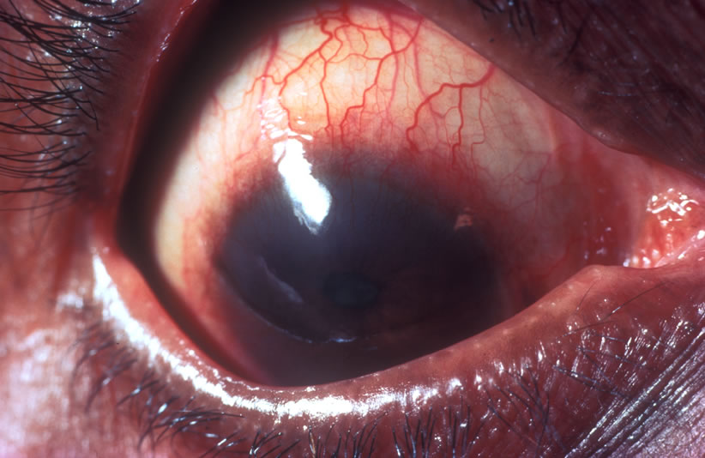
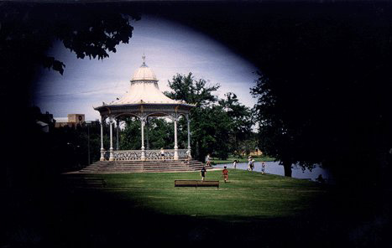
GLAUCOMA
Group of diseases
Pressure builds up in the eye which affects the optic nerve
Loss of ganglion cells
Gradual loss of sight and eventual blindness
Check eyes regularly
Can be treated

Slide 41
Activity 3.6
(p.100)
 | TIME TAKEN TO THREAD THE NEEDLE in seconds(s)
Attempts | Two eyes open | Only right eye open
1 | 12 | 38
2 | 12 | 35
3 | 10 | 37
4 | 11 | 36
5 | 9 | 34
6 | 9 | 33
7 | 10 | 30
8 | 8 | 31
9 | 7 | 29
10 | 7 | 28
In an investigation a learner was asked to thread a cotton thread through the ‘eye’ (hole) of a needle 10 times with both eyes open and then with only the right eye open. This was done under the same light intensity and at a distance of 30 cm from the eyes. The results are recorded in the table below.
Set 5 questions incorporating all four cognitive levels on the investigation on the eye

Slide 42
KEY POINTS FOR THE MODULE
The eye can’t be studied without diagrams.
Structure and function is NB.
Accommodation and the pupillary mechanism are asked every year.
Let the weaker learners only learn accommodation for near vision – accommodation for far vision is just the opposite.

