Slide 1
SSIP April – May 2020
LIFE SCIENCES
Topic(s) : EAR
Venue:

Slide 2
SSIP AIMS/GOALS
The four interconnected outcomes that drive the professional development activities for SSIP are:
Enhancing Teachers knowledge: deep understanding of subject matter knowledge and students ideas on the content
Enhancing quality teaching and assessment for learning: effective instructional approaches that teachers may use to ensure improved understanding by most learners.
Developing ICT integration skills :Use of ICT to improve teaching and learning
Building professional learning communities: allow teachers to start collaborating and form professional networks in non-formal settings in context of their schools

Slide 3
ATP FOR TERM 2
04/05 – 08/05 | 16 |  |  | Human Ear Structure of the human ear and the functions of the different parts, using a diagram Functioning of the human ear in: Hearing (include the role of the organ of Corti without details of its structure) Balance (include the role of maculae and cristae without details of their structure) Cause and treatment of the following hearing defects: Middle ear infections (Use of grommets) Deafness (Use of hearing aids and cochlear implants) |  |  | 64

Slide 4
MODULE 4
Overview of Module 4
In this module we will look at the concept of ‘The Ear’
Content
You will study this module through the following units:
Unit 1: Structure of the human ear and the functions of the different parts, using a diagram
Unit 2: Functioning of the human ear in hearing and balance
Unit 3: The nature and treatment of hearing defects
Notes:
Give an overview of the module and give the key content and or index that you will be covering in the Module

Slide 5
OUTCOMES OF THIS MODULE
Statement of the learning outcomes/objectives
When you complete this module you will be able to:
Draw and label the parts of the ear.
Describe the functions of the different parts.
Briefly describe the path of sound as it travels through the ear
Briefly describe the functioning of the maculae and cristae and their role in balance
Briefly describe the defects of the ear
Notes:
Please state these very simple and explicit and in the FG you may ask one participant to read those out loud and make sure they are linked to the activities that you have in the Manual.

Slide 6
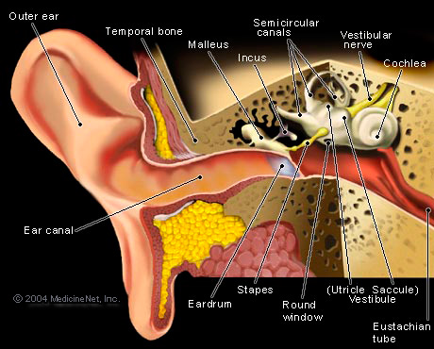
UNIT 1: STRUCTURE OF THE EAR
Notes:
There are several definitions of PBL found in literature and here are some of the key definitions of PBL as a teaching and learning strategy.

Slide 7
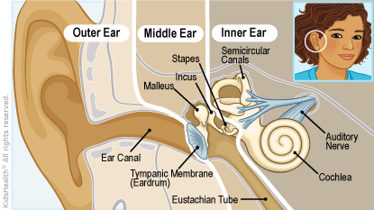
THREE PARTS OF THE EAR
The ear consists of three regions:
Outer ear
Middle ear
Inner ear

Slide 8
Outer ear
Pinna
External auditory canal
Tympanic membrane
Transfers sound waves to the bones of the middle ear
Cerumen glands
Specialized wax glands
trap tiny bits of dirt or other tiny foreign materials and move this debris outward, away from the eardrum
Lubricates the skin of the ear canal and tympanic membrane

Slide 9
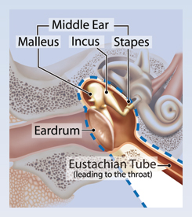
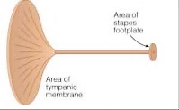
The area of the tympanic membrane is much larger than the area of the stapes footplate/oval window
Therefore sound is amplified 20X in the middle ear
Middle ear and amplification of sound

Slide 10
Inner ear

Slide 11
Activity 4.1 (p.103)

Slide 12
Answer 4.1

Slide 13
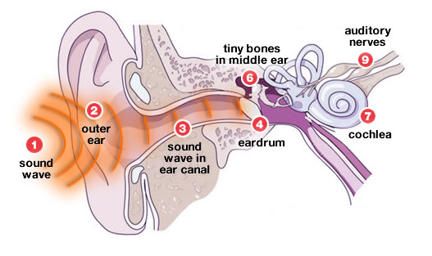
UNIT 2:PATH OF SOUND THROUGH THE EAR
Pinna
Auditory canal
Tympanum
Hammer
Anvil
Stirrup
Oval window
Cochlea
Organ of Corti
Auditory nerve

Slide 14
PATH OF SOUND

Slide 15
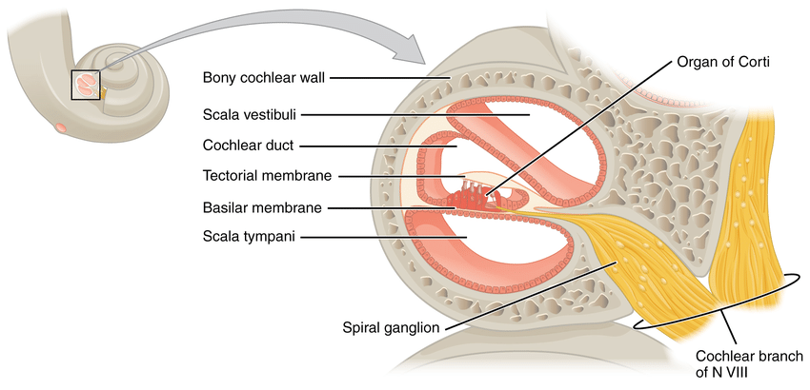
Hearing
The stirrup causes the membrane of the oval window to vibrate.
This sets up waves in the perilymph of vestibular canal.
The organ of Corti in the cochlea canal becomes stimulated.
The stimulus is converted to a nerve impulse.
The nerve impulse is carried by the auditory nerve to the cerebrum where the sound is interpreted.

Slide 16
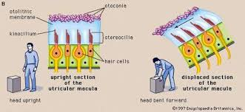
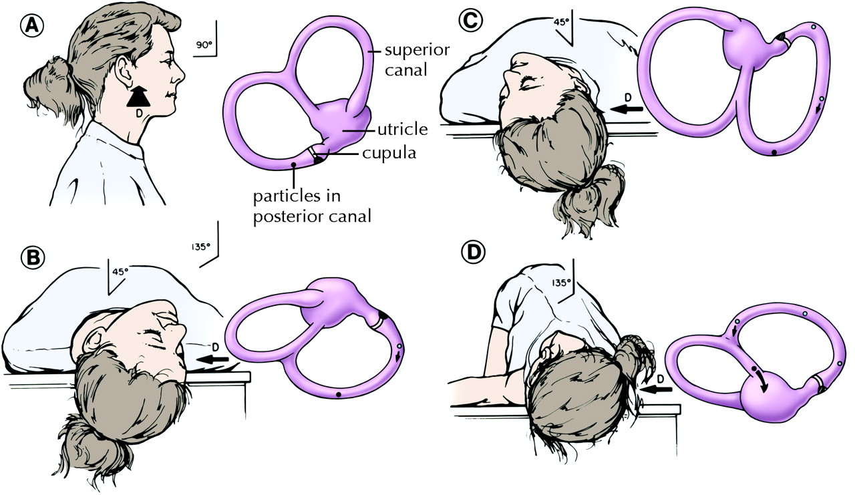
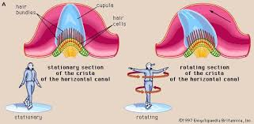
Dynamic balance

Slide 17
Balance and equilibrium
Sudden changes in speed and direction causes the endolymph within the semicircular canals to move.
The movement of the fluid stimulates the cristae in the ampullae – situated at the base of the semi circular canal.

Slide 18
Balance and equilibrium
When the direction of the head changes, gravitational pull stimulates maculae – in the sacculus and utriculus
Within the cristae and maculae the stimuli is converted to impulses
These impulses are sent to the brain by the vestibular branch of the auditory nerve to the cerebellum for interpretation to restore balance.

Slide 19
Activity 4.2 (p.109)

Slide 20
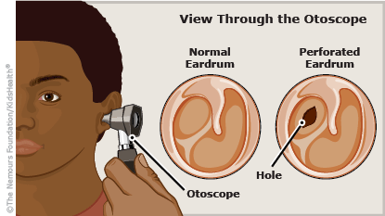
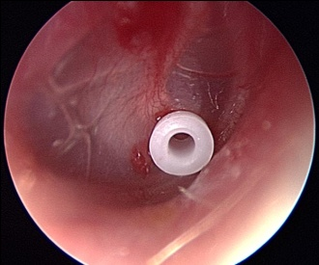
Unit 3: Diseases and disorders of the ear
Middle ear infections are the most common causes of ear ache.
Micro-organisms cause the production of fluids in the middle ear,
the fluid cannot then drain through the eustachian tube as it is swollen,
The fluid caused by the infection makes the Eustachian tube to be swollen, inflamed and clogged.
the accumulation of the fluids increases pressure in the middle ear causing the ear to ache.
Grommets -tiny plastic buttons with a fine hole down the middle may be inserted into the eardrum to allow drainage of the middle ear until the eustachian tube recovers.

Slide 21
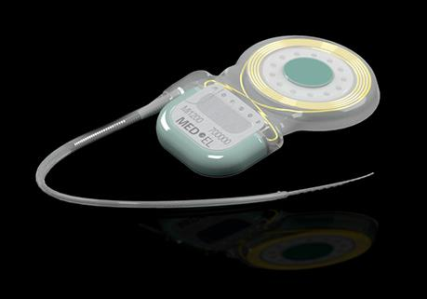
Deafness and difficulty in hearing
Causes
Damage to hair cells in the cochlea
Due to disease, ageing or injury
Injury to parts of the ear, nerves or parts of brain responsible for hearing
Hardened wax
Hardening of ear tissues such as ossicles
Treatment
Hearing aids
Cochlea implants

Slide 22
Cochlea implant

Slide 23
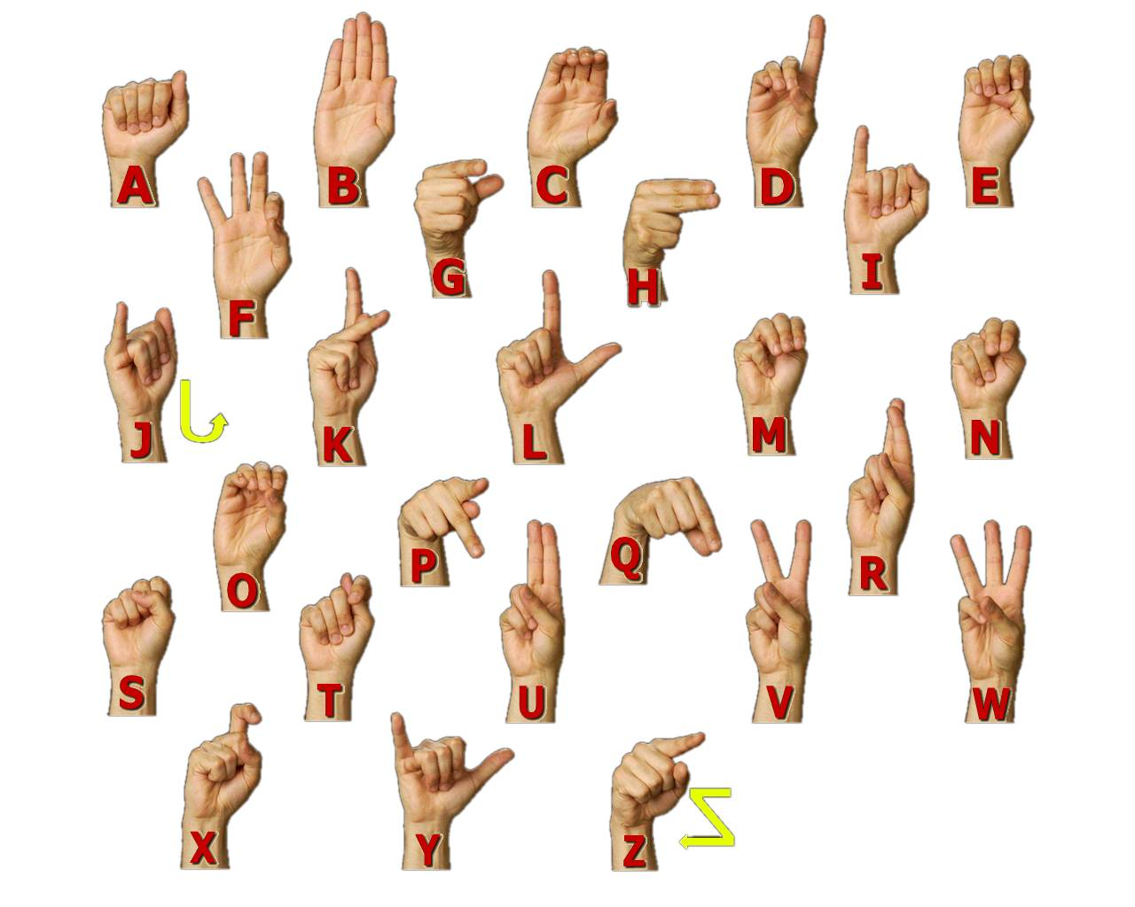
Sign language alphabet

Slide 24
Activity 4.3 (p.111)
1.1. Identify: B D 1.2 Describe the role of the semi-circular canals in maintaining balance. 1.3 Describe how an increased production of mucus in the nose and throat may lead to the bursting of part E. 1.4 Explain why fusion of the structures at A may lead to hearing loss. 1.5 Which part of the brain will receive impulses from part C?

Slide 25
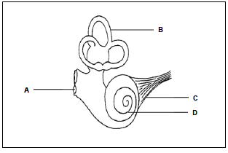
QUESTION 2: (Taken from DBE Feb/March 2016) The diagram represents a part of a human ear. 2.1 Identify part: a) A b) D 2.2 Name the receptors that are found in part B. 2.3 Explain the consequence to the human body if: a) Part C is damaged b) Part A becomes hardened 2.4 Explain why people with middle-ear infections are usually advised not to travel by aeroplane. QUESTION 3: (Taken from DBE Nov 2015 P1) Describe how the sacculus and utriculus in the human ear maintain balance in the human body.

Slide 26
Answers 4.3
Question 1
1.1. (a) Auditory nerve √
(b) Round window √
1.2.
- The cristae √ in the semi-circular canals
- are stimulated by changes in speed and direction √ of
movement
- The cristae convert the stimuli to nerve impulses √
- The nerve impulses are transported along the auditory
nerve √
- to the cerebellum √ to be interpreted

Slide 27
1.3.
- The mucus will block the opening of the
Eustachian tube √
- Air cannot enter or leave the middle ear √
- to equalise pressure √ /causing imbalance in pressure
OR
- Mucus may move through the Eustachian tube to
the middle ear √
- Build-up of mucus causes pressure in the middle
ear √
- pushing on the tympanic membrane √ /part E

Slide 28
1.4. - The ossicles/structures at A will not be able to vibrate √
- and hence no vibrations will be passed to the inner ear√/cochlea will not be stimulated
1.5. Cerebrum √
QUESTION 2
2.1.(a) Round window√
(b) Cochlea√
2.2 Cristae√

Slide 29
2.3
(a) - Impulses from the cochlea cannot be transmitted to the brain√
- and therefore hearing will not occur √
(b)- Part A will not be able to vibrate √
- The round window will not absorb the sound waves from the cochlea - and hearing will be affected√ (Any 2)
2.4. - Mucus in the middle ear√
- will lead to the blockage of the Eustachian tube√
- which will not be able to equalise the pressure √ in the middle ear
- resulting in pressure on the tympanic membrane √
- that may cause the tympanic membrane to burst √
- leading to hearing loss √

Slide 30
Question 3
Changes in the direction and speed of movement:
- Causes the endolymph in part D √ /semi-circular canals to move
- The cristae √ are stimulated
- and converts the stimulus into an impulse √
- which is transmitted via the auditory nerve √
- to the cerebellum √
from which impulses are transmitted via motor
neurons √
- to the skeletal muscles √ /effector
- to restore balance of the body √

Slide 31
KEY POINTS FOR THE MODULE
In the process of hearing, learners need to know that sound coming from a source is the stimulus.
This stimulus moves as sound waves from the source through the auditory canal until it reaches the tympanic membrane.
From here the stimulus of sound moves as vibrations through the tympanic membrane, ossicles and oval window.
When the vibrations pass into the endolymph of the inner ear then the stimulus is in the form of pressure waves which then
stimulate the organ of Corti.
This is when the stimulus is converted into an impulse which can be transmitted to the cerebrum.
The ear also plays an important role in maintaining balance.

Slide 32
KEY POINTS FOR THE MODULE
Teachers must emphasise that the parts involved in amplification are the tympanic membrane, the ossicles and the oval window. The following features of the structures involved help in the amplification process:
* The sound vibrations move from the large tympanic
membrane to the smaller oval window
* The ossicles that transmit the vibrations decrease in size
from the hammer to the anvil to the stirrup
The above features concentrate/intensify the sound vibrations causing it to be amplified.

