Slide 1
SSIP April – May 2020
LIFE SCIENCES
Topic(s) : ENDOCRINE SYSTEM
Venue:

Slide 2
OUTCOMES OF THIS MODULE
Statement of the learning outcomes/objectives
When you complete this module you will be able to:
differentiate between endocrine and exocrine glands
discuss the differences between the nervous system and the endocrine system
identify the different endocrine glands and the hormones they secrete
discuss the different negative feedback mechanisms
define homeostasis
Notes:
Please state these very simple and explicit and in the FG you may ask one participant to read those out loud and make sure they are linked to the activities that you have in the Manual.

Slide 3
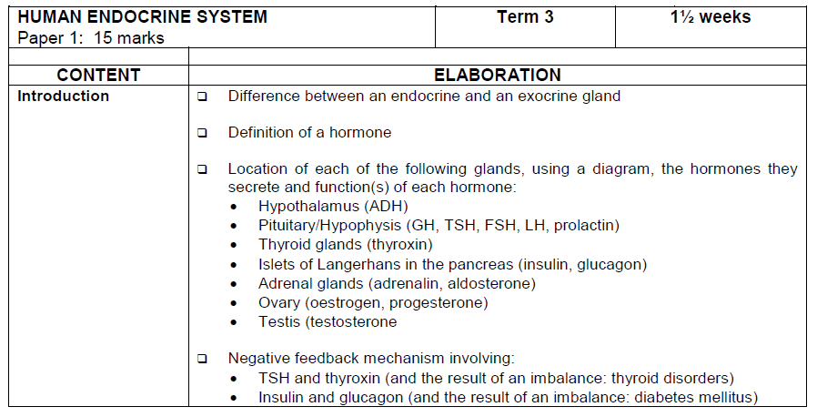

Slide 4
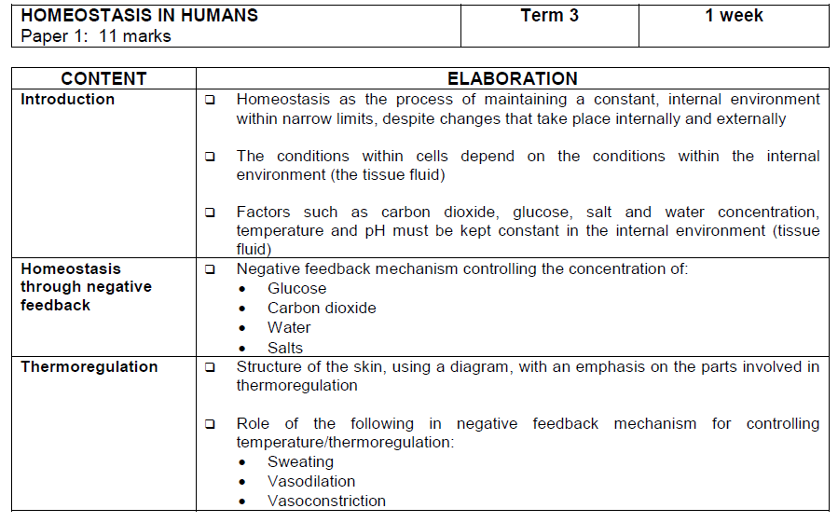
Will not be dealt with in this training session

Slide 5
The endocrine system vs. nervous system
The nervous system and endocrine system controls different types of activities in the body.
They are jointly responsible for the functioning of all the different organs and systems, this is known as coordination
The nervous system co-ordinates very quick responses to external stimuli
The endocrine system controls responses that are not that fast but are long-lasting and reflect the body’s internal environments

Slide 6
Comparison between Endocrine and nervous system
Endocrine system | Nervous system
Made up of glands Produces hormones Hormones transported by the blood Effects are slower and more general Hormones control long-term changes (e.g. growth) | Made up of nerves Produces nerve impulses Impulses transmitted along the nerves Effects are very quick and very specific Nerve impulses control short-term changes (e.g. sneezing, lifting your arm)

Slide 7
The endocrine system
The Endocrine system works in conjunction with the Nervous system.
The endocrine system is responsible for chemical coordination, regulating the functioning of all the organs in the body.
Consists of glands situated throughout the body
These endocrine glands secrete organic chemical messengers called hormones in the bloodstream
Hormones are organic substances and are mostly proteins, but a few are lipids(fats) (usually the sex hormones)
Hormones are produced in small quantities
They are carried in blood stream to target organ/tissue where they control the activities of a target organ to perform a specific function
Hormones work together as an integrated system where they either stimulate or inhibit organs
Why is adrenalin injected instead of taken orally?

Slide 8
Endocrine glands vs. Exocrine glands
Endocrine glands | Exocrine glands
Glands are ductless, secrete directly into bloodstream | Secrete their substances into ducts and not the bloodstream (think of the salivary glands secreting saliva in ducts that transports it to the mouth) sweat glands, mammary glands, the liver, salivary glands and the pancreas.)
Secrete hormones | Does not secrete hormones

Slide 9
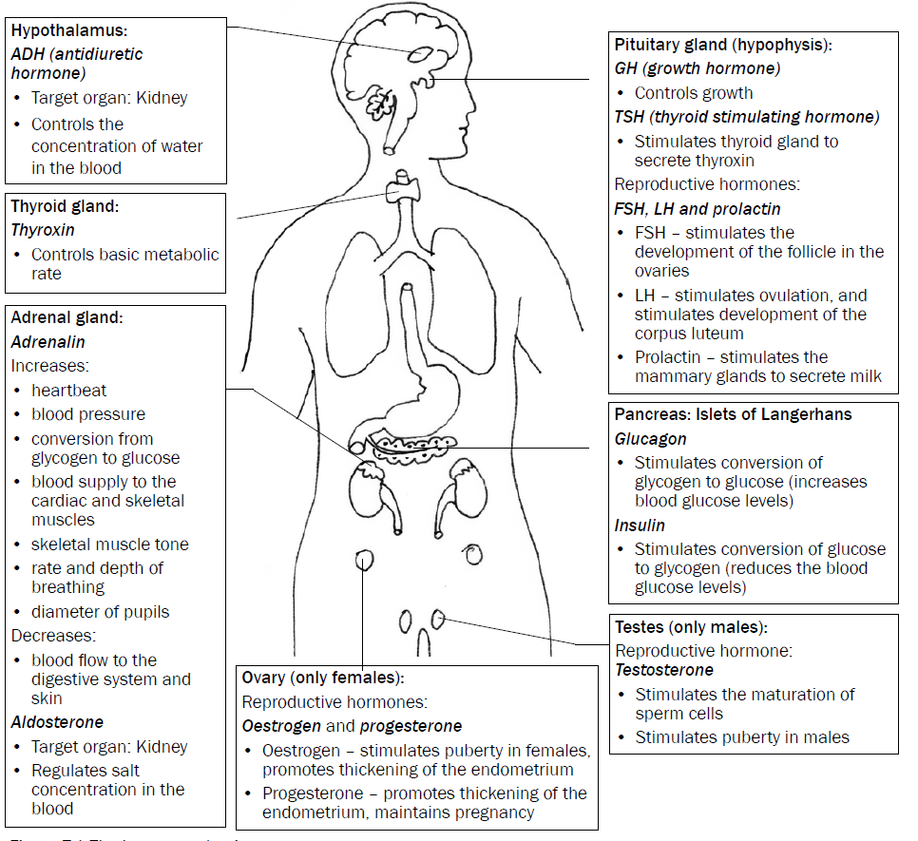
A “ snapshot” of the human endocrine system

Slide 10
HOMEOSTASIS
It is a process of maintaining a constant internal environment (blood and tissue fluid) within the body. This enables the body to function efficiently, despite changes in the external or internal environment

Slide 11
NEGATIVE FEEDBACK MECHANISMS
They operate in the human body to detect changes or imbalances in the internal environment and to restore the balance.

Slide 12
General sequence of events in a negative feedback mechanism
STEP 1- An imbalance is detected
STEP 2 - A control centre is stimulated
STEP 3- Control centre responds
STEP 4- Message sent to target organ/s
STEP 5- The target organ responds
STEP 6- It opposes/reverses the imbalance
STEP 7- Balance is restored

Slide 13
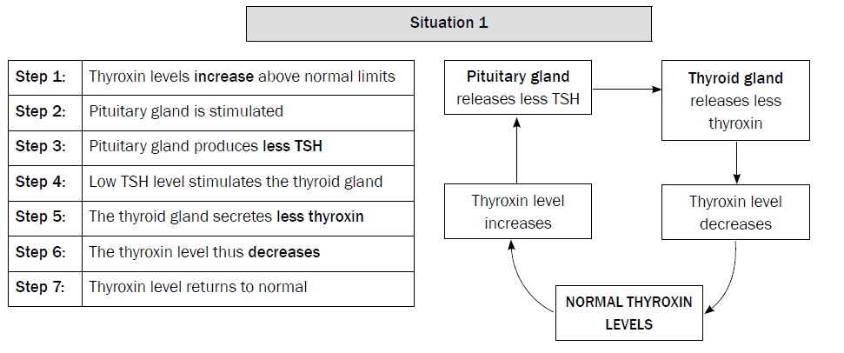
Regulation of thyroxin levels in body Thyroxin levels are too high

Slide 14
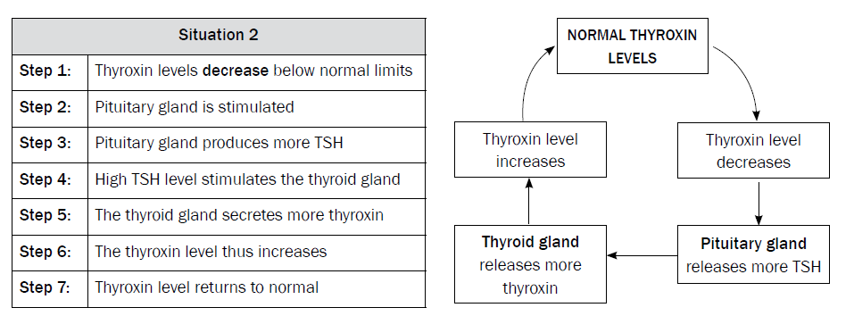
Regulation of thyroxin levels in body Thyroxin levels are too low

Slide 15
Regulation of GLUCOSE levels in bloodstream

Slide 16
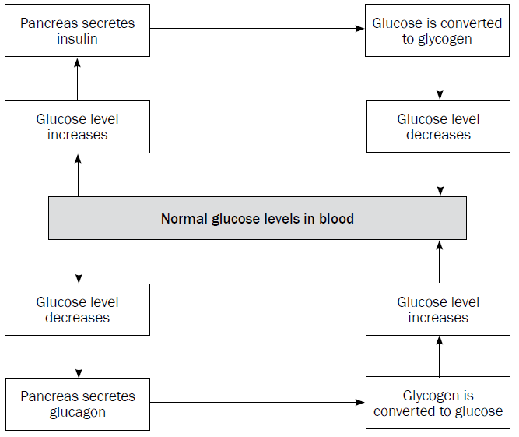
Flow chart of negative feedback mechanism involving GLUCOSE levels in bloodstream

Slide 17
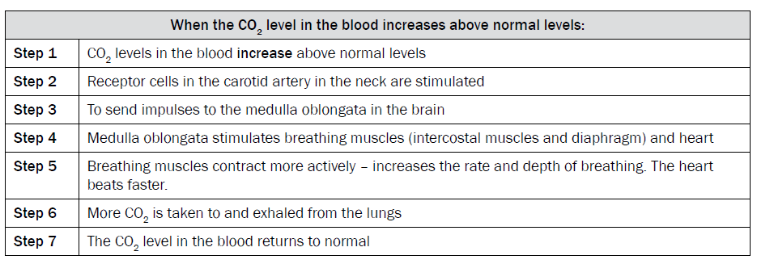
The regulation of CARBON DIOXIDE levels in body’s internal environment

Slide 18
The regulation of WATER balance in internal environment (OSMOREGULATION)

Slide 19
The nephron- throwback to grade 11!
Glomerus
Distal convoluted tube
Collecting ducts

Slide 20
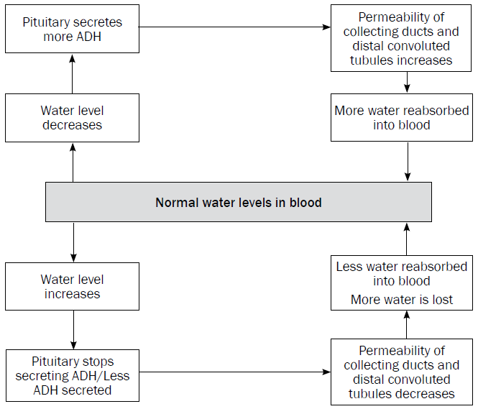
Flow chart of Osmoregulation

Slide 21
The regulation of SALT balance in internal environment

Slide 22
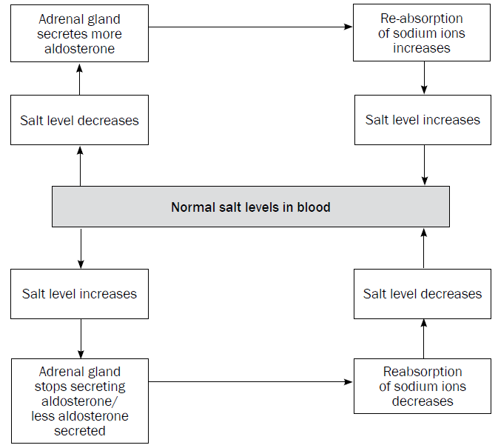
Flow chart of regulation of salt balance

Slide 23
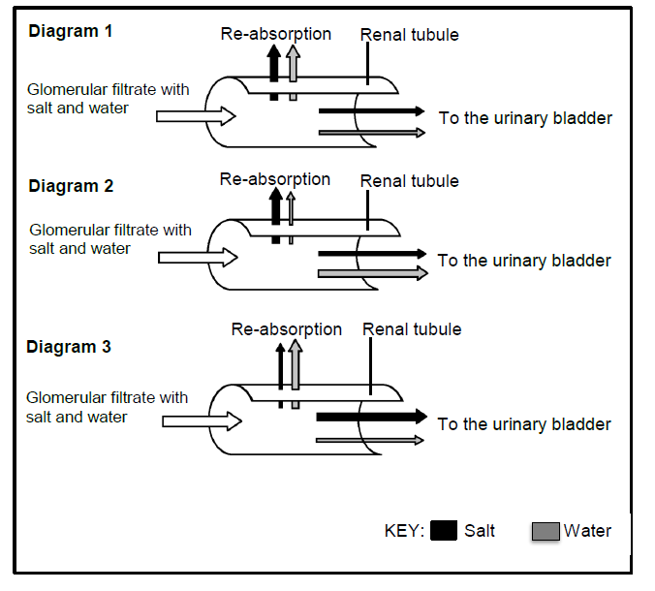
Activity 1.1
The diagrams below show the re-absorption of salt and water through the tubules of a nephron in the kidney under three different conditions. The width of the arrows represents the amounts of salt and water
1. Name the hormone in a human body that is responsible for controlling the:
a) Water content (1)
b) Salt content (1)
2. Name the gland that secretes the hormone in question 1b. (1)
3. Which diagram (1,2,3) would represent a person who had eaten salty chips on a hot day without any intake of water? (1)
4. Explain your answer to question 3. (5)

Slide 24
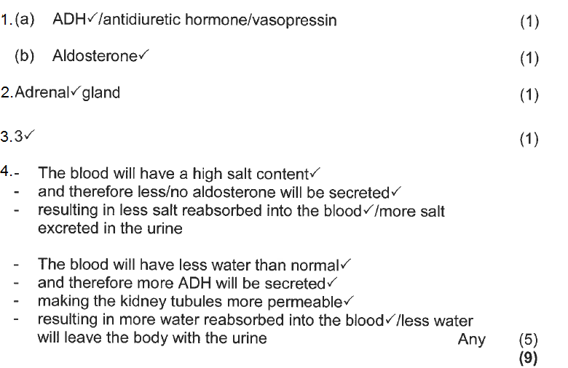
Answers Activity 1.1.

Slide 25
KEY POINTS FOR THE MODULE
Emphasis should be placed on what a hormone is
Learners have to know the “snapshot” diagram
The seven steps of a negative feedback mechanism assists in understanding the 5 different ones.
Learners have to know the 5 different negative feedback systems

