Slide 1
SSIP July 2020
LIFE SCIENCES
Topic(s) : Evolution
Venue:

Slide 2
SSIP AIMS/GOALS
The four interconnected outcomes that drive the professional development activities for SSIP are:
Enhancing Teachers knowledge: deep understanding of subject matter knowledge and students ideas on the content
Enhancing quality teaching and assessment for learning: effective instructional approaches that teachers may use to ensure improved understanding by most learners.
Developing ICT integration skills :Use of ICT to improve teaching and learning
Building professional learning communities: allow teachers to start collaborating and form professional networks in non-formal settings in context of their schools

Slide 3
PROGRAMME
Insert the programme about here as in your Manual

Slide 4
MODULE 1
Overview of Module 1
In this module we will look at the basic concepts of ‘Evolution’
Content
You will study this module through the following units:
Unit 1: Introduction to evolution
Unit 2: Evidence of evolution
Unit 3: Lamarckism and Darwinism
Unit 4: Punctuated equilibrium
Unit 5: Artificial selection
Unit 6: Speciation
Unit 7: Mechanisms of reproductive isolation
Unit 8: Evolution in present times
Notes:
Give an overview of the module and give the key content and or index that you will be covering in the Module

Slide 5
OUTCOMES OF THIS MODULE
Statement of the learning outcomes/objectives
When you complete this module you will be able to:
Define biological evolution .
  (knowledge: level A of Bloom’s taxonomy)
Differentiate between a hypothesis and a theory .
  (understanding: level B of Bloom’s taxonomy)
Describe different types of evidence of evolution
  (knowledge and understanding: level A and B of Bloom’s taxonomy)
Understand how variation is brought about the role of variation in evolution
  (knowledge, understanding and application: level A; B and C of Bloom’s taxonomy)
Describe Lamarck and Darwin's theory of evolution
  (knowledge, understanding and application: level A; B and C of Bloom’s taxonomy)
Explain how natural selection occurs
  (understanding and application: level B and C of Bloom’s taxonomy)
Describe and explain punctuated equilibrium as a theory of evolution
  (knowledge, understanding and application: level A; B and C of Bloom’s taxonomy)
Explain how artificial selection occurs
  (knowledge, understanding and application: level A; B and C of Bloom’s taxonomy)
Describe the process of speciation and apply the theory to new case studies
  (knowledge, understanding and application: level A; B and C of Bloom’s taxonomy)
Describe reproductive isolating mechanisms and say how they keep species separate
  (knowledge, understanding and application: level A; B and C of Bloom’s taxonomy)
Explain how evolution is still evident in present times using different examples
  (knowledge, understanding and application: level A; B and C of Bloom’s taxonomy)
Notes:
Please state these very simple and explicit and in the FG you may ask one participant to read those out loud and make sure they are linked to the activities that you have in the Manual.

Slide 6
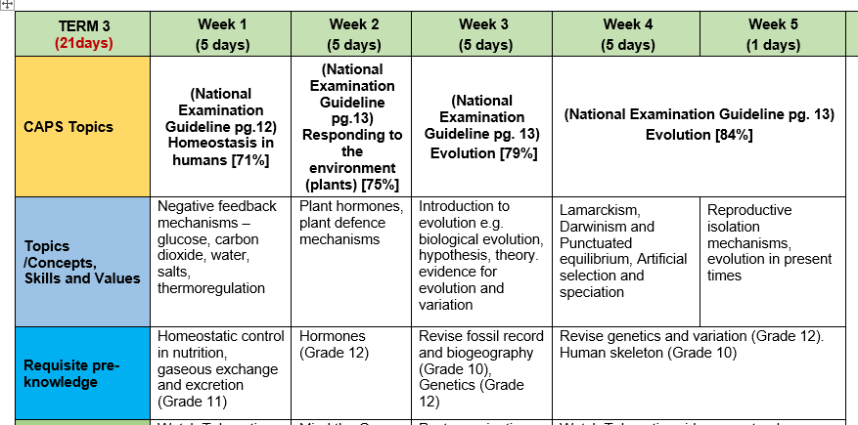
2020 Post COVID: Revised ATP FOR TERM 3
15/07 – 19/07

Slide 7
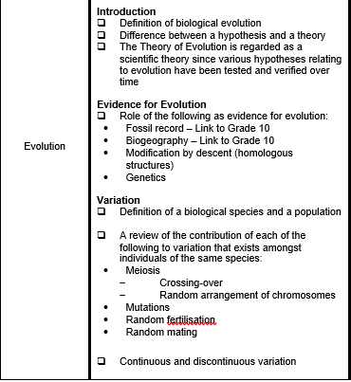
CAPS information

Slide 8
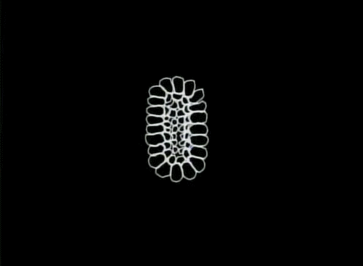
What is evolution?
Introduction to evolution
The processes that have transformed life on earth from its earliest forms to the vast diversity that characterizes life on earth today.
A change in the genes!!!!!!!!
Notes:
They look diff because things change over time…
Applies also to the galaxy and the universe

Slide 9
Teaching Terminology
STRATEGIES TO TEACH TERMINOLOGY:
In every lesson identify new terms/concepts and write it on the board.
Learners will take down terms/concepts at the back of their notebooks noting the correct spelling.
Learners must define/write down the meaning of these words from listening to the educator’ lesson/finding meaning from the dictionary or textbook.
Break down the concept/term where possible- give the meaning of the prefix and suffix e.g. photo (light) synthesis (to build up).
Use the concept in a sentence.
Educators must check that learners have done the above, on a daily basis e.g. asks any learner to define a concept.
By the end of the year ALL learners have a comprehensive GLOSSARY of ALL terms /concepts.
ASSESSMENT: Biological terms to be included in all daily assessment tasks. Develop crossword puzzles. (Use various websites from internet e.g. A – Z teachers stuff)
Learning terminology also helps in answering MCQs and matching questions, etc.
Activity 1.1 puzzle making and google quiz
Notes:
Participants to practice making their own crossword puzzle or word search

Slide 10
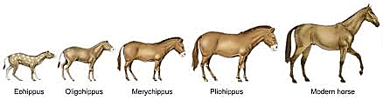
Biological evolution
means that all present-day forms of life …
  have descended from, and are related to, those that lived in the past
  may look different because they became modified from one generation to another

Slide 11
HYPOTHESIS VS. THEORY
TERM | Hypothesis | Theory
DEFINITION | A testable statement about the natural world that can be used to build more complex inferences and explanations. | A well-substantiated explanation of some aspect of the natural world that can incorporate facts, laws, inferences, and tested hypotheses.
EXAMPLE | The high incidence of HIV-AIDS is due to the lack of education about the causes of the disease | The sun is the centre of the universe, around which all the planets revolve (Heliocentric theory)
Activity 1.2
Notes:
Participants to fill in the table before revealing the information in the table

Slide 12
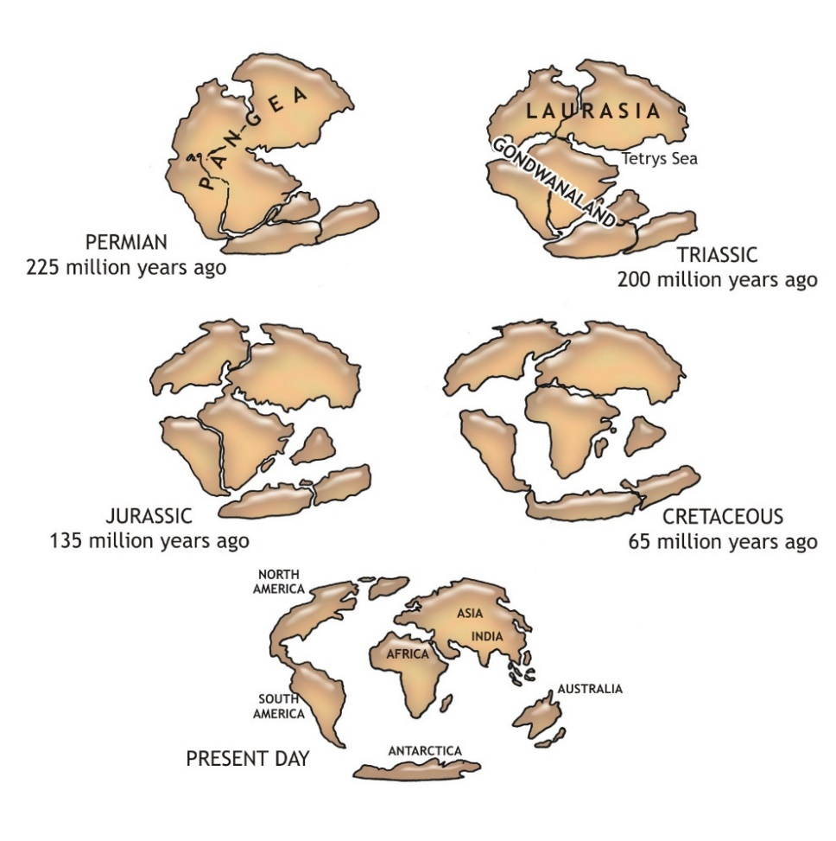
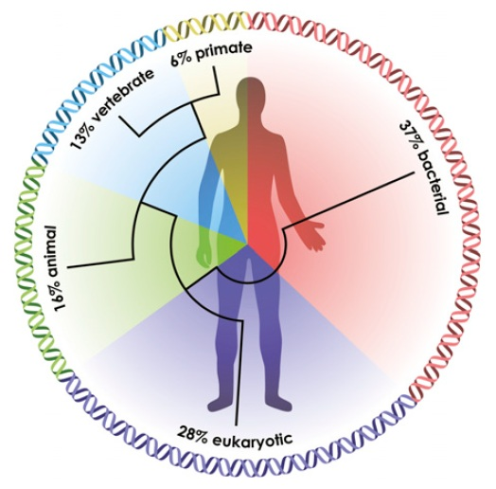
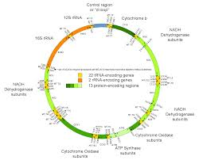
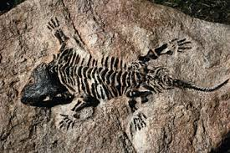
Evidence of evolution
Biogeography
Genetics
Fossil record
mtDNA
Notes:
Video embedded in the title

Slide 13
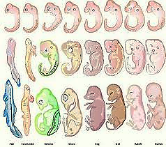
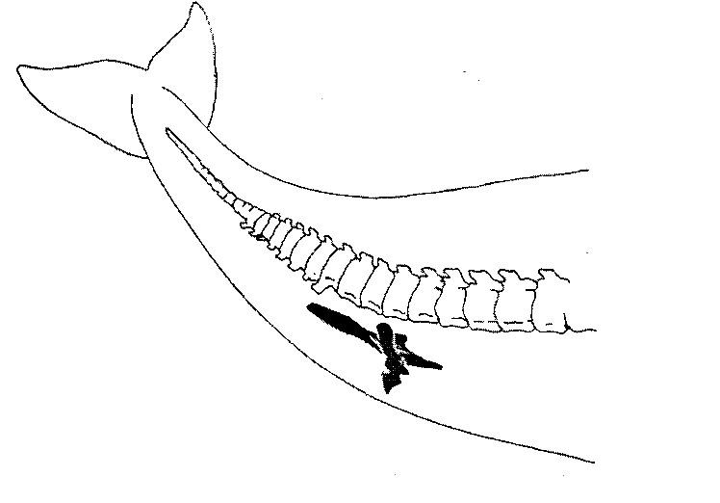
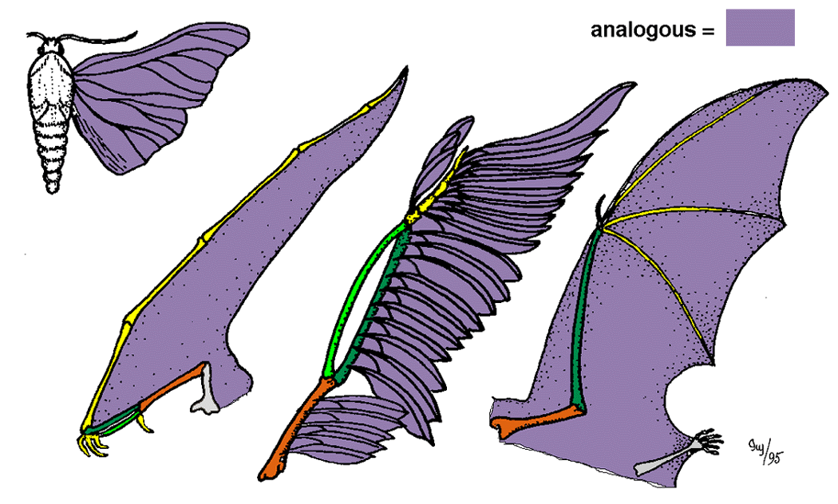
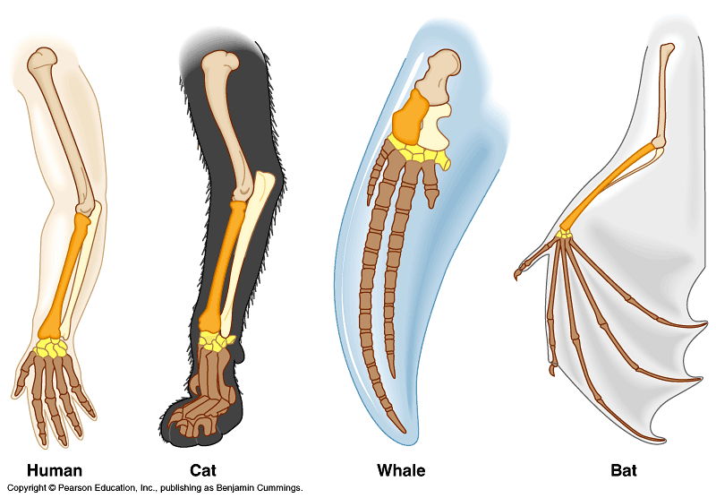
Evidence of evolution
Embryology
Vestigial organs
Comparative anatomy
Analogous structures
Homologous structures

Slide 14
Sources of Variation
Mutation: a sudden unexpected change in the genetic structure/DNA of a cell
Harmful mutations: causes changes in the DNA that can cause errors in protein sequencing that can result in partially or completely non functioning proteins
Harmless mutations: have no effect on the structure or functioning of the organism.
Useful mutations: can be advantageous to the organism and are passed on from parent to offspring

Slide 15
Sources of Variation
Meiosis: causes genetic variation in gametes. This results in offspring that are better adapted to a particular environment and ensures that they will have a better chance of survival
  crossing over: genetic information is exchanged by homologous chromosomes
  Random arrangement: homologous chromosomes line up along the equator randomly

Slide 16
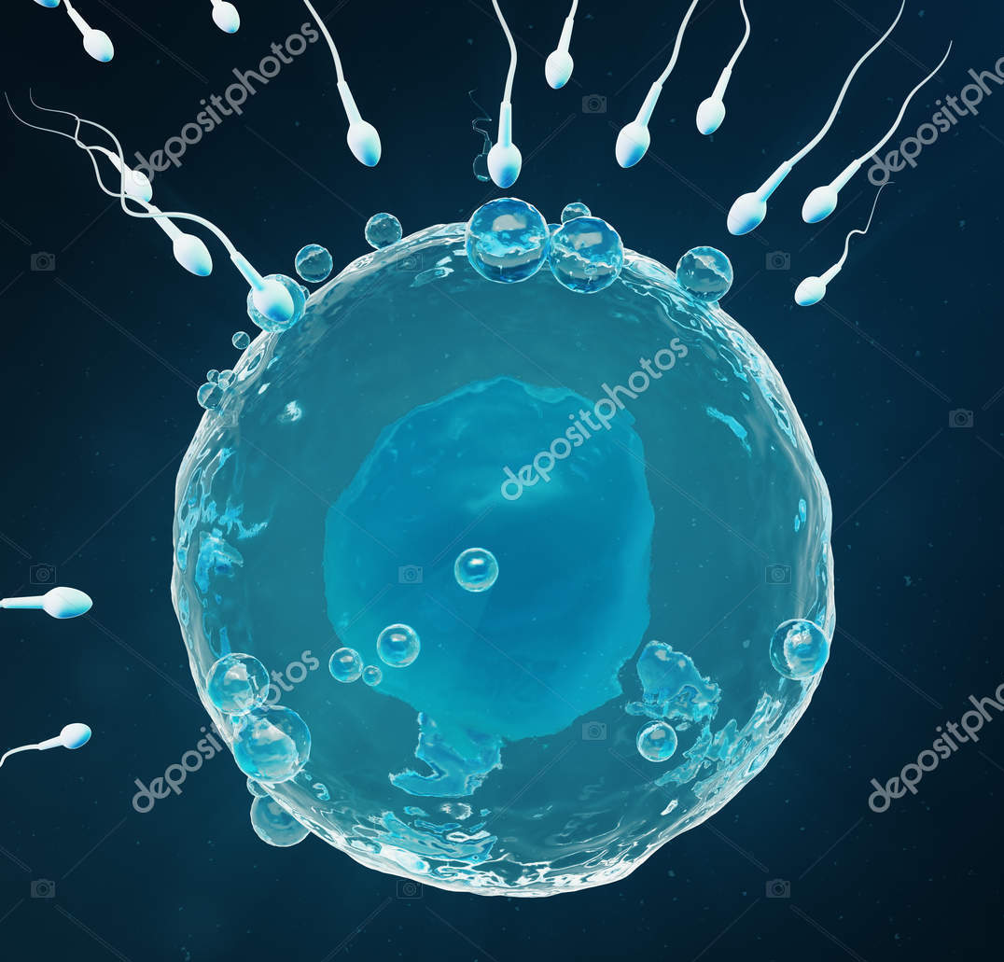
Sources of Variation
Random fertilization: Fertilisation is a chance process and we can therefore not be sure which sperm cell will fertilise which egg cell.
  All sperm produced by the male are different and all the ova produced by the female are different therefore the offspring produced by these parents will be different.
  If there were 4 sperm cells and 4 ova there would be 16 possible zygotes.
Random mating between organisms within a species
16

Slide 17
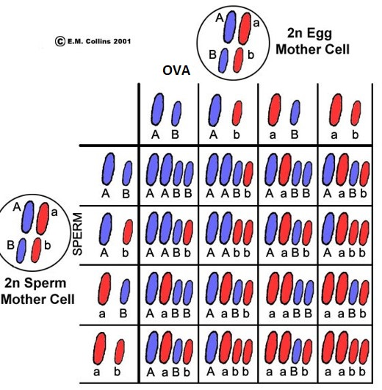
Sources of Variation
Table showing how chance fertilisation results in variation of offspring

Slide 18
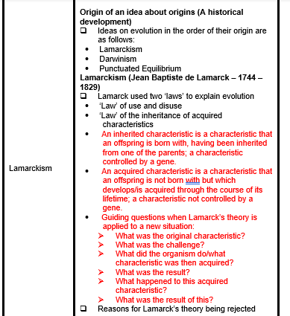
CAPS information

Slide 19
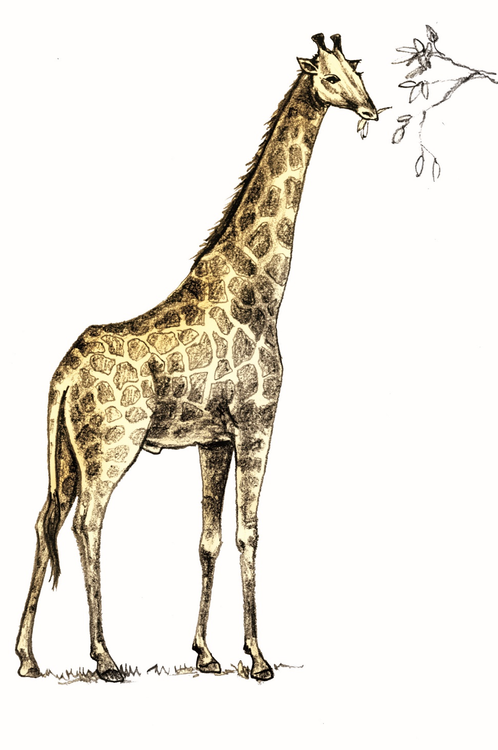
Theories of evolution
Jean Baptiste Lamarck (early 1800’s) proposed:
“The inheritance of acquired characteristics”
He proposed that by using or not using its body parts, an individual tends to develop certain characteristics, which it passes on to its offspring.
Example:
A giraffe acquired its long neck because its ancestor stretched higher and higher into the trees to reach leaves, and this increasingly lengthened neck was passed on to its offspring.

Slide 20
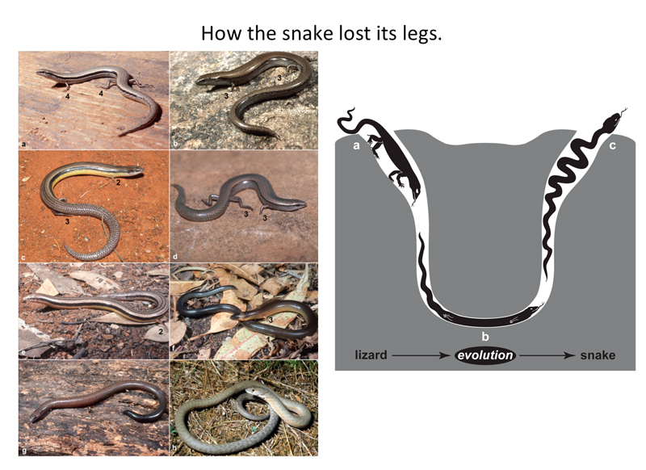
Jean Baptiste de Lamarck
As the environment changes , organisms will be determined to use an organ more/less so that the organ becomes bigger/ smaller in order to adapt to environmental changes
This is known as the “law of use and disuse”
Activity 1.3
Notes:
Participants to complete the activity on p23 of participants manual before going on to the next slide

Slide 21

Rejection of Lamarck’s theory
Organisms do not evolve because they were determined to change but changes took place randomly due to mutations
Acquired characteristics cannot be inherited i.e.. The phenotype cannot affect the genotype as discovered later by Mendel

Slide 22
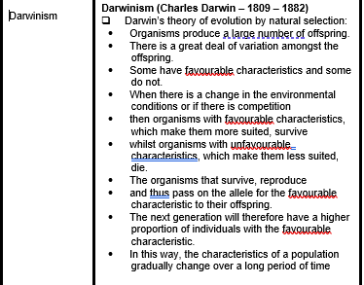
CAPS information

Slide 23
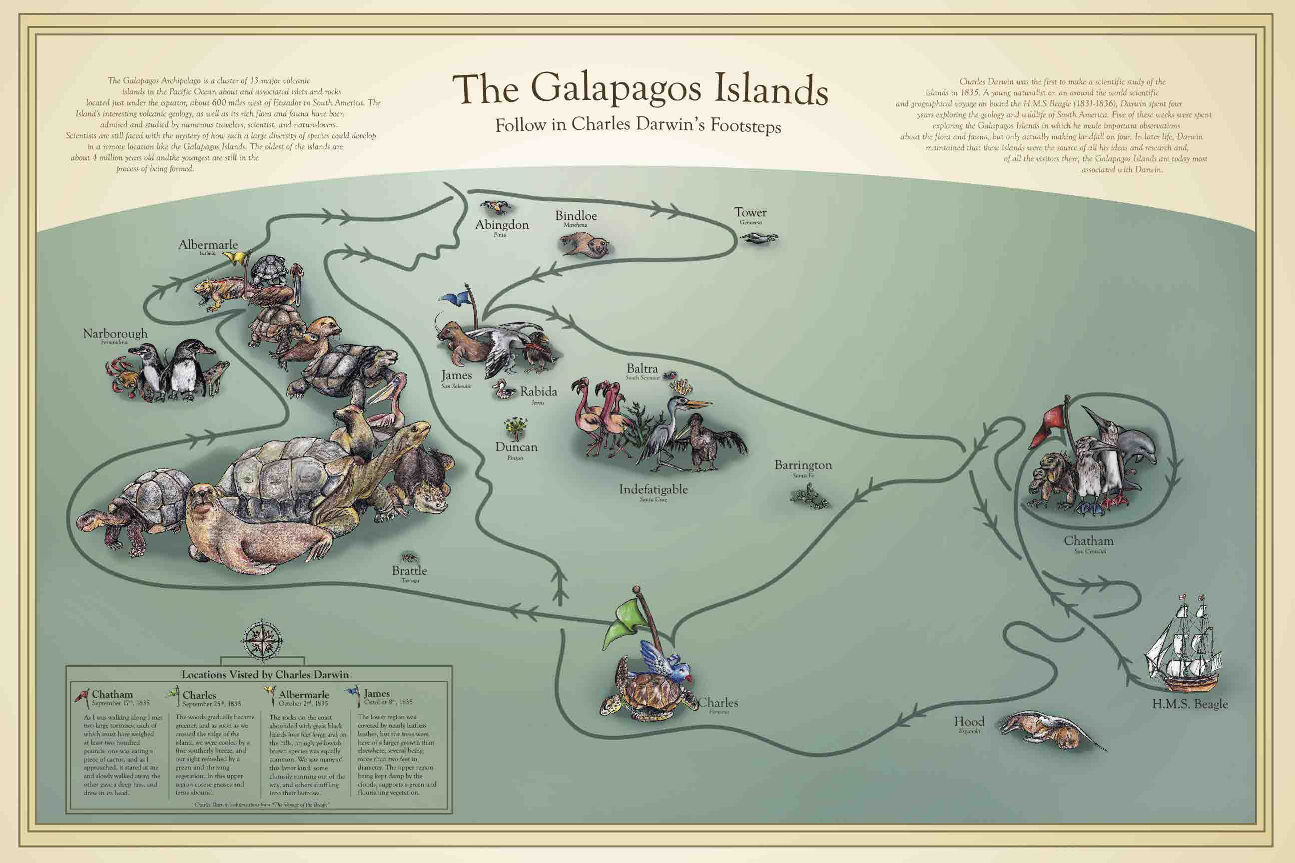
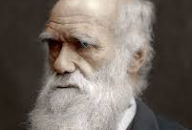
Charles Darwin
Darwin set sail on the H.M.S. Beagle (1831-1836) to survey the south seas (mainly South America and the Galapagos Islands) to collect plants and animals.
On the Galapagos Islands, Darwin observed species that lived nowhere else in the world.
These observations led Darwin to write a book.

Slide 24
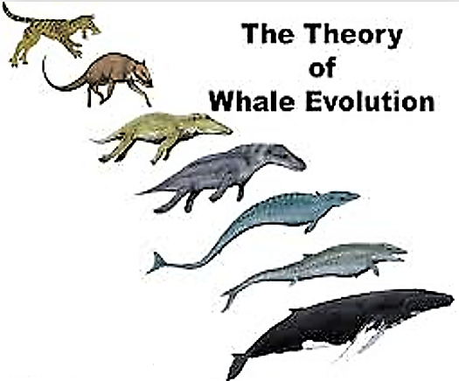
Charles Darwin
Book published in 1859:
“On the Origin of Species by Means of Natural Selection”
Two main points:
Species were not created in their present form but evolved from ancestral species i.e. whale evolution
Proposed a mechanism for evolution - NATURAL SELECTION
Notes:
Video on term NATURAL SELECTION

Slide 25
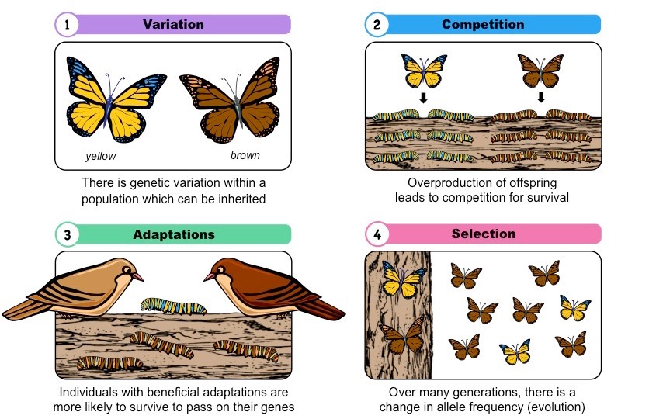
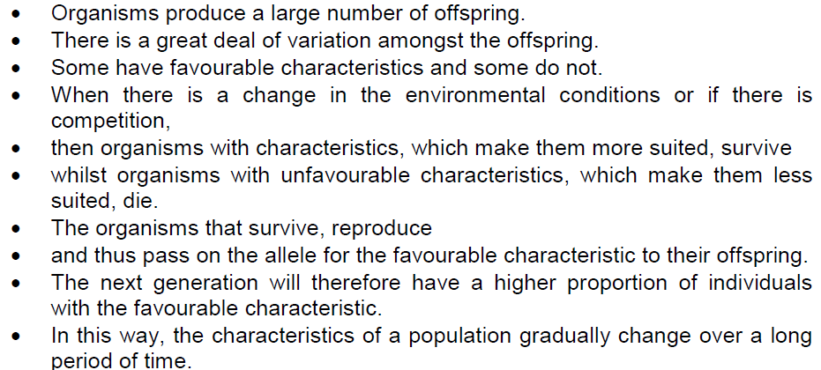
Natural selection
Notes:
Natural selection activity embedded in the heading

Slide 26

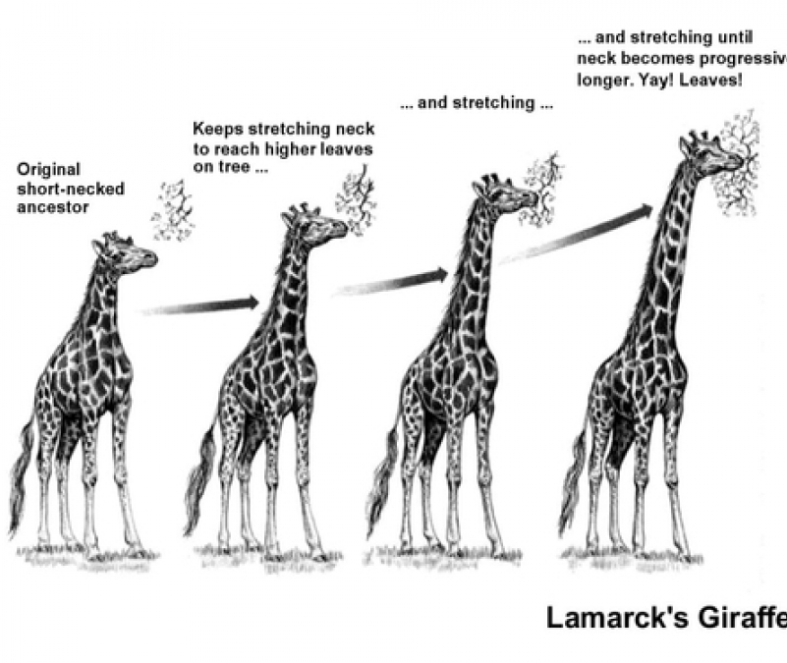
How did Lamarck explain the long necks of giraffes?
Lamarck
All giraffes had short necks✓ originally
Giraffes frequently stretched✓/used their necks to reach for leaves of tall trees✓
necks become longer✓
The long necks acquired✓ in this way
could be passed on to the next generation✓ /were inherited

Slide 27

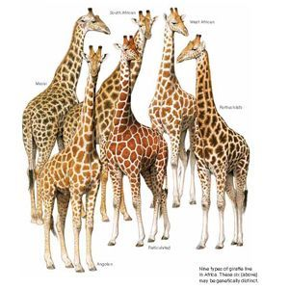
How would Darwin account for the long necks of the giraffes
As a result of genetic variation✓ in the giraffe population
some giraffes have longer necks✓ than others
Environmental change✓/competition for resources occurred causing those with shorter necks to die✓
and those with longer necks to survive✓
This is natural selection✓/survival of the fittest
The genes✓/genotype for longer necks
were passed on to subsequent generations✓ most of which now have long necks
Activity 1.4 & 1.5
Notes:
Participants to complete the activity on pp25 - 26 of participants manual before going on to the next slide

Slide 28
ACTIVITY 1.6: NATURAL SELECTION
Rock pocket mouse
Activity 1.6
Notes:
Video embedded in the title ‘Rock pocket mouse’

Slide 29

CAPS information

Slide 30
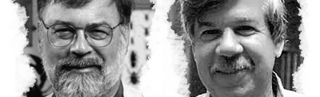
Punctuated equilibrium
Eldredge and Gould formulated this model (1972)
They observed that the fossil record gives a different picture of evolution
They believed that the fossil record did not support the theory of gradual evolution
but rather that there were long periods of stasis (4-10 million years) involving little evolutionary change
Then occasional rapid formation of new species (5,000 - 50,000 years).
Notes:
Video embedded in the title

Slide 31
Gradualism vs Punctuated Equilibrium
Some biologists claim that most evolutionary change takes place as a result of a series of very small changes (‘gradualism’).
Others claim that there were long periods with no or little change and then short periods of rapid change (‘punctuated equilibrium).
Punctuated equilibrium predicts that rapid (a lot of) evolutionary change takes place in short periods of time tied to speciation events

Slide 32
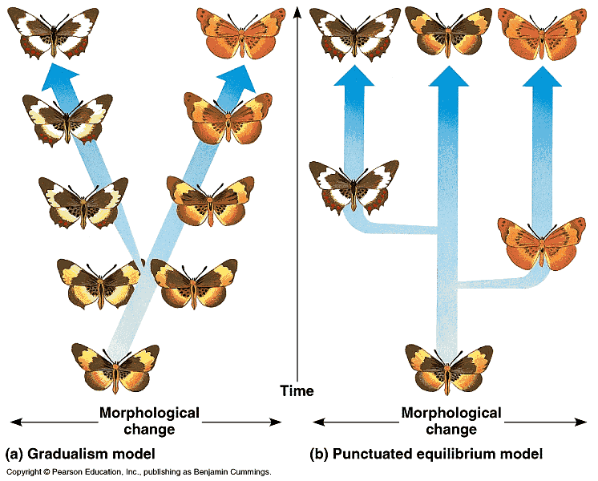
Two models

Slide 33
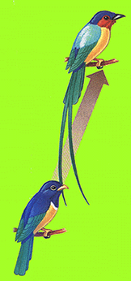
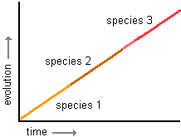
Gradual evolution
Graph showing Gradual Evolution

Slide 34
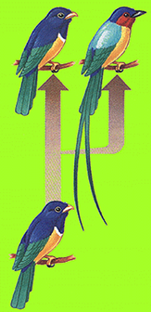
Species Z
Species Y
Graph showing punctuated equilibrium
Species X
Species W
Stasis
Time
Rapid speciation
Stasis
Rapid speciation
Stasis
Rapid speciation
Evolution

Slide 35
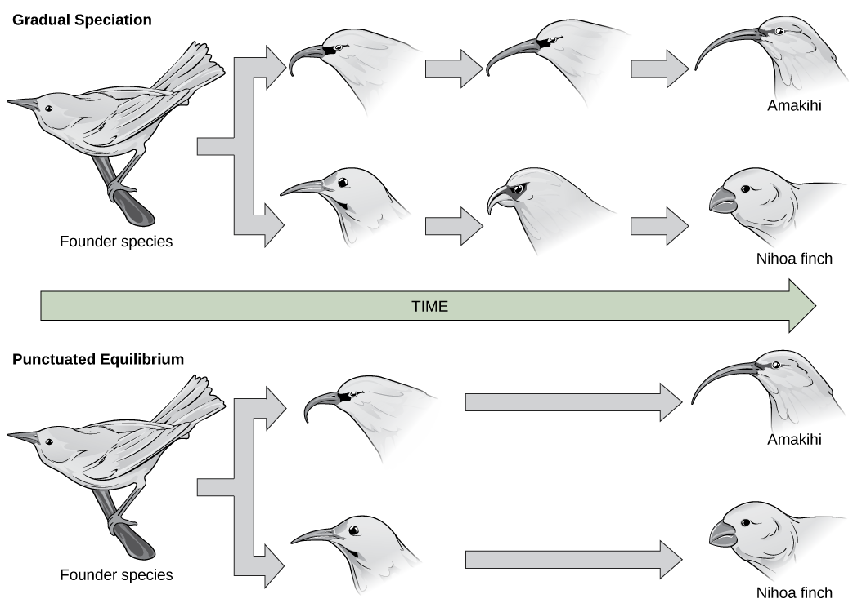

Slide 36
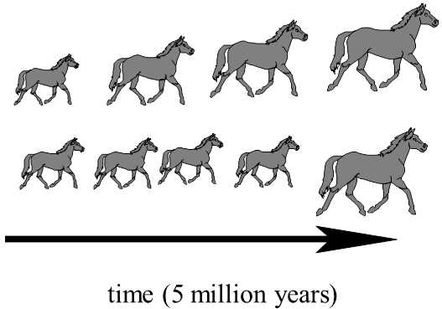
Gradualism
Punctuated equilibrium

Slide 37
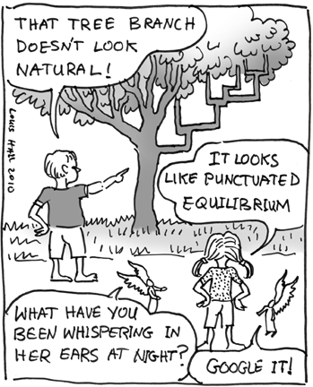
practical worksheet 11
Activity 1.7

Slide 38
CAPS information

Slide 39
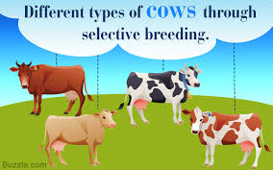
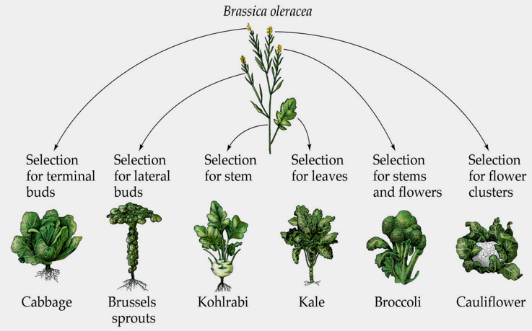
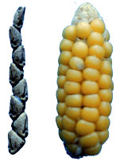
Artificial selection
Artificial selection is the intentional reproduction of individuals in a population that have desirable traits.
Some consider domesticated animals to be the ultimate products of artificial selection.
  The selective breeding of cows, pigs, sheep, and chickens.
  Food crops
  Thoroughbred racehorses
  Cats and dogs
Notes:
Video embedded in the title

Slide 40
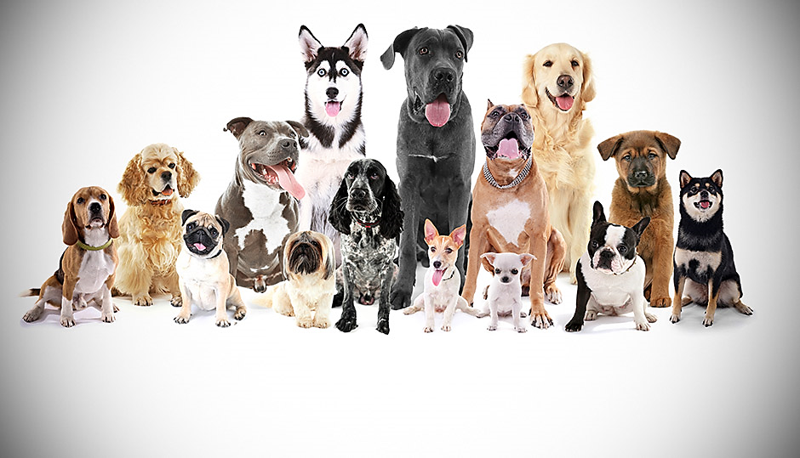
Artificial selection
There can be a down side to artificial selection.
  Reduction in genetic variation
  Inbreeding has resulted in health issues ranging from decreased life span to hip dysplasia.
Activity 1.8
Notes:
Participants to complete the activity on pp40 - 41 of participants manual before going on to the next slide

Slide 41
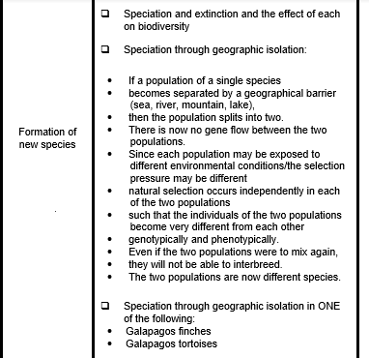
CAPS information

Slide 42
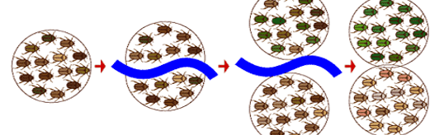
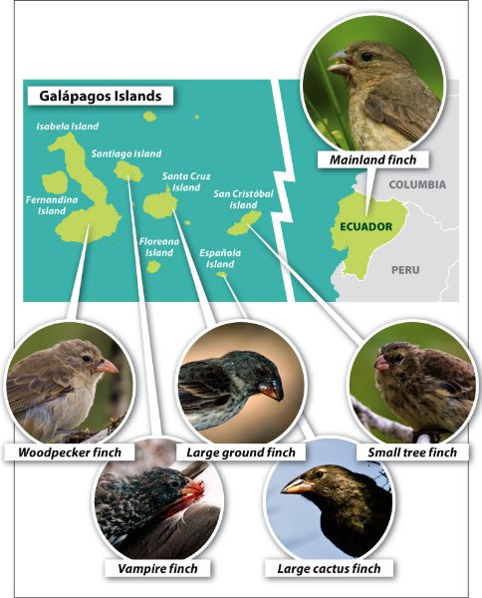
Speciation
Population: individuals of the same species living in the same area that can randomly interbreed
Species: organisms that have the same characteristics, capable of random interbreeding and producing fertile offspring
Speciation: is the evolutionary process by which populations evolve to become distinct species.
Geographical isolation and reproductive isolation mechanisms, isolate the gene pool of a species resulting with formation of new species.
Notes:
Video embedded in the title

Slide 43
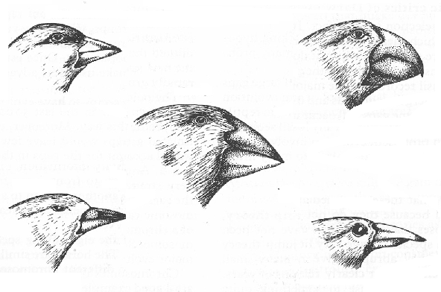
Mechanism of speciation
If a population of a single species is divided by a geographical barrier river/mountain✓(compulsory mark)
The population will split up into two groups ✓
there is no gene flow ✓/no reproduction
between the two groups as they could not interbreed ✓
Each population is exposed to different environmental conditions/selection pressure
each group undergoes natural selection independently ✓,
and each group adapts to the new environmental factors/✓develops separately
Develops differently, each group may become genotypically and phenotypically different ✓
leading to the formation of a new species✓
which might prevent them from interbreeding/become
reproductively isolated✓/producing fertile offspring
Leaves
Buds and fruit
Ancestral seed-
eating species from
the mainland
Larvae/worms
Insects
Activity 1.9
Notes:
Participants to complete the activity on pp43 - 44 of participants manual before going on to the next slide

Slide 44
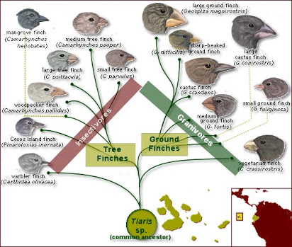
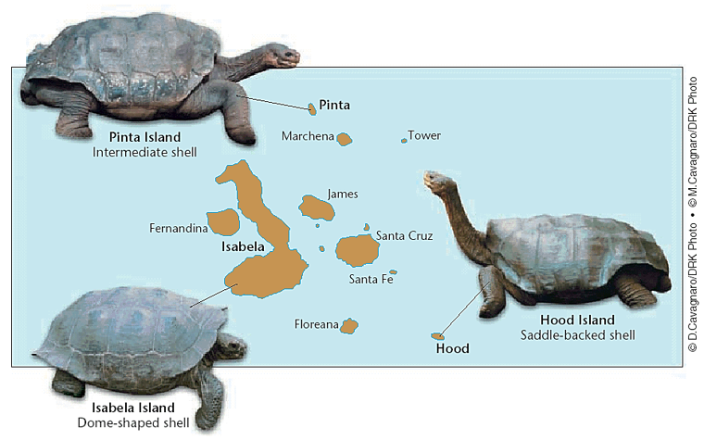
Speciation

Slide 45
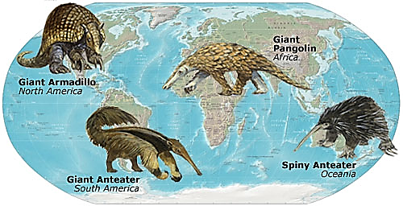
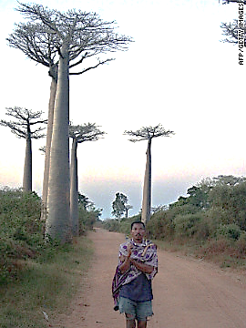
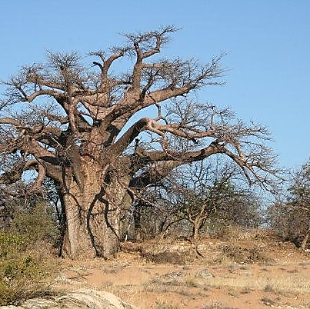
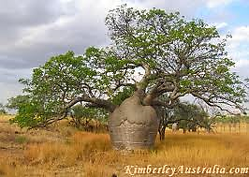
Pangolins/ Anteaters
Madagascar Baobab trees
Australian Baobab trees
South African Baobab trees

Slide 46
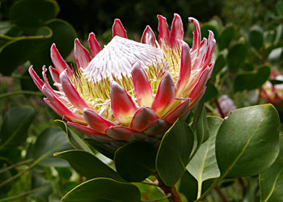
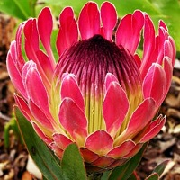
Proteas
AUSTRALIA SOUTH AFRICA
Activity 1.10
Notes:
Participants to complete the activity on pp44 - 46 of participants manual before going on to the next slide

Slide 47
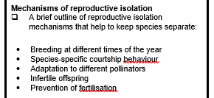
CAPS information

Slide 48





Mechanisms of reproductive isolation
Activity 1.11
Breeding at different times of the year
Species-specific courtship behaviour
Adaptation to different pollinators
Infertile offspring
Prevention of fertilization
Notes:
Video embedded in the title
Participants to complete the activity on pp49 - 50 of participants manual before going on to the next slide

Slide 49

CAPS information

Slide 50




Evolution in present times
Multi Drug Resistant TB bacterium
Anopheles mosquito
Activity 1.12
Notes:
Participants to complete the activity on pp51- 52 of participants manual before going on to the next slide

Slide 51
KEY POINTS FOR THE MODULE
Teacher inputs: Learning Tasks | Learning activities: Learners extrapolating from the generic steps in Natural selection and speciation to specific case studies given in assessments | Teachers support and actions: Teachers can give learners practice questions and examples used in previous question papers to do and facilitate | Assessing the learning: Formative and diagnostic (informal) assessment | Common exam errors: Not knowing terminology Confusion between Lamarck and Darwin’s theory Confusion of the processes of natural selection and speciation

