Slide 1
SSIP July 2020
LIFE SCIENCES
Topic(s) : Plant responses to the environment
Venue:

Slide 2
SSIP AIMS/GOALS
The four interconnected outcomes that drive the professional development activities for SSIP are:
Enhancing Teachers knowledge: deep understanding of subject matter knowledge and students ideas on the content
Enhancing quality teaching and assessment for learning: effective instructional approaches that teachers may use to ensure improved understanding by most learners.
Developing ICT integration skills :Use of ICT to improve teaching and learning
Building professional learning communities: allow teachers to start collaborating and form professional networks in non-formal settings in context of their schools

Slide 3
PROGRAMME
Insert the programme about here as in your Manual

Slide 4
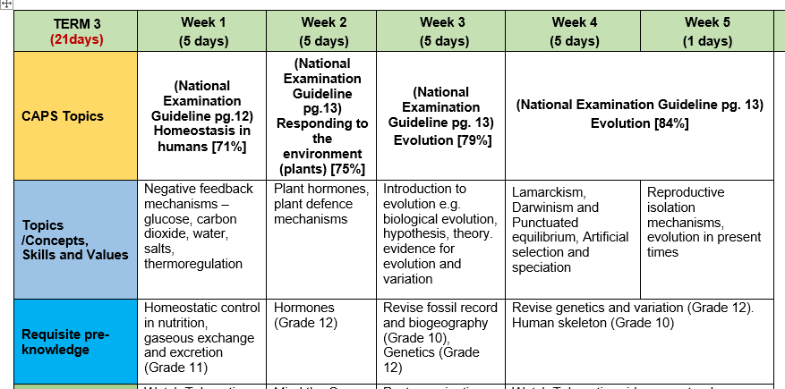
2020 Post COVID: Revised ATP FOR TERM 3
15/07 – 19/07

Slide 5
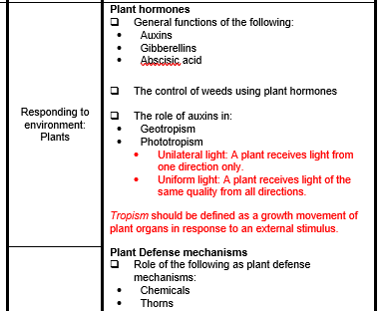
CAPS information

Slide 6
MODULE 3
Overview of Module 3
In this module we will look at the concept of ‘Plant hormones and their role in tropic movement’
Content
You will study this module through the following units:
Unit 1: the general functions of auxins; gibberellins and
abscisic acid
Unit 2: the control of weeds using plant hormones
Unit 3: the role of auxins in geotropism and phototropism
Unit 4: plant defence mechanisms
Notes:
Give an overview of the module and give the key content and or index that you will be covering in the Module

Slide 7
OUTCOMES OF THIS MODULE
Statement of the learning outcomes/objectives
When you complete this module you will be able to:
Describe the general functions of auxins; gibberellins and abscisic acid.
  (knowledge and understanding: level A and B of Bloom’s taxonomy)
Briefly describe the use of plant hormones in controlling weeds
  (understanding and application: level B and C of Bloom’s taxonomy)
Briefly describe the role of auxins in geotropism and phototropism
  (understanding and application: level B and C of Bloom’s taxonomy)
Interpret and conduct investigations based on the role of plant hormones
  (understanding, application and analysis: level B; C and D of Bloom’s taxonomy)
Briefly describe the role of thorns and chemicals as plant defence mechanisms
- (knowledge and understanding: level A and B of Bloom’s taxonomy)
Notes:
Please state these very simple and explicit and in the FG you may ask one participant to read those out loud and make sure they are linked to the activities that you have in the Manual.

Slide 8
What are plant hormones?
These substances are not true hormones because they work in the part of the plant where they are produced.
Therefore they are also referred to as plant growth substances.
These allow plants to respond to certain stimuli in the environment:
  allow plants to bloom at an appropriate time
  allow plants to grow toward a light source
  allow seeds to germinate at the appropriate time
  induce dormancy in plants at the appropriate time
  https://www.youtube.com/watch?v=PxSkuyjZ3MM
Activity 3.1

Slide 9
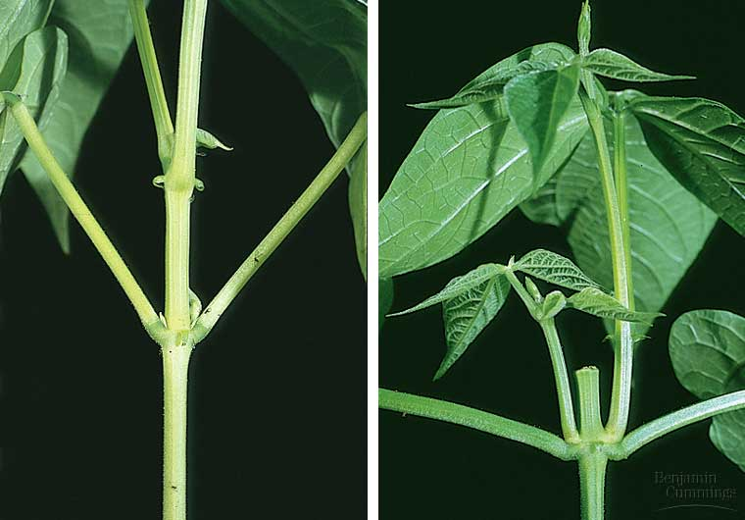
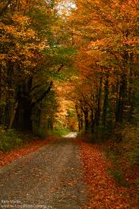
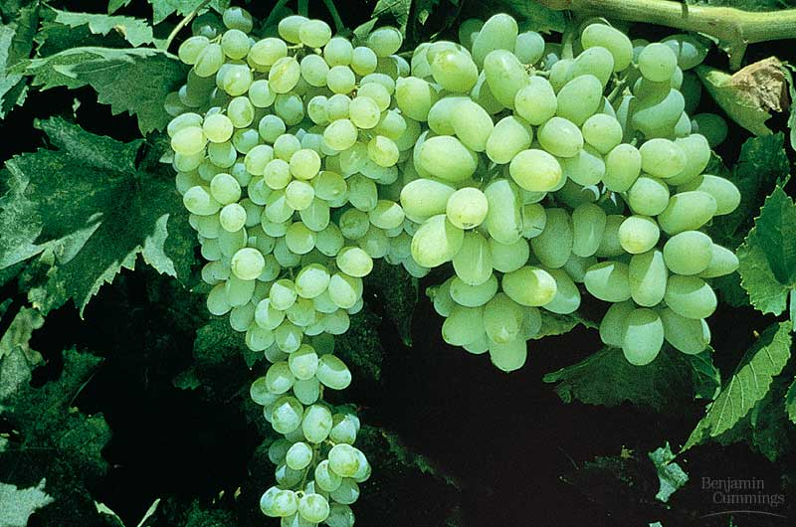
Plant hormones
3
auxins
gibberellins
abscisic acid
2
1
4

Slide 10
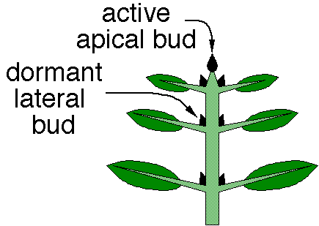
The role of auxins
Stimulate:
Cell division
Cell elongation (growth in stem length)
The development of fruit
The abscission of leaves and fruit
The development of adventitious root in stem cuttings
Tropic movement in stem and roots
Apical dominance it suppress the growth of the lateral buds.

Slide 11
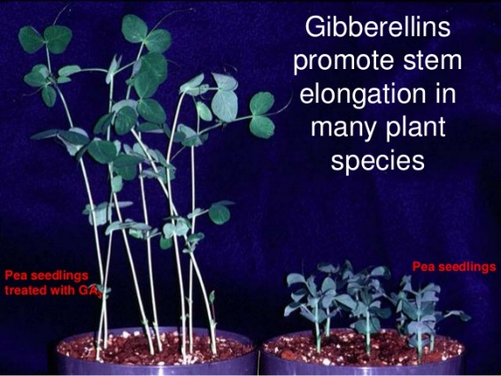
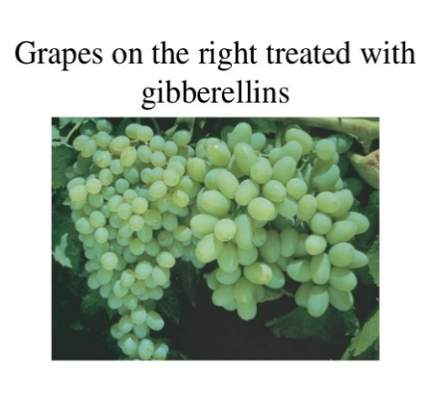
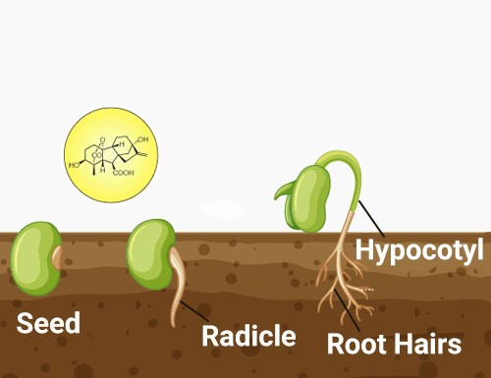
The role of gibberellins
Stimulate:
Stem elongation
Root growth
The germination of seeds
Promotes flowering
plump grapes in grocery stores have been treated with gibberellin hormones while on the vine
https://www.youtube.com/watch?v=EZ5tU45Ti_g&t=29s

Slide 12
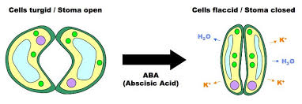
The role Abscisic Acid
  Is an inhibitor of growth
  Causes plants to become dormant in winter
  abscission in leaves and fruit.
  Lack of water (water stress) stimulates the production of Abscisic acid
  Causes the closing of stomata when the plant wilts

Slide 13
Use of auxins in agriculture
Hormone weed killers are auxin-based selective herbicides.
The main factor that controls the weed growth in these herbicides are the auxins.
These herbicides can only kill weeds.
Advantages of Hormone Weed-killers…
They are non toxic to animals and humans.
There is no longer the need for weeding the garden.
Auxins as herbicides
Synthetic auxins like 2,4 dichlorophenoxyacetic acid (2,4 D) are used as weed killers (herbicides)
2,4 D kills broad leaved weeds but not grasses, so farmers spray maize fields.
The weeds are killed but not the maize plants.
https://www.youtube.com/watch?v=TTLgTIipmA8

Slide 14
Role of auxins in phototropism and geotropism
Role of auxins in phototropism | Role of auxins in geotropism
Produced at the tip of the stem/shoot | Produced at the tip of the roots
Auxins move downward evenly | Auxins move upward evenly
This even distribution brings about equal growth on all sides of the stem | This even distribution brings about equal growth on all sides of the root
As a result the stem grows upward | As a result the root grows downward
When the stem is exposed to a unilateral light (light from one side) | When the root is placed horizontally (only one side exposed to gravity)
The auxin concentration will be high on the dark side of the stem – light destroys auxins | The auxin concentration will be high on the lower side of the root – gravity attracts auxins
More growth occurs on the dark side because auxins stimulate growth on the dark side | More growth occurs on the upper side because auxins inhibit growth on the lower side
As a result the stem bends towards the light | As a result the root bends downwards
P A S D
G A I L

Slide 15
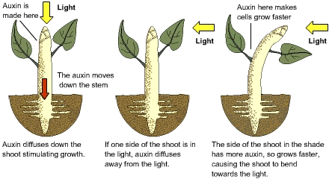
The role of auxins in: phototropism

Slide 16
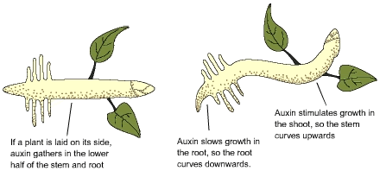
The role of auxins in geotropism

Slide 17
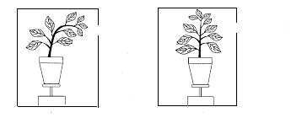
Investigations
Experiment showing phototropism
Experiment | Control
The experiment has no clinostat | The control has a clinostat that causes the pot to rotate
The plant is exposed to light only on the one side | all sides of the stem are exposed to light,
The stem grows towards the light and is therefore, phototropic. | causing the plant to growth straight

Slide 18
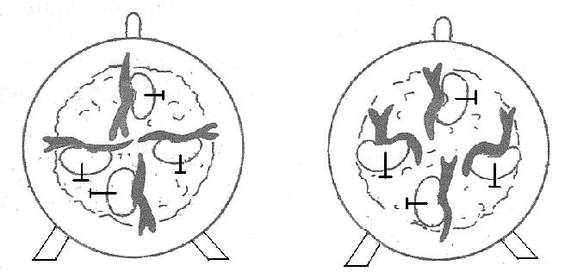
Experiment Showing Geotropism
Control – wound clinostat Experiment – unwound clinostat
damp cotton wool roots growing do
towards gravity
cork discs
germinating
seeds
The control
has a clinostat that causes the cork disk to rotate the germinating bean seeds, causing the roots to grow in the direction in which they were placed.
The experiment
the clinostat is unwound and and does not rotate the germinating bean seeds. The roots grow downwards towards gravity.
Activity 3.2

Slide 19


Investigations
Activity
A grade 12 learner performed an investigation to determine the effect of light on the growth of a plants
Shoots. The learner divided the plants that were used into three groups as follows:
Group A – The tips of the shoot was intact.
Group B – The tips of the shoot was removed.
Group C – The tips of the shoot was covered by a cap that does not allow light to pass through.
The diagram below shows each shoot at the start of the investigation and next to each the same shoot at the
the end of the investigation.
Set 3 questions based on the investigation ( include C and D cognitive levels)

Slide 20
PLANT DEFENSE MECHANISMS
Plants have adapted to prevent herbivores from eating them.
Chemical defense: plants produce chemicals called phytoecdysteroids to defend against insects.
The chemicals cause insects to moult prematurely, lose weight and if enough is ingested, metabolic damage and death.

Slide 21
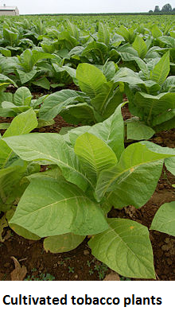
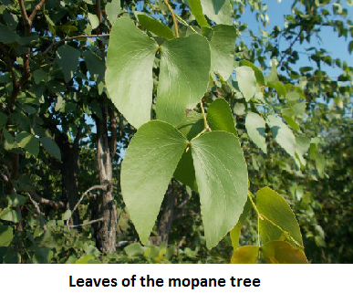
PLANT DEFENSE MECHANISMS

Slide 22
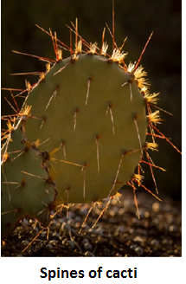
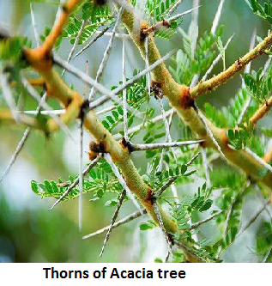
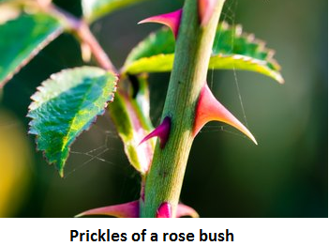
PLANT DEFENSE MECHANISMS
Thorns: this is a common term for a sharp structure found on plants for protection against herbivores. There are various
types of sharp structures:

Slide 23
KEY POINTS FOR THE MODULE
Here it is your choice on what you want the participants to take from the Module and what you want to summarize
You may discuss around the following key points for teaching and learning: CoPA[F]
Teacher inputs: Learning Tasks | Learning activities: Possible learners ideas and responses | Teachers support and actions: What the teachers can give learners to do and facilitate | Assessing the learning: Formative and diagnostic assessment | Common exam errors

